Slide 1
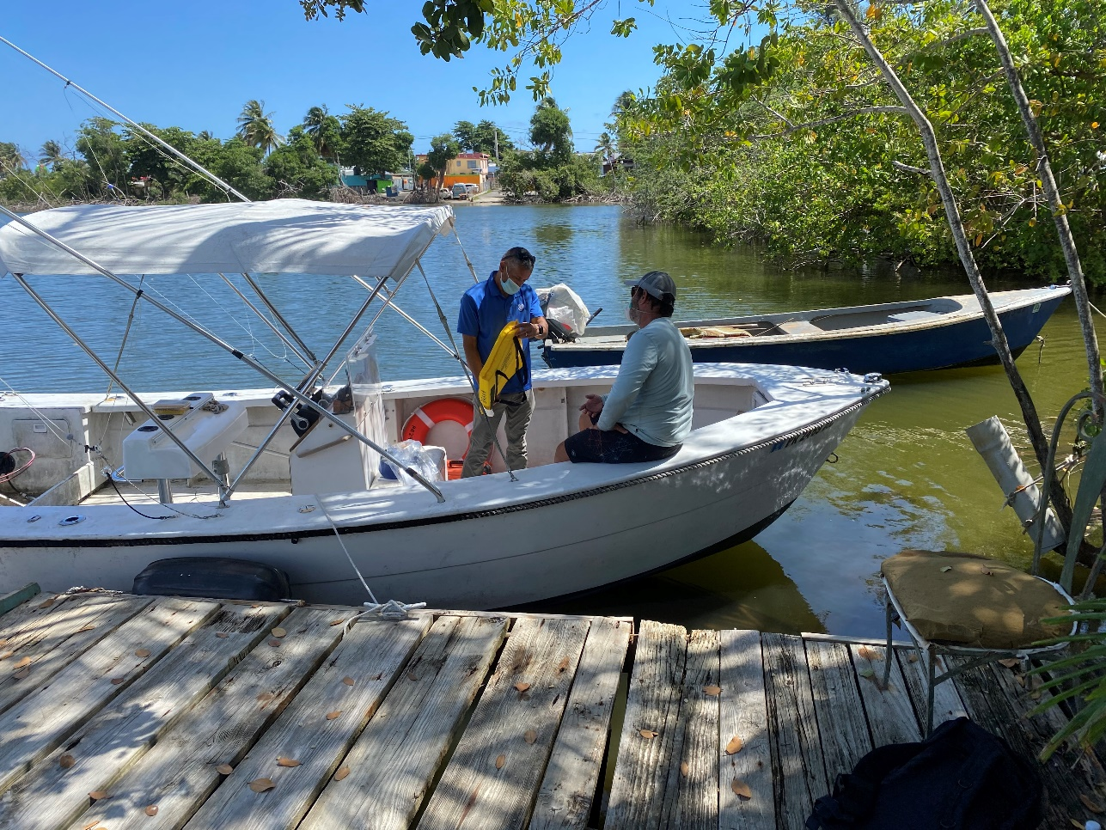
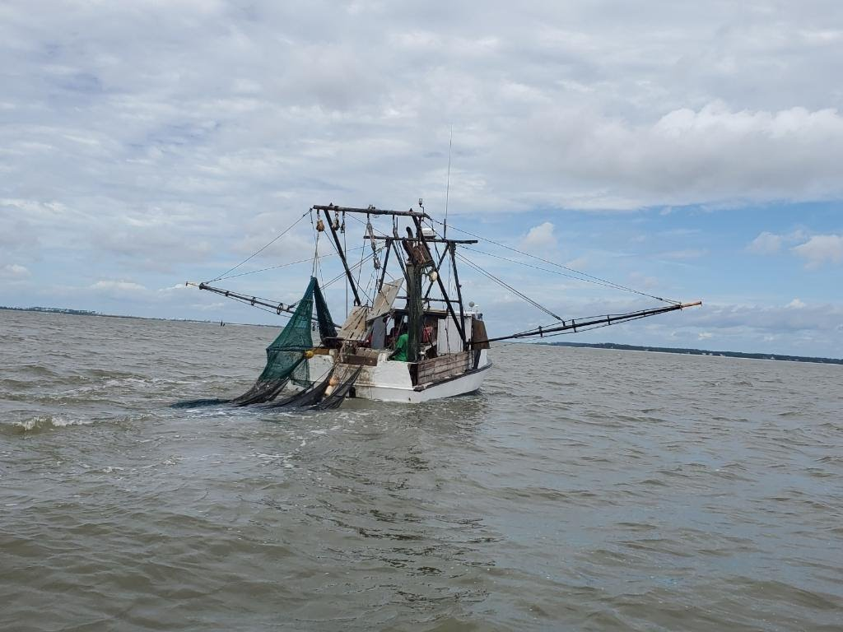
Coast Guard District 7
FV District Coordinator Report
Notes:
Pictures:
Left: A post COVID CFV exam in Sector San Juan
Right: A small 1977 FRP shrimp boat u/w in Sector Charleston

Slide 2
FV District Coordinator Report
8 CFV losses FY20 to date
3 CFV fatalities FY20 to date
9 CFV injuries FY20 to date
CFV population within District (4900 State/1943 Documented)
438 Dockside Exams completed (within District FY20 to date)
Outreach initiatives - Unit training for Stations/Cutters, AMSEA trainings, Dockwalking
District priorities -CFVs >3 NM mandatory exam requirement, Aging CFV fleet, Consistent regulatory enforcement
District sponsored fishing industry expos, forums, meetings - SAFMC, CFSAC, Third Party Organization Audits

Slide 3
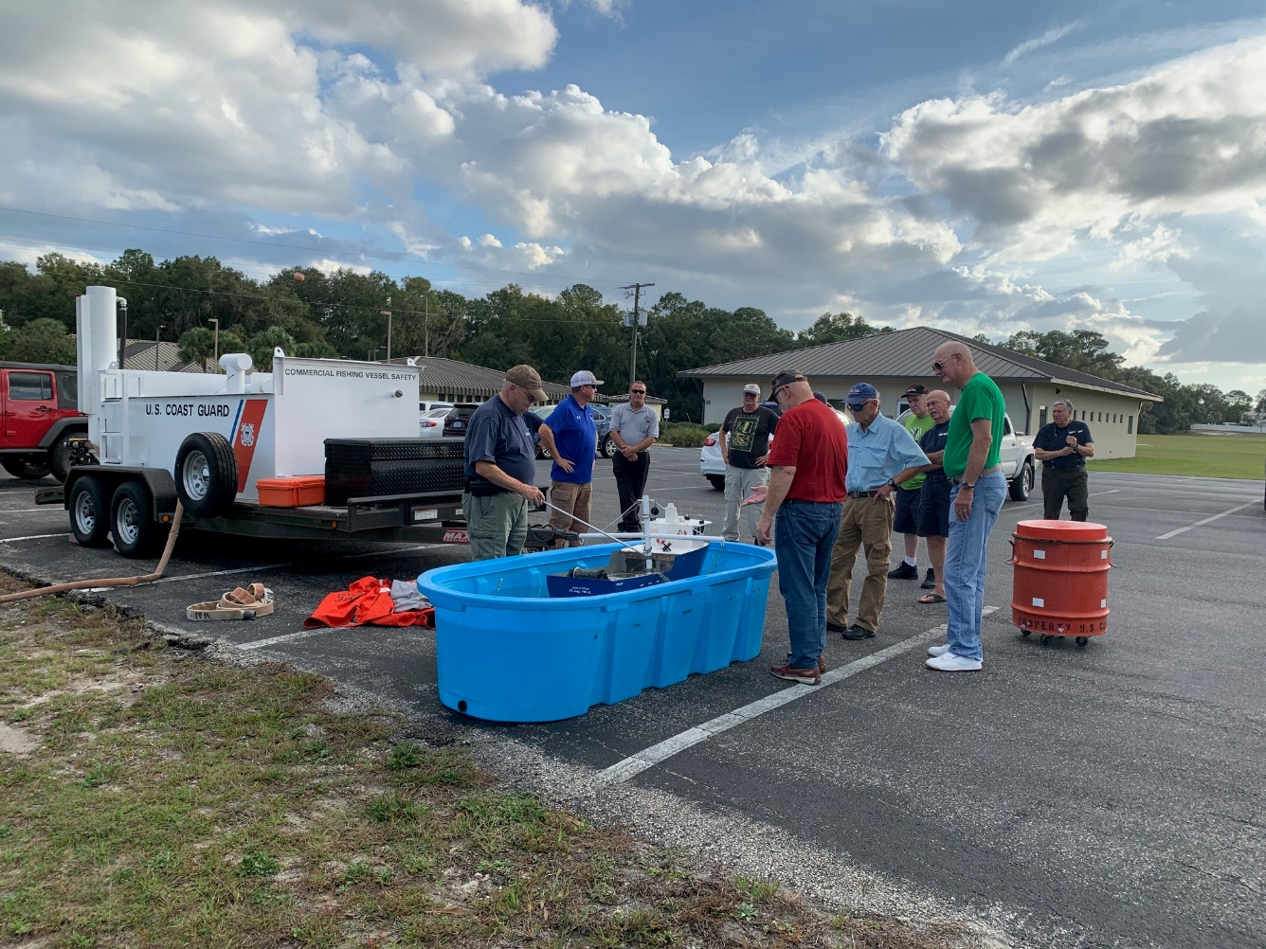
Notes:
Pictures:
Left: D7 CFV training provided to Auxilliarists
Right: A 1958 wooden shrimp boat gets washed ashore after loss of propulsion in Sector Charleston

