Slide 1
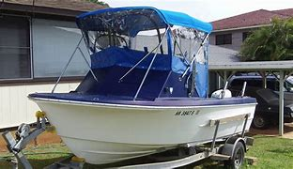
CFV population within District: D14
There are approximately 1200 vessels that are less than 36 feet in length. They are issued Commercial Marine License (CML) by the State of Hawaii and primarily engage in traditional subsistence fishing. Additionally, an exemption exists for these vessels D14 MSIB 01-15. Vessels are exempt from 406 EPIRB requirements (PLB in lieu of) and life raft requirements if operating within 15 miles of the main Hawaiian Islands and with less than four POB.

Slide 2
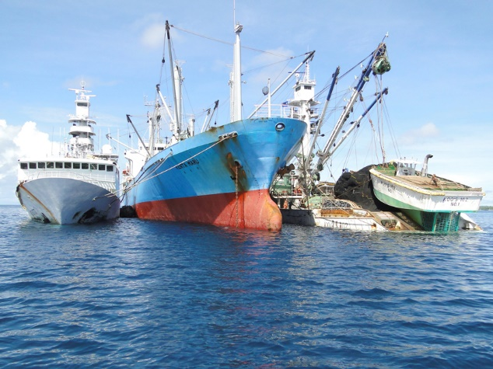
CFV population within District: D14
US flagged distant water tuna fleet (DWTF). 45 permits are issued to the US by the South Pacific Tuna Treaty and 32 vessels currently fishing. These vessels are between 110 and 210 feet long and average 1600 GRT. The majority of this fleet is foreign built and limited to “registry” endorsement only so they cannot land fish in a US port. This fleet primarily fishes from Pago Pago, American Samoa and Majuro, Republic of the Marshall Islands.
DWTF vessels seldom call on US ports and are not required to. Due to provisions in the Magnusson Stevens Fisheries Act these vessels are exempt from US manning standards so they can hire all foreign crew but a US citizen is still required to be the Master. This fleet is currently mostly using CG approved third party examiners. This fleet does not carry US fisheries observers.

Slide 3
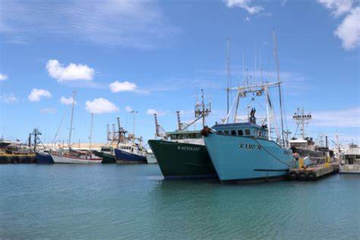
CFV population within District: D14
The Long Line Fleet is primarily based out of Honolulu, Hawaii and Pago Pago, American Samoa. There are 160 federal permits available but only 137 are currently being fished. These vessels are between 45 and 90 feet, and all of them are less than 200 GRT. The vessels are not required to have licensed Master, Mates or Engineers. Due to provisions in the Magnusson Stevens Fisheries Act, these vessels are exempt from US manning standards so they can hire all foreign crew but a US citizen is still required to be the Master.

Slide 4
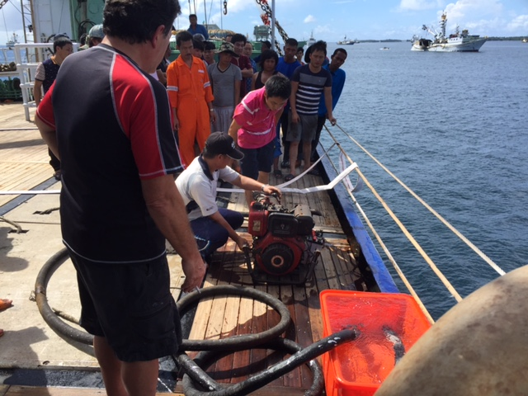
District: D 14 Outreach
Attend quarterly Long Liners owners meeting in Honolulu
Conducted Safety/regulatory/MARPOL compliance training for fishermen in Pago Pago American Samoa and Apia Western Samoa

Slide 5
FV District 14 Coordinator Report
CFV losses: 0
CFV fatalities: 1 Crewman crushed by shifting cargo
CFV injuries: 2
CFV population within District: 1200 state/ 174 documented
Dockside Exams completed: 47 (20% less due to COVID pandemic)
District priorities: Reduce reportable marine casualties, loss of power, steering etc.
Focus on compliance with drills and training requirements.

