Slide 1

Preliminary Assessment & Actions
Continued…
LCDR K. Pounds
NSF Response Officer
Federal On-Scene Coordinator Representative Training

Slide 2
Origins of NOAA HAZMAT Program…
    1976 Spilled Oil Research (SOR)
    Team established
    Argo Merchant oil spill,
    Nantucket, Massachusetts
    The tanker broke into two pieces Dec. 21, 1976, after running aground six days earlier on its way to Salem with a load of 7.5 million gal. of heavy fuel oil.
    Nov 16, 1977 Scientific Support Team established for emergency spill response assistance to the U.S. Coast Guard and EPA
Notes:
In 1976, as part of its Outer Continental Shelf Environmental Assessment Program (OCSEAP) to study the effects of oil and gas exploration in Alaska, NOAA established the Spilled Oil Research (SOR) Team. HAZMAT's precursor, the SOR Team was a network of coastal geologists, marine biologists, chemists, and oceanographers. When an oil spill occurred, the SOR Team would mobilize quickly and go on-scene at these "spills of opportunity" with the goal of gaining information to help minimize damages from future spills.
In December 1976, the 640-foot Liberian-flag tanker Argo Merchant ran aground near Nantucket Island directly over Georges Bank, which at that time, was one of the world's most productive commercial fishing areas. Bound for Salem, Massachusetts from Venezuela, the tanker carried 7.5 million gallons of residual fuel oil in one of its thickest, heaviest forms. Both government agencies and the scientific community recognized the seriousness of the situation. However, the Coast Guard, charged with directing the spill response and cleanup effort, was inundated with competing and often conflicting recommendations from all sides. Accordingly, the Coast Guard asked the SOR Team, with its established operational experience in spill response, to act as an informal liaison with the scientific community at the spill.
The SOR Team, while continuing to investigate oil spill phenomena, acted as the Coast Guard's scientific advisor at spills that followed the Argo Merchant, including: the Metula off Tierra del Fuego, Chile; the Amoco Cadiz, off the Breton coast of France; and the IXTOC I well blowout in the Gulf of Mexico in June 1979. By that time (in 1977 to be exact), the SOR Team had been renamed the Hazardous Materials Response Project or HAZMAT and established the Scientific Support Team to assist the USCG and EPA.

Slide 3
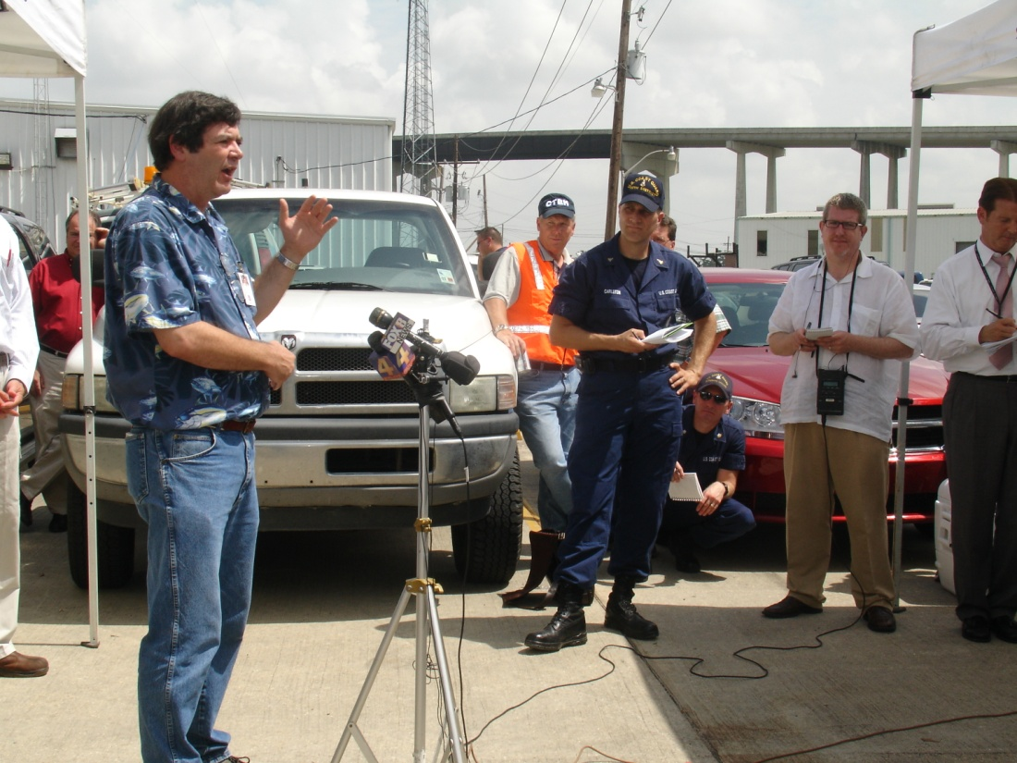
Other than just another NOAA Scientist…
…what is a Scientific Support Coordinator (SSC)?
…see IMH, p15-22
…total of 9 SSCs and two
Regional Response Officers
Notes:
Full definition in the Incident Management Handbook on pages 15-22

Slide 4
Scientific Support Coordinator (SSC):
SSCs provide the Federal On Scene Coordinator (FOSC) with scientific advice with regard to the best course of action during a spill response.
  FOSC is most often the USCG COTP or an EPA OSC
  SSC’s do not restrict support to only the USCG and EPA
The SSCs are essentially scientific-technical consultants to the FOSC for oil and hazardous material incidents. SSCs may be requested to respond to any emergency (all hazards).
One of the identified Special Forces (just like the USCG Strike teams…)

Slide 5
NOAA Scientific Support Includes:
Weather Forecast
Tides and Currents
Hazard Characterization
Tactical Trajectory
Resources at Risk (RAR)
Overflight Observations
SCAT
Environmental issues and trade-offs
Consultation

Slide 6
Science Team Composition
(the guys and gals who make the SSC look good)
SSC’s often manage a team of scientists:
  Oceanographers
  Modelers
  Biologists
  Chemists
  Weather Forecasters
  Info. Management Specialists
Each spill is unique and the team composition highly variable to meet the needs and demands of the FOSC.
(30 years of corporate knowledge)

Slide 7
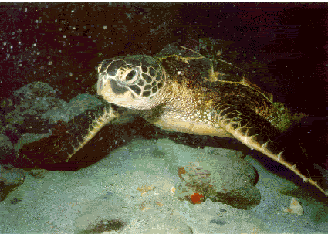
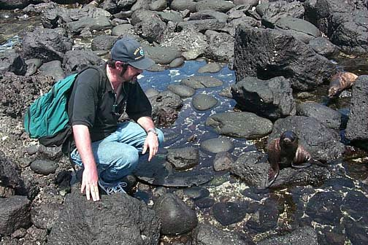
National Oceanic and Atmospheric Administration
Stewards of the Nation’s Coastal Environment
Trustee Role
Notes:
What are NOAA trust resources?
NOAA acts on behalf of the U. S. Department of Commerce as a trustee for natural resources. NOAA protects and restores aquatic organisms and their habitat on behalf of current and future generations of Americans. Some state government agencies and Native American tribes are also natural resource trustees.
NOAA is a trustee for coastal and marine resources, including:
Commercial and recreational fishery resources;
Anadromous(Pronunciation: \ə-na-drə-məs\)species (species that spawn in fresh water and then migrate to the sea, like salmon);
Catadromous (Pronunciation: \kə-ta-drə-məs\)species (species that spawn in sea water and then migrate to fresh water, like the American eel);
Marine mammals, including whales, dolphins, and seals;
Endangered and threatened marine species and their habitats (salmon, steller sea lions, and sea turtles, for example);
Marshes, mangroves, seagrass beds, coral reefs, and other coastal habitats; and
Resources associated with National Marine Sanctuaries and National Estuarine Research Reserves.
Overall, NOAA is guided by three goals in carrying out its responsibilities as a trustee:
Reducing threats to coastal resources and human health through planning and prevention;
Protecting coastal resources and human health by recommending and implementing appropriate response actions; and
Restoring injured trust resources.

Slide 8
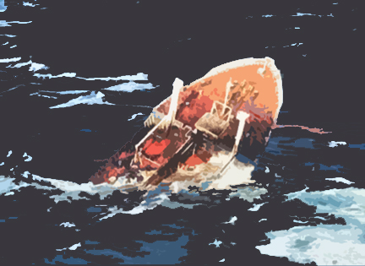
When things go bump in the night…
Notes:
Since spills NEVER happen during normal business hours….

Slide 9
Thought process… asking the right questions.
What got spilled? - hazard characterization
Where is it and where’s it going? - transport/fate (models)
Who’s going to get hit? - resources at risk (ESI)
How will it hurt? - impacts/injury
What can be done? -

Slide 10
Preliminary Assessment & Actions
2.1 Plot an oil spill trajectory based on a recent pollution response.
What Information Drives a Good Oil Spill Trajectory?
  Spill Source and Pollution (Surface Slick) Observations
    Point Source Location (Lat./Long.)
    Slick Position, Orientation, and Heading
    Slick Distribution and Weathering Observations
    On-Scene Weather Observations (Wind Direction, Sea State)
    Multiple Observations (Time Sequence)
  Pollution Type (Oil Type and Characterization)
    Density (API Gravity)
    Persistence (API Gravity, Sim. Distillation Curve-chemistry)
  Understanding of Pollution Transport
    Marine Currents
    Tidal Currents
    Wind (for Surface Oil)
    Bathometry (Conversion Zones, Coastal Currents, etc.)
Federal On-Scene Coordinator Representative Training
Notes:
Distribution and weathering observations: silver sheen, rainbow sheen, black oil, mousse – what does the oil LOOK like
API Gravity is the American Petroleum Institute's inverted scale for denoting the 'lightness' or 'heaviness' of crude oils and other liquid hydrocarbons. Oil with API greater than 30º is termed light; between 22º and 30º, medium; below 22º, heavy; and below 10º, extra heavy

Slide 11
(More Than Just a Guess)
Pollutant Transport and Oil Weathering Modeling
Interpretive Oil Trajectories (Mental Model-Verbal Trajectory)
  Verbal Forecast
  Written Forecast
Notes:
Interpretive oil trajectories use the human mind instead of a computer. The Science Team uses the facts (weather, currents, oil type, etc.) to create a mental model and give a verbal or written trajectory. This is usually the first trajectory and then the computer models are used later if necessary.

Slide 12
Verbal Trajectory Example
SUBJECT: M/V Sea Lion grounding
For additional information, please contact Chris Barker,
NOAA Emergency Response Division, Seattle, WA.
Phone: (206) 526-4911.
_______________________________________________________
Per your request, we have looked at trajectory implications of a possible release of fuel from the grounded vessel M/V Sea Lion.
Sector New Orleans received a report that a dive support vessel allided with the SWP jetties (28°54.8'N. 089°25.0'W). The Vessel has a hole or crack in its bow thruster compartment. So far there have been no signs of pollution. The vessel has 29,062 gallons of diesel onboard, but they are reporting that the fuel tanks are intact.
If a leak does occur, we can provide a more specific trajectory, and if the vessel is still aground in a couple days, please ask for an updated trajectory.
If any of this initial information is incorrect, please let us know ASAP, as it would affect any trajectory implications.
_______________________________________________________
1) WINDS:
Today: Winds from the S at 10-15 knots.
Tonight: Winds from the SE at 5-10 knots.
Thursday: Winds from the NE at 5-10 knots.
Thursday night: Winds from the E at 5-10 knots.
Friday: Winds from the SW at 10-15 knots.
Weekend: Strong North winds.
2) TRAJECTORY:
Any fuel released will spread and thin to a sheen fairly quickly. Its movement will be dominated by the winds. With the south and southeast winds forecast this afternoon and tonight, the sheen would tend to move to the north and northwest, toward the jetty, impacting the jerry within hours. However, the sheen will be broken up fairly quickly in the surf on the jetty.
A slight staining, or greasy film-like bathtub ring is likely on the jetty, within a couple miles of the release location.
If the jetty is porous in the region of the vessel, some sheen may leak through to the channel side of the jetty, where is will dissipate fairly quickly.
On Friday, the winds are expected to be from the northwest. If a release were to occur then, a visible sheen of up to 5 miles or so would develop top the southeast, away from the jetty. This sheen would not last very long as the winds pick up Friday night.
3) OIL FATE:
In the 10-15 knot winds forecast for this afternoon, we expect the visible sheen to persist for up to 12 hours. In the lighter winds forecast to Thursday, any sheen may last longer, up to couple days, though it will probably break up faster in the surf around the Jetty. If a release occurs Friday or over the weekend, when the winds are expected to be much stronger, visible sheen will last only a few hours.

Slide 13
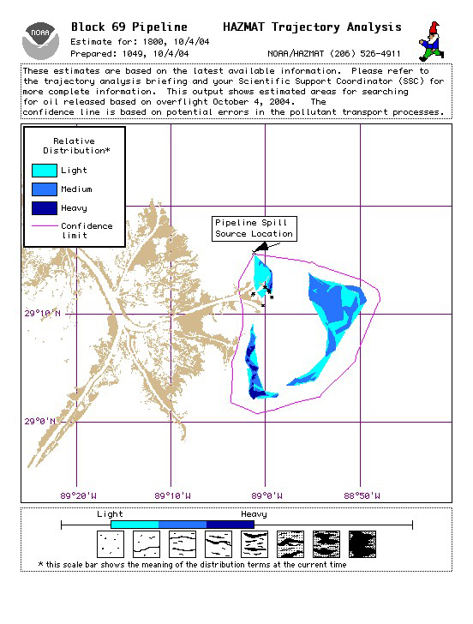
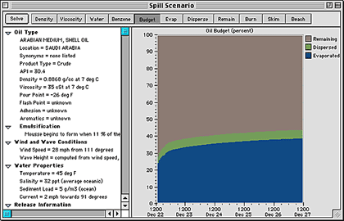
NOAA Modeling Products
OSSM
ADIOS2
GNOME
Notes:
The NOAA computer modeling products include the :
OSSM – On-scene Spill Model, father of GNOME, created in 1979, the first trajectory model created by NOAA
GNOME – General NOAA Operational Modeling Environment, created in 1999, is the oil spill trajectory model used by ERD
ADIOS2 – Automated Data Inquiry for Oil Spills, is an oil weathering model that incorporates a database containing more than a thousand crude oils and refined products, and provides quick estimates of the expected characteristics and behavior of oil spilled into the marine environment.

Slide 14
Spilled Crude Oil on Water
Notes:
Evaporation is a type of vaporization(transition from liquid to a gas) of a liquid, that occurs only on the surface of a liquid
YES. Oil does evaporate. But it evaporates in a weird way. As most of you know, oil is not a pure compound. Oil is a blend of many different sizes of what chemists call 'hydrocarbons' or 'molecules'. These molecules range from very very small to very very large molecules. The lighter molecules will evaporate quicker than the heavier molecules. WHY?
If you want to understand how oil evaporates you need to know how evaporation really works. Evaporation happens when a molecule has enough energy to leave its fellow liquid molecules surrounding it. For any given temperature, or energy, the smaller molecules will move quicker than the larger molecules. Think about kicking a soccer ball versus kicking a bowling ball. OF COURSE I DO NOT RECOMMEND KICKING A BOWLING BALL. However, if you imagined it, the soccer ball will travel much faster than the bowling ball. This is what happens in oil. The temperature is the energy from your "foot" and the balls that have different masses are the molecules in the oil. Now you can imagine that over a long period of time the lighter molecules will tend to evaporate away leaving the larger and heavier molecules behind.
So what determines oil evaporation rate? A number of parameters, such as, temperature, wind speed, solar radiation, thickness of oil on the surface, and composition of the oil, govern its rate of evaporation.
Physical transport or Spreading of the oil occurs under the influence of gravitational forces. It is controlled by oil viscosity and the surface tension of water.
Dissolution. Most oil components are water-soluble to a certain degree, especially low-molecular-weight hydrocarbons. Polar compounds formed as a result of oxidation of some oil fractions in the marine environment also dissolve in seawater. Compared with evaporation, dissolution takes more time. Conditions in the surface waters strongly affect the rate of the process.
Emulsification. The process of suspending oil droplets in an emulsion with water. Increases surface area. Oil emulsification in the marine environment depends on oil composition and the turbulence of the water.
Dispersion, in chemistry, a mixture in which fine particles of one substance are scattered throughout another substance. So, the natural action of oil dispersing into the water column. (Dispersants)
The few we didn’t cover are photo oxidation, absorption, and biodegradation – longer processes and less oil effected

Slide 15
Spilled Crude Oil on Water
Persistent vs. Nonpersistent Oils
Notes:
Persistent - existing for a long or longer than usual time
ADIOS2 can give us the oil fate information…

Slide 16
ADIOS2: Evaporation
(API 28.1 Furrial Crude Oil, Venezuela)
Notes:
Example:
Remember…API greater than 30º is termed light; between 22º and 30º, medium; below 22º, heavy; and below 10º, extra heavy

Slide 17
ADIOS2: Water-in-Oil Emulsification
(API 28.1 Furrial Crude Oil, Venezuela)

Slide 18
Typical Oil Weathering: Emulsification
(API 28.1 Furrial Crude Oil, Venezuela)
ADIOS2

Slide 19
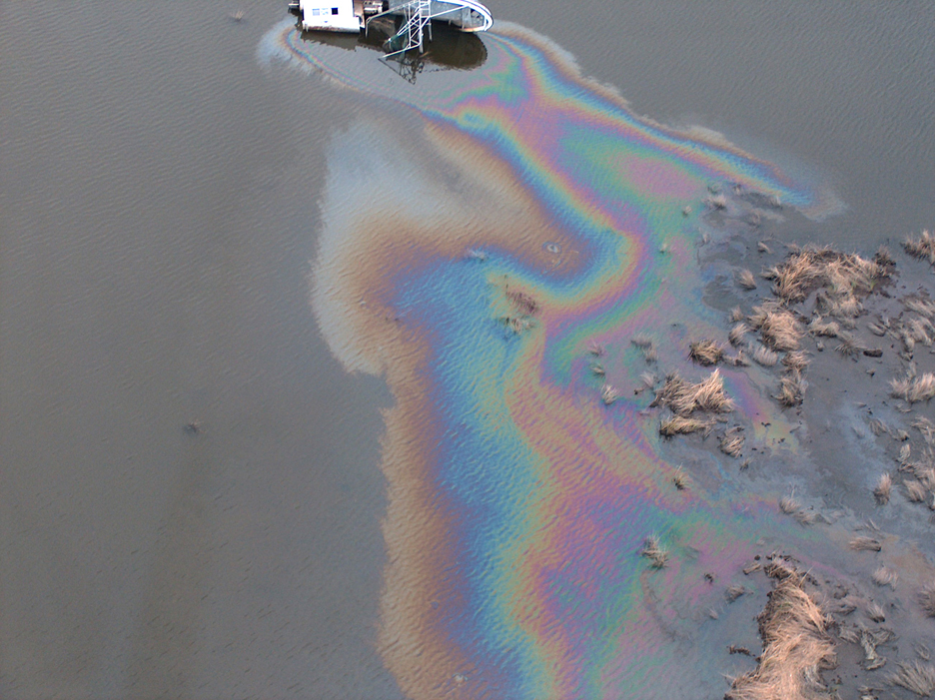
Observations
Notes:
Observations are the information that drives Modeling and trajectories

Slide 20
Things to note during an observation…
Record time and lat./long.
Notes:
Before we start, if you do not have it: get it or download it, also on the TGLO Toolkit – open water oil identification job aid for aerial observation – glossary of common terminology, photo examples, percent coverage chart, and an observation checklist to remind you of what to record
Time and lat/long – at least record start and end time and lat/long. Some programs can merge GPS and photos (photologger)

Slide 21
Things to note during an observation…
Record time and lat./long.
Use common terminology for describing oil sightings. Use a glossary if necessary.
Notes:
Use common terminology – silver, rainbow , black oil, mousse (note color) -
Again use a glossary if necessary

Slide 22
Things to note during an observation…
Record time and lat./long.
Use common terminology for describing oil sightings. Use a glossary if necessary.
Record direction of slick (heading).
Notes:
Direction and heading, if possible
Direction that the slick is trailing or moving…either way. Anything is better than nothing.

Slide 23
Things to note during an observation…
Record time and lat./long.
Use common terminology for describing oil sightings. Use a glossary if necessary.
Record direction of slick (heading).
Record Beginning (Leading Edge) and End of Slick
Notes:
Beginning(leading edge) and end (trailing edge) – open water observations, if possible

Slide 24
Things to note during an observation…
Record time and lat./long.
Use common terminology for describing oil sightings. Use a glossary if necessary.
Record direction of slick (heading).
Record Beginning (Leading Edge) and End of Slick
Avoid making volume estimates based on slick color.

Slide 25
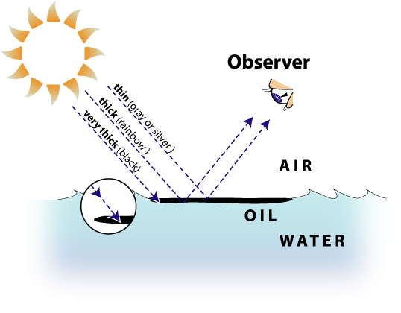
Notes:
Color gives us a general idea of thickness. Trying to estimate amount from color is NOT accurate!

Slide 26
Things to note during an observation…
Record time and lat./long.
Use common terminology for describing oil sightings. Use a glossary if necessary.
Record direction of slick (heading).
Record Beginning (Leading Edge) and End of Slick
Avoid making volume estimates based on slick color.
Always have the sun at your back when taking photographs. And try to take photos outside of the vessel (airplane, helicopter, boat, etc.) to avoid glare.
Notes:
Try to keep the sun behind you and do not take photos through a window or you’ll have glare – only if possible! Safety first!
Take good photos – they are essential to show people what you have seen – even the changes that you see….Comparison photos

Slide 27
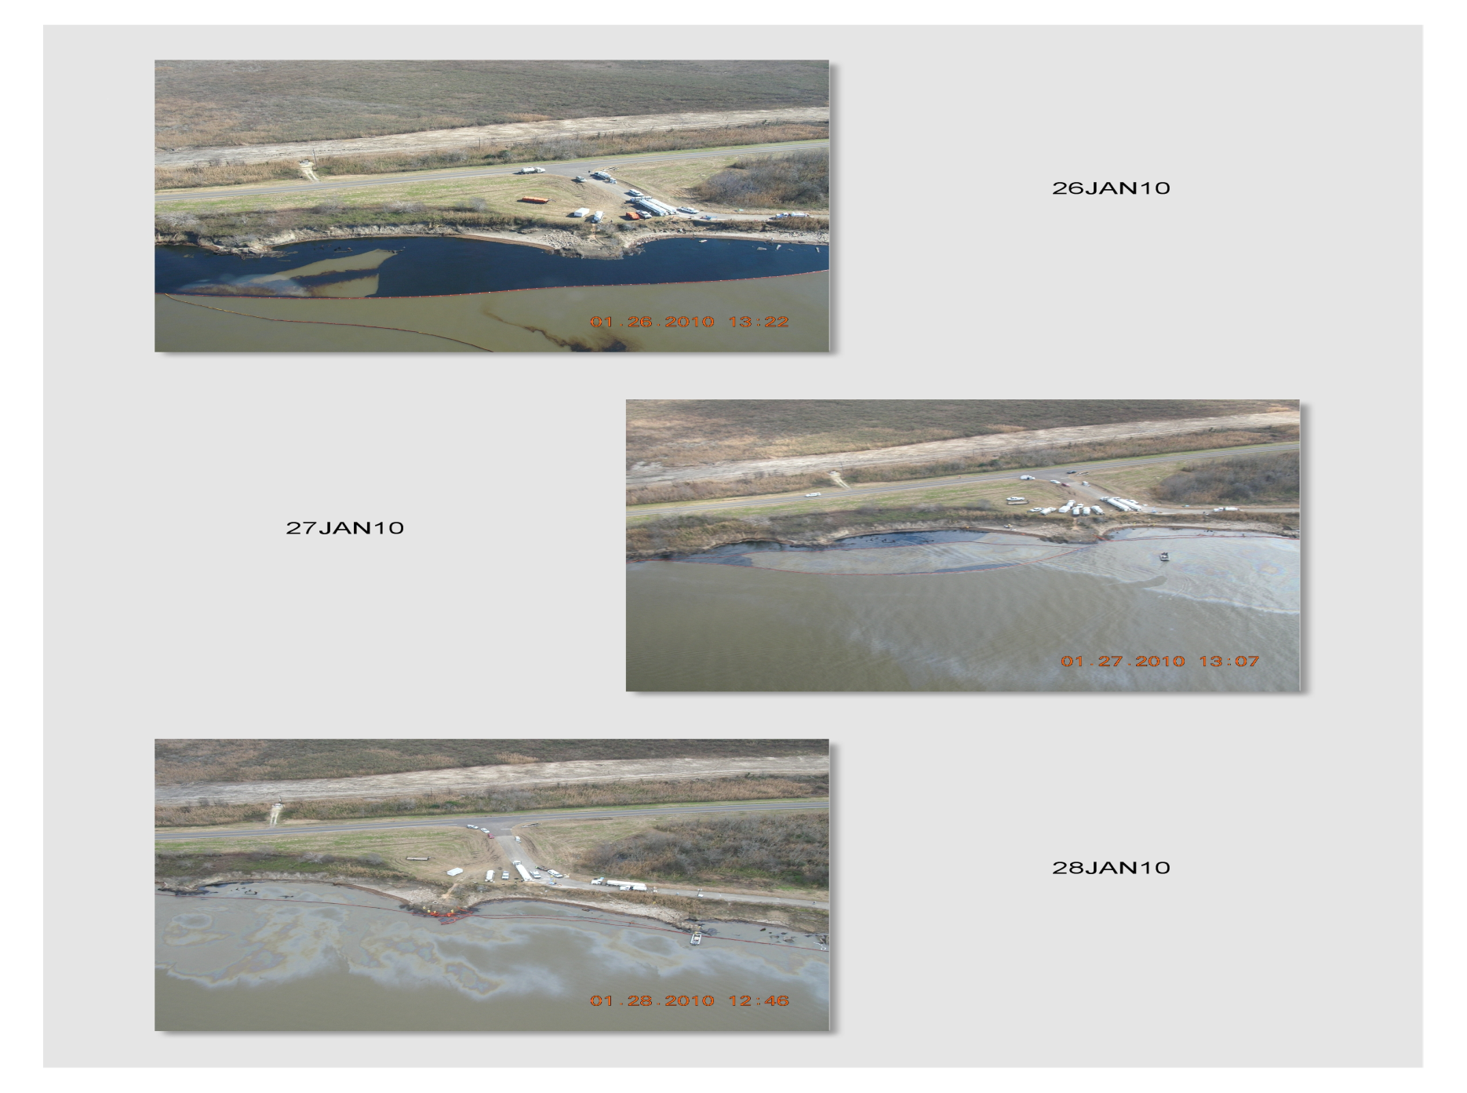
Comparison Photos
Notes:
If you note a specific area of shoreline impact, repeat photos on subsequent flights.

Slide 28
Things to note during an observation…
Record time and lat./long.
Use common terminology for describing oil sightings. Use a glossary if necessary.
Record direction of slick (heading).
Record Beginning (Leading Edge) and End of Slick
Avoid making volume estimates based on slick color.
Always have the sun at your back when taking photographs. And try to take photos outside of the vessel (airplane, helicopter, boat, etc.) to avoid glare.
Beware of false positives!
Notes:
Last but not least…Make sure it is OIL! Beware of false positives!

Slide 29
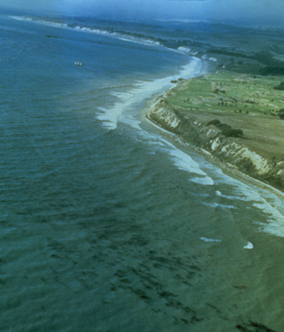
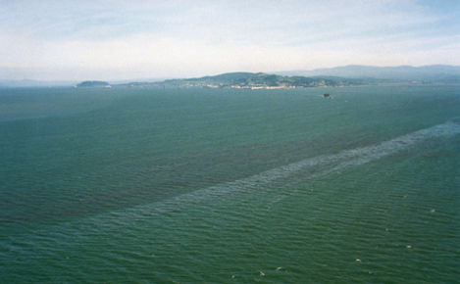
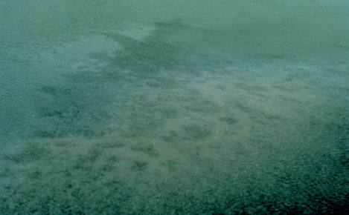
Beware of False Positives!
Kelp Beds
Red Tide
Jellyfish
Notes:
Convergence Lines or zones, Red Tide, Kelp Beds, Jellyfish, Fish spawns near shore, cloud shadows, etc.

Slide 30
Real-life Example
After the passing of Hurricane Ivan in September 2004, several oil slicks were reported in the Pass A Loutre, LA area. Without going into the “who spilled what” and pointing fingers, a pipeline leak remained unsecured on the 26th of September, 2004. The amount of oil was not identified as many pipelines were leaking in the same area.
Careful observations helped produce accurate trajectories which directed skimming and dispersant operations.

Slide 31
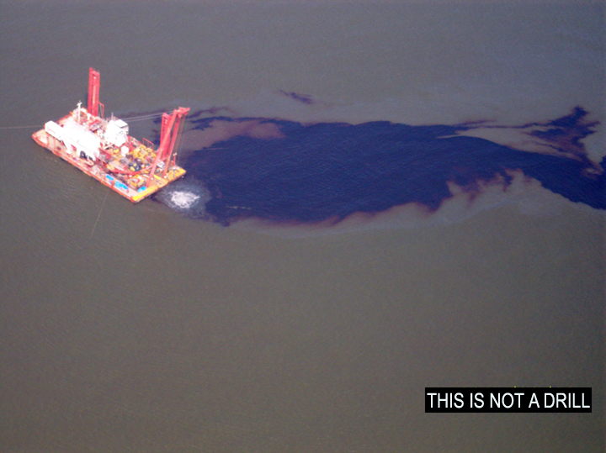
Notes:
This photograph was taken on the 28th of September by a member of the NOAA science team above the uncontained source of the pipeline leak.

Slide 32
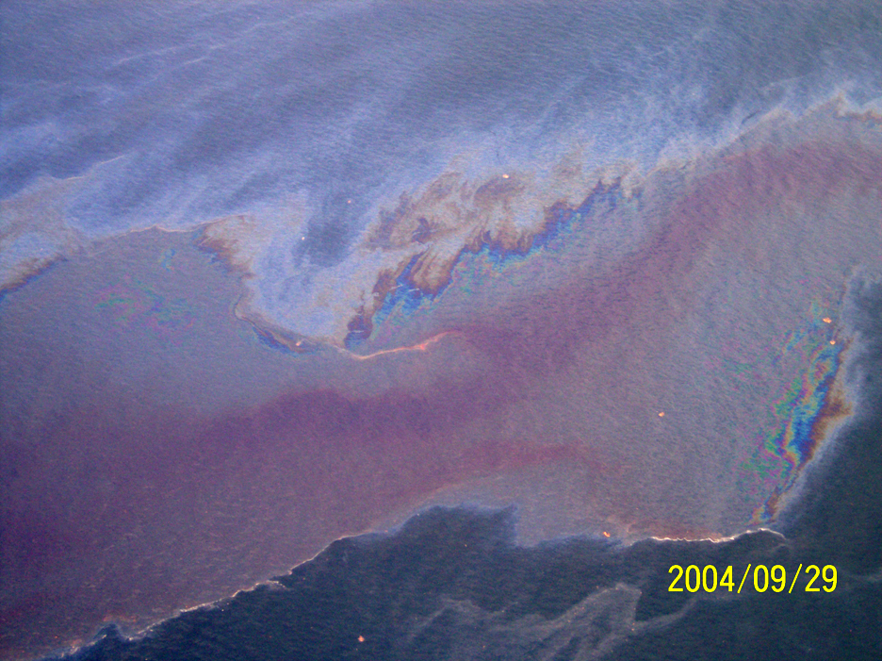
Notes:
On 29 September, two dispersant sorties were conducted using a DC-3 aircraft to treat oil that would threaten adjacent wildlife areas should there be a wind change. The areas include several exposed sand bars that readily attract coastal birds and extensive coastal marshes that are important fish habitat. A total of 2000 gallons of Corexit 9500 was applied. The dispersant activities were conducted in water greater than 10 meters in depth, but not exclusively in federal waters.
This photo shows the dispersant working on the thin edges of the oil slick.

Slide 33
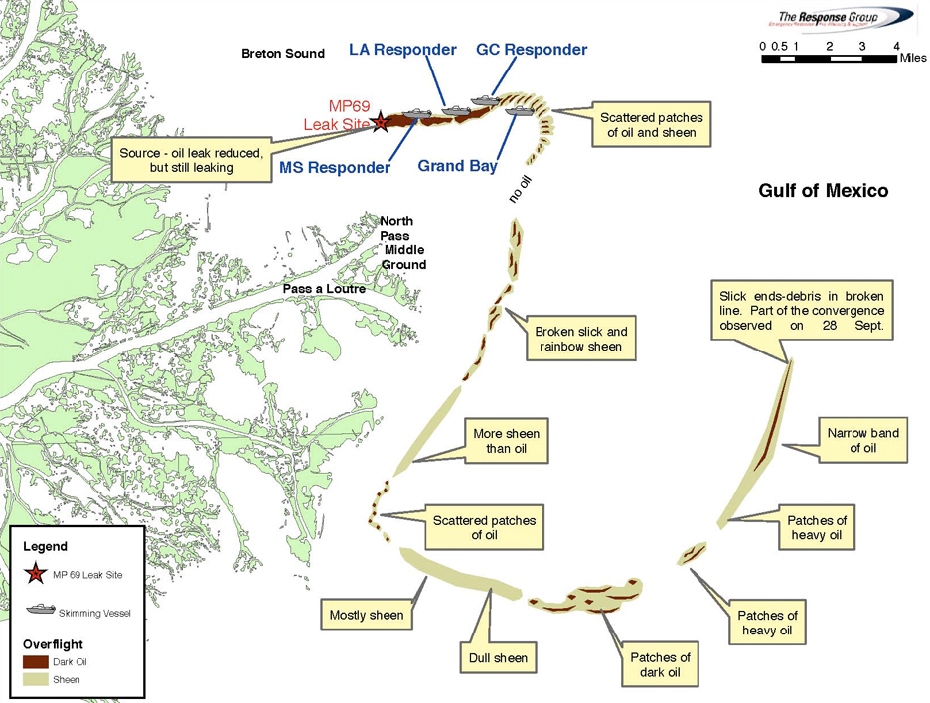
Notes:
This is a situation map updated by over flight information. This situation map leads operations and is vitally important information. So, once again, tha more current the information the better.

Slide 34
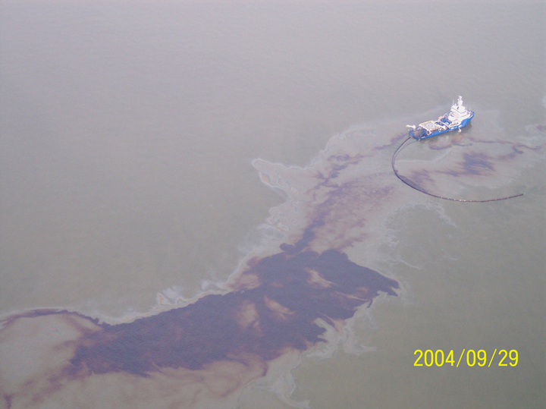
Notes:
Skimming operations

Slide 35
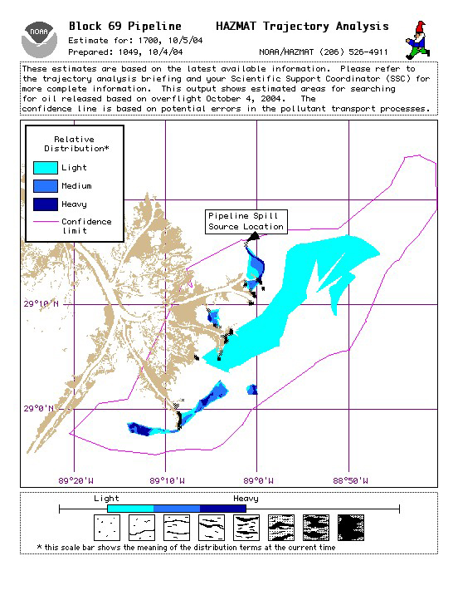
Notes:
These trajectories were produced from NOAA over flights on Oct 4th. By this time, the pipeline was partially patched and “pigging” operations had begun.

Slide 36
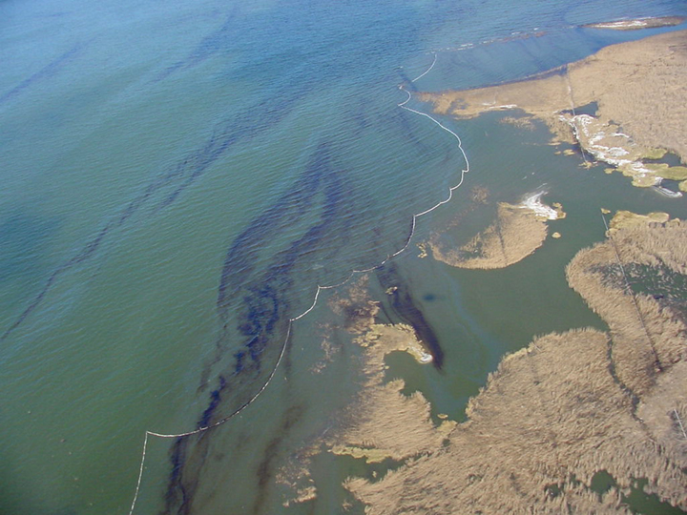
Charlie Henry
Notes:
Oil beginning to strand along the delta. The source was secured on the 6th of October. Minor shoreline clean up was necessary.

Slide 37
Preliminary Assessment & Actions
2.1 Plot an oil spill trajectory based on a recent pollution response.
  “Good field intel and observations set up the trajectory analysis, but what moves the oil onshore?”
Federal On-Scene Coordinator Representative Training

Slide 38
2D On-Water, Surface Transport Drivers:
Winds (Weather Information from NOAA Marine Forecaster)
Ocean Currents (TABS, Earth Observing Systems, Observations)
Tidal Currents (NOAA Tide Predictions, Real-Time Monitoring)
Oil generally moves at 2.5 to 3.5% (3%) of the wind speed and at 100% of the current speed.
To put oil onshore, you generally need an on-shore wind and slack or flood tides.
Remember: “Winds are the direction from… currents are the direction of movement.”
Notes:
TABS – Texas Automated Buoy System, access online
SW winds will blow oil in what direction? – NE
SW currents will carry the oil in what direction? - SW

Slide 39
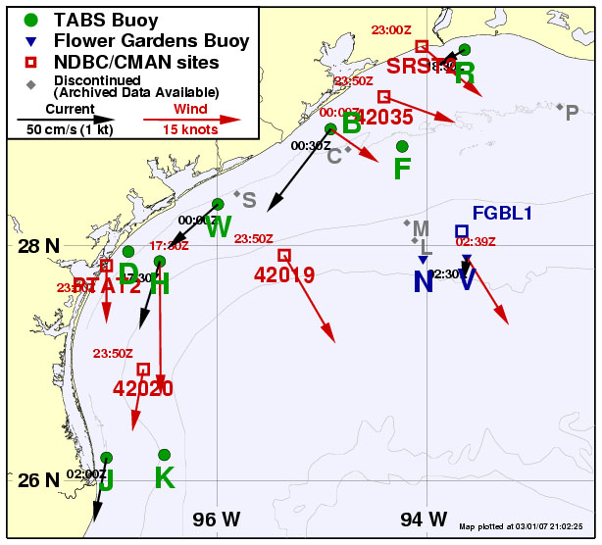
Charlie Henry
http://tabs-os.gerg.tamu.edu/Tglo/
Notes:
TABS Buoys can be accessed from online

Slide 40
Preliminary Assessment & Actions
2.3 Create an air plume model for a Hazardous Substance in your AOR.
What Information Drives a Good Plume Trajectory?
  Release Source Information and Field Observations
    Point Source Location (Lat./Long.)
    Source Strength (Release Rate, Pool Area, Etc)
    Plume Observations and Heading(actual)
    “Is this an actual release or are we planning for possible release?”
    On-Scene Weather Observations (Wind Direction, Cloud Ceiling)
    Released on land, water, into the air…
  Pollution Type (Chemical Type and Characterization)
    Density (Heavy Gas or Vapor)
    Vapor Pressure
    Reactivity
  Understanding of Pollution Transport
    Wind (Dispersion)
    Humidity (Reactivity)
    Stability Factors
    Topography (ALOHA Doesn’t Include Topography)
Federal On-Scene Coordinator Representative Training

Slide 41
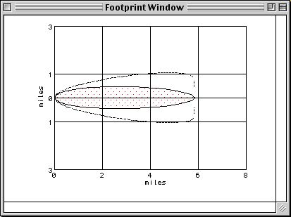
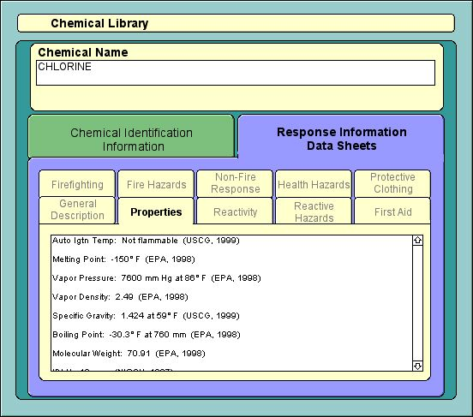
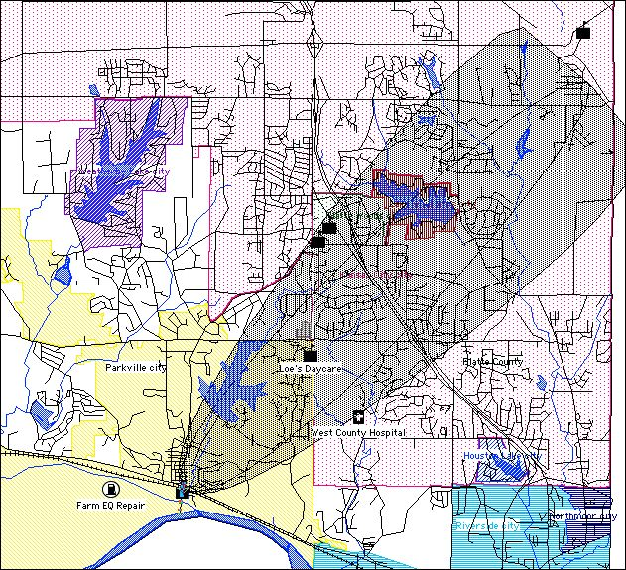
HAZMAT Chemical Products
ALOHA
CAMEO Chemicals
MARPLOT
Notes:
CAMEO (Computer-Aided Management of Emergency Operations) is a set of software modules and programs designed to assist first responders and emergency planners
CAMEO Chemicals contains:
A library with thousands of datasheets containing response-related information and recommendations for hazardous materials that are commonly transported, used, or stored in the United States.
A reactivity prediction tool, which you can use to predict potential reactive hazards between chemicals.
Can use this online: cameochecmicals.noaa.gov
Or can download to use on your computer without internet access.
ALOHA is CAMEO’s hazard modeling program. Uses chemical and environmental information to create a possible threat zone.
MARPLOT (Mapping Application for Response, Planning, and Local Operational Tasks) is a mapping program used with ALOHA to map these possible threat zones.
All of these are downloadable from NOAA’s OR&R website: response.restoration.noaa.gov

Slide 42
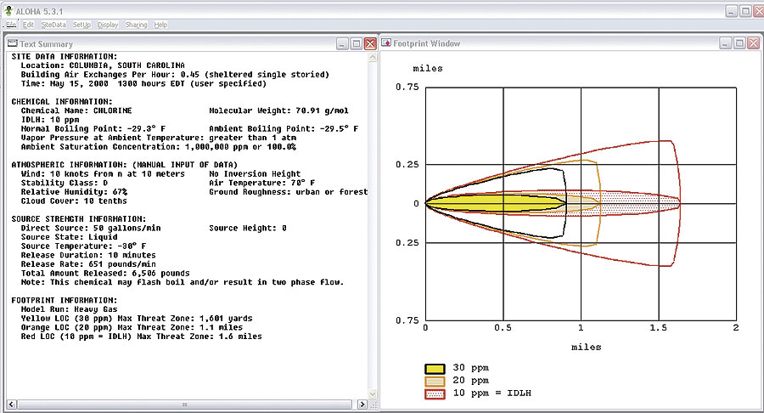
NOAA’s ALOHA MODEL
Notes:
ALOHA (Areal Locations of Hazardous Atmospheres) is a modeling program that estimates threat zones associated with hazardous chemical releases, including toxic gas clouds, fires, and explosions. A threat zone is an area where a hazard (such as toxicity, flammability, thermal radiation, or damaging overpressure) has exceeded a user-specified Level of Concern (LOC).

Slide 43
Fundamentals…
Plume Dispersion
Plume Dispersion Models are driven by the physical properties of the chemical, the release scenario, and the current or predicted weather. Of these, weather can be the most unpredictable. Uncertainty in forecasts grows the farther out you attempt to forecast. NOAA’s Plume Model is limited to only a few hours duration and a 6-mile distance from the source.

Slide 44
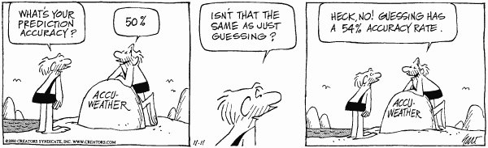
Weather forecast for tonight: dark. Continued dark overnight,
with widely scattered light by morning.
George Carlin (1937-2008 )
Notes:
Weather forecasts are just that – Predictions. Be prepared for it to be incorrect.

Slide 45
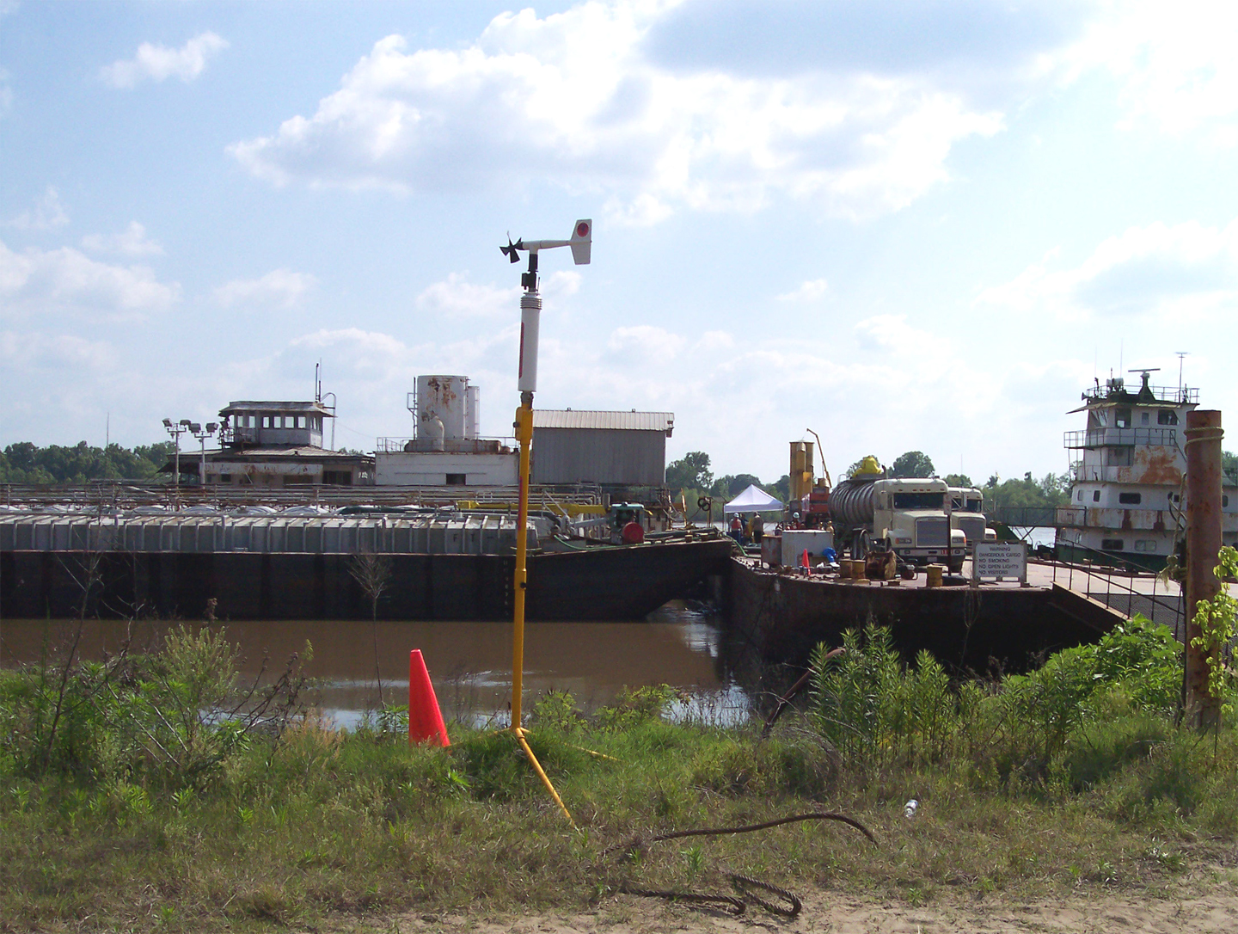
Hydrogen Sulfide Release
(Barge FT-22)
Notes:
On April 28, 2004, NOAA was notified of a hydrogen sulfide release from a barge located in a fleeting area near Baton Rouge, Louisiana. At that time, the identified problem, i.e., the failure of two gaskets, was repaired and no subsequent emissions were observed. During assessment activities, it was discovered that the product was "off-spec" and the barge was not certified for such a product. The NOAA Scientific Support Coordinator (SSC) worked with USCG Marine Safety Unit Baton Rouge to address concerns related to the stability of the barge product and plans to off-load the product to prevent subsequent releases that might threaten local communities.

Slide 46
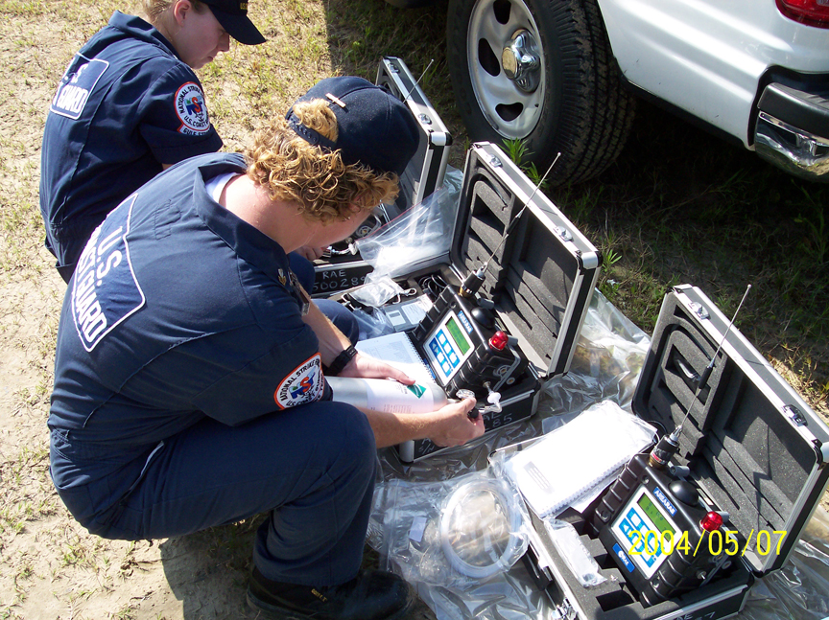
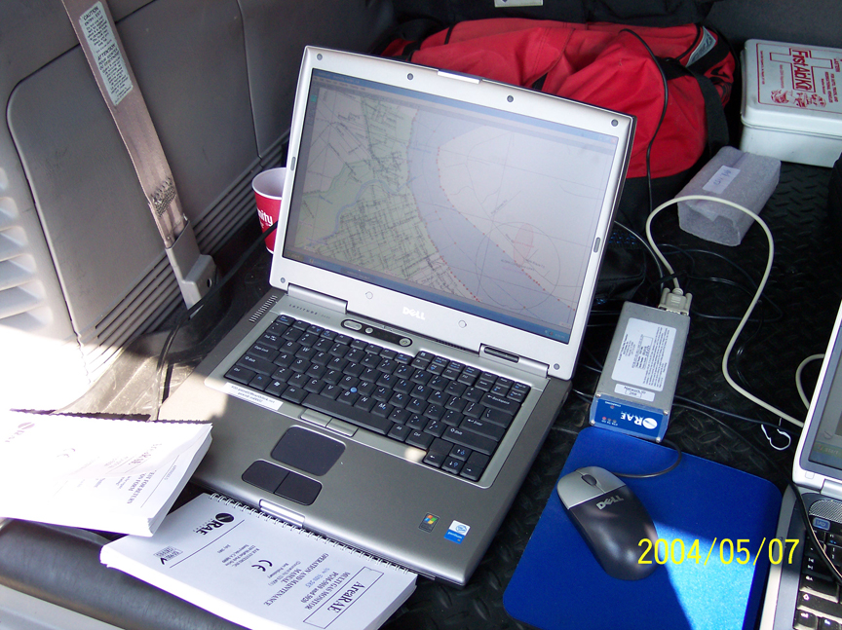
USCG Strike Team Deployment
Notes:
For air monitoring…

Slide 47
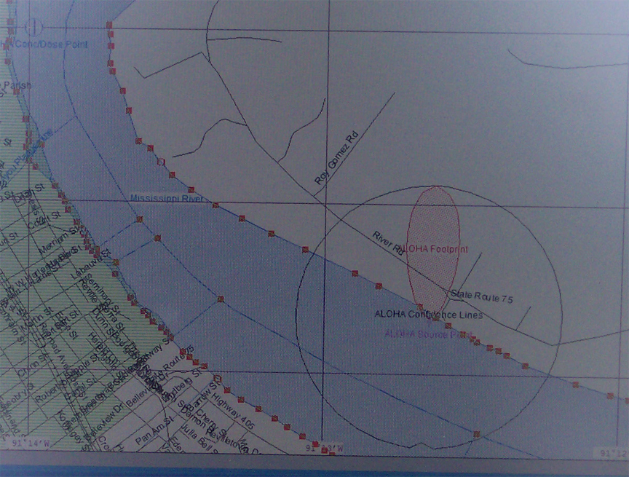
NOAA ALOHA Generated Output
Notes:
CAMEO Suite was used to produce an ALOHA/MARPLOT possible threat zone.

Slide 48
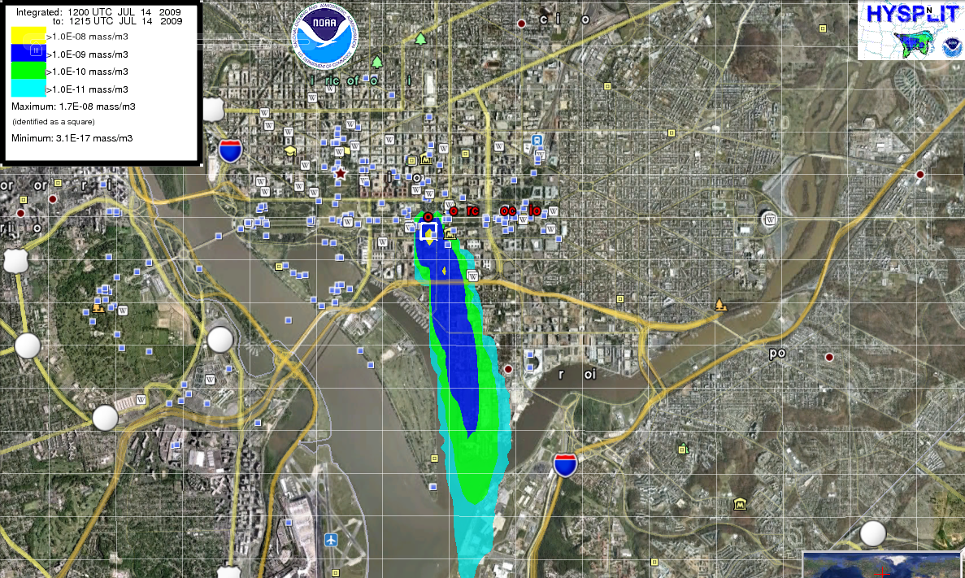
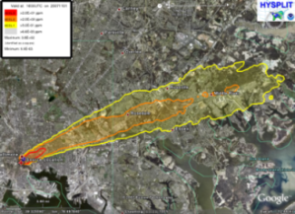
HYSPLIT
http://ready.arl.noaa.gov/HYSPLIT.php
Notes:
The HYSPLIT (HYbrid Single-Particle Lagrangian Integrated Trajectory) model is a complete system for computing simple air parcel trajectories to complex dispersion and deposition simulations. The intial development was a result of a joint effort between NOAA and Australia's Bureau of Meteorology.
Uses Google Earth and is a bit more complicated than ALOHA. But still available for download.
I work with the NWS and provide Chemical info and have them run the model.

Slide 49


Preliminary Assessment & Actions
2.4 Identify the agency or agencies that may assist in determining the fate of an oil spill/hazardous substance release in your AOR.
NOAA
Federal On-Scene Coordinator Representative Training

