Slide 1
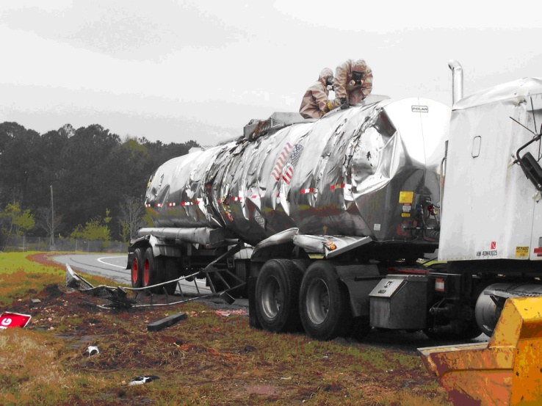
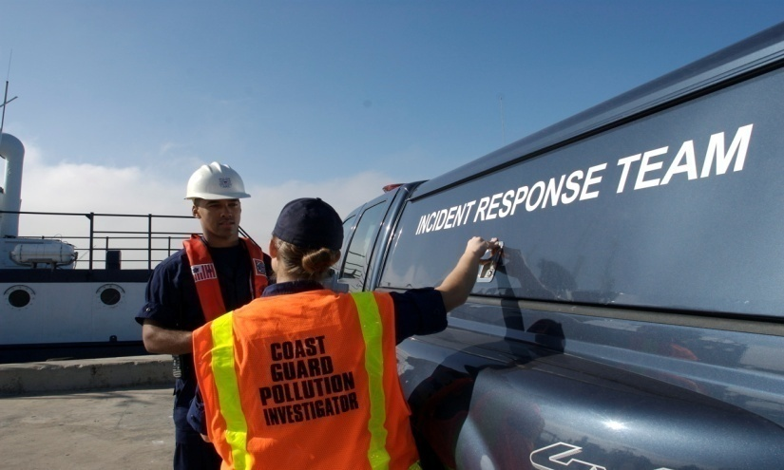
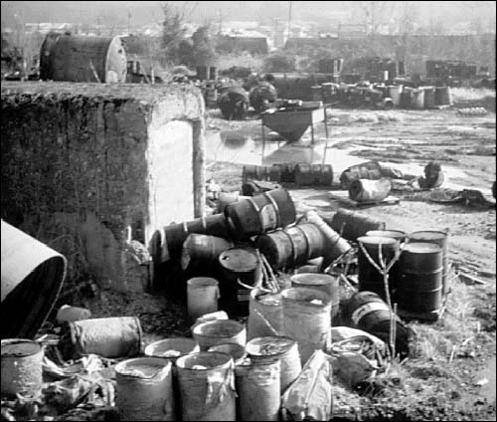
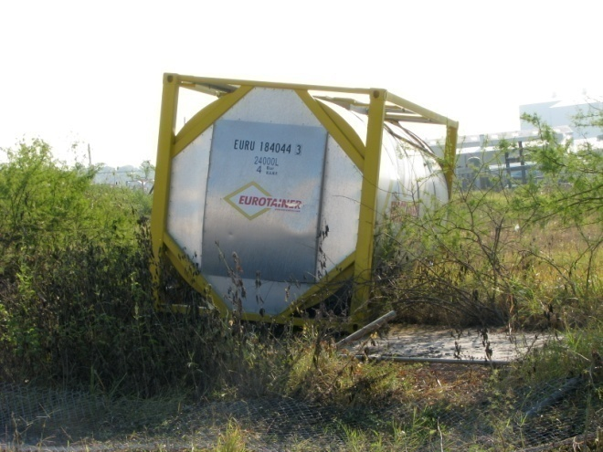
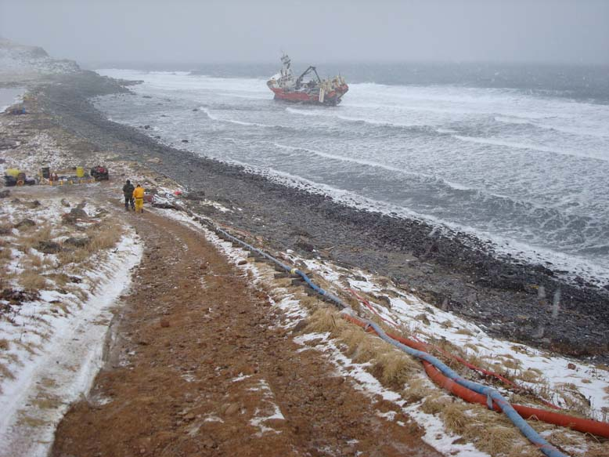
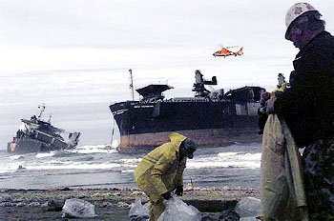
Jurisdiction and authority review
US Coast Guard Federal On-scene Coordinator Representative:

Slide 2
Learning Objectives
Students will fully understand the answer to each appropriate FOSC-R PQS item
Included will be a comprehensive review of authorities and jurisdiction in order to ensure familiarity with:
Specific aspects of CWA & CERCLA
Response framework under the NCP, CWA, CERCLA, and RCRA
Enforcement mechanisms under the NCP, CWA, and CERCLA
The differences and relationships between applicable statutes, regulations, guidance, and SOPs
Statutory vernacular and nomenclature
The ability to identify common problems, pitfalls, and politics associated with environmental response and enforcement
OSHA standards & site safety issues for all phases of the response

Slide 3
The Legal Framework
Environmental Law
U.S. Constitution
Treaties
Federal statutes
Federal Regulations
State statutes (State law is not necessarily subordinate to federal law)
State regulations
Local (city/county) laws, ordinances, and regulations
Case law (with its own hierarchy)

Slide 4
The Legal Framework
Case law
Legislative bodies are empowered to enact laws
The courts are the final arbiters on the validity and interpretation of the laws
The courts’ rulings are CASE LAWS
Establish legal precedents that lower courts are bound to follow
Case law is the source of U.S. common law, (i.e., Nuisance)
Negligence- body of law governing liability mostly based on common law

Slide 5
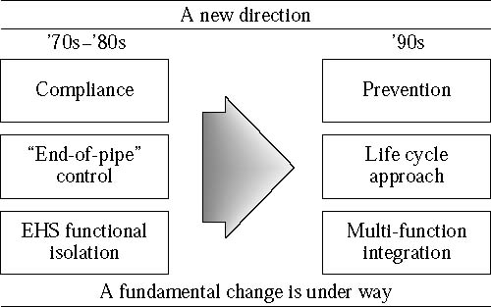
The Legal Framework
A new direction for corporations.

Slide 6
Important Legal Terms
Environmental Law is an organized way of using all of the laws in our legal system to minimize, prevent, punish, or remedy the consequences of actions which damage or threaten the environment, public health, and safety.

Slide 7
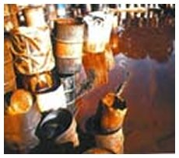
Important Legal Terms
Hazardous Materials
Transportation (Products!)
Hazardous Substances
CERCLA Defined
Hazardous Waste
RCRA Defined
Note that these are NOT interchangeable terms!
Notes:
All of these will be defined later at the appropriate time.
Important technical and LEGAL distinction. Although, does the public care? What about the press? The response community at large?
Lesson, if you are in this business, better know that difference.

Slide 8
Important Legal Terms
Negligence
The failure to exercise due care; the omission to do something which ordinarily regulate human affairs, would do, or the doing of something which a reasonable and prudent man would not do.”
Regulations
Rules or orders issued by various governmental departments to carry out the intent of the law.
Some provisions of statutes are self-implementing, most direct regulators to develop regulations
Regulation allows regulators to deal with complex issues in greater detail than is possible in a statute.
Notes:
Agencies issue regulations to guide activity of their employees and to ensure uniform application of the law. Regulations are not the work of the legislature and do not have the effect of law in theory.
In practice, however, because of the intricacies of judicial review of administrative action, regulations can have an important effect in determining the outcome of cases involving regulatory activity. United States Government regulations appear first in the Federal Register, published five days a week, and are subsequently arranged by subject in the Code of Federal Regulations.
How are they arranged?
29 is Labor
40 is Environment
49 is Transportation
Any others?
Difference between REGS and LAWS (statutes)?
TORT: The elements of a tort are a duty owed, a breach of that duty, and the resultant harm to the one to whom the duty was owed. A tort arises from the existence of a generalized legal duty to avoid causing harm to others, through acts of omission as well as commision. 3 flavors of TOXIC TORTS:
Nuisance
Trespass
Negligence

Slide 9
Important Legal Terms
Statutes
Are acts of a legislature (US Code).
Statutes of Limitations
Laws setting time limits after which a dispute cannot be taken to court
Strict Liability
Common law theory often applied by the courts in environmental cases to remedy environmental harm; liability for damages to persons or property can be imposed without requiring a showing negligence
Subpoena
A court order compelling a witness to appear and testify in a certain proceeding

Slide 10
Environmental Law Enforcement
Environmental Response is a unique combination of roles for the US Coast Guard:
Public Affairs and Outreach: Ensuring the public knows the law
Civil Investigator: PIs are enforcing Federal Law
Criminal Investigator: Many spills could be enforced criminally
Environmental Health Officer: Many spills require decisions to be made about human health and welfare threats as well as threats to the environment
Regulatory Inspector: Many spills occur because regulations were not followed
PIs and FOSC-Rs have a great deal of response and enforcement authority, this requires a knowledge base well beyond the brevity of the FOSC-R PQS

Slide 11
Public Welfare Offense Doctrine
As it applies to Environmental Statutes:
“Generally, a public welfare statute without a standard for culpability will require the government to only prove the defendant had the responsibility and had either the authority to prevent or the ability to remedy a violation; the government does not have to show that the individual had the intent to violate the law or even any knowledge of the violation.”
“As defined by the US Supreme Court, a public welfare statute is one that makes criminal an act that a reasonable person should know is subject to stringent public regulations and may seriously threaten the community’s health or safety”

Slide 12
Public Welfare Offense Doctrine
Public welfare statutes impart strict liability standards, eliminating mens rea requirements even if the individual defendant had no knowledge of the violation or intent to violate the law. Courts have traditionally found that the risk of harm to the public by not holding a party accountable for a hazardous activity outweighs the conventional requirement for criminal conduct-awareness of some wrongdoing. The rationale is the accused, if he does not cause the violation, usually is in a position to prevent it with no more care than society might reasonably expect and no more exertion that it might reasonably exact from one who assumed his responsibilities.
Notes:
Mens Rea: Criminal Intent
Students should ask themselves about spills they have responded to…were they preventable?
Also, those that were deemed accidental, was there enforcement?
If not, given that CWA and CERCLA are Public Welfare Statutes, does that change your response/enforcement paradigm?

Slide 13
Jurisdiction & Authority
Coast Guard FOSC-R have a tendency to apply Oil Response/Enforcement elements to Chemical spills
PQS will be covered, but will be presented from both CERCLA and OPA perspectives
All FOSC-R need to be mindful of differences
CERCLA authority and CG CERCLA legal concepts & policy:
M16465.29: CERCLA Response Policy (in-depth review)
CGINST released in 25May83, still 99.9% valid
Reference sections within presentation refer to *M16465.29*
Read: Discussion (a); 2.b.(2)
CWA/OPA-90 authority and CG legal concepts & policy:
Responding to Oil Spills under OSHA
Appendix E to the NCP

Slide 14
Jurisdiction & Authority
Oil
Discharge
Navigable Waterway
5 Elements
O/O Liability Only
How clean is clean: straight-forward determination
OSLTF restricts usage
Restoration
vessel destruction
chemical containing oils
Chemical
Release
Environment
Elements more ‘fluid’
2.A & 2.B (page 2-1)*
Joint, Strict, & Several Liability Scheme
Legally complex
How clean is clean determined by ARARs
Petroleum Exclusion
Notes:
Teaching points for this slide should include the differences between the two statutes and the ‘language’ responders and enforcement officers should ALWAYS use in the field and when communicating with industry.

Slide 15
Jurisdiction & Authority
1.1 Identify the purpose and the four general priorities of the National Contingency Plan (NCP)
The purpose NCP is to provide the organizational structure and procedures for preparing for and responding to discharges of oil and releases of hazardous substances, pollutants, and contaminants.
To give safety and human health top priority during every response action.
To stabilize the situation in order to prevent the event from worsening.
To use all necessary containment and removal tactics in a coordinated manner to ensure timely, effective response.
To take action to minimize further environmental impact from additional discharges.
All FOSC-Rs should read the NCP cover-to-cover!!!
Notes:
This isn’t listed anywhere directly in the NCP, but once read this can be fully understood.
Students MUST be stressed the importance of full comprehension of the NCP and that this can only be achieved by actually reading 40CFR300.

Slide 16
Jurisdiction & Authority
1.2 Describe the authority a qualified FOSCR has under the NCP
40 CFR 300.2 The president delegated to the EPA the responsibility for the amendment of the NCP.
33 CFR 1.01-70 CERCLA delegations to CG.
33 CFR 1.01-80 FWPCA and OPA 90 delegations to CG.
33 CFR 1.01-85 Redelegation within CG.
33 CFR 1.01-90 Delegation of authorities to commissioned, warrant, and petty officers.
Notes:
Key points here is the understanding of the students full delegated authority to act under applicable statutes and regulations.
Also, how broad their delegated authority can and should be interpreted. For example, boarding authority (not criminal PC). Also, the limits of that authority as it relates to vessel destruction, (only the COMDT).

Slide 17
Jurisdiction & Authority
1.3 Identify the On-Scene Coordinators primary responsibilities
40CFR300.120 The OSC directs response efforts and coordinates all other efforts at the scene of the discharge or release and oversees the development of the ACP.
Ensure that persons designated to act as their on-scene representatives are adequately trained and prepared to carry out actions under the NCP (why you are at this training).
OSC will coordinate, direct and review the work of other agencies, Area Committee members, and contractors to ensure compliance with NCP and other plans applicable to response

Slide 18
Jurisdiction & Authority
1.4 Identify the notification requirements outlined in the NCP
Notice of discharges and releases must be made telephonically through a toll free number or a special local number to the National Response Center (NRC).
In accordance with 33CFR153.203 and 40CFR302, the notice of an oil discharge or release of hazardous substances in an amount equal to or greater that the reportable quantity must be made immediately.

Slide 19
Jurisdiction & Authority
1.4 (continued)
40CFR110.6: Notification of a discharge of oil in a harmful quantity must be made to NRC as soon as RP has knowledge.
If not practicable, notice may be made to the local OSC.
40CFR117.21: Notification of a discharge of a designated hazardous substance in a harmful quantity must be made to the appropriate agency as soon as RP has knowledge.
40CFR302.6: Notification of a release of a hazardous substance in an amount over the reportable quantity must be made to the NRC as soon as RP has knowledge. No exceptions.
Notes:
Common misconception: Who is compelled to report in a reasonable time frame?
NOT Innocent bystanders, but they should be educated to report…(HARPATs, constant dock walking)
Students should be stressed that this is how we discover spills, any delay in report should be meet with strict enforcement and admonishment.

Slide 20
Jurisdiction & Authority
1.5 Identify the four phases of an oil spill incident
Phase I - Discovery and Notification
Phase II - Preliminary assessment and Initiation of Action
Phase III - Containment, Countermeasures, Cleanup, & Disposal
Phase IV - Documentation and Cost Recovery
Things to remember:
FOSC-Rs shall use NCP language whenever possible
All oil spill clean-up actions funded by the OSLTF should be categorized within these phases
NRDA activities may be funded by OSLTF, but NOT part of the initial response funding via FPN
Following slides will review overall scope of CWA/OPA-90

Slide 21
CWA/OPA-90
Objective:
To Restore AND Maintain
the chemical, physical, radiological, and biological
Integrity of the Nation’s waters
Goals:
Water Quality Level
Achievement and Attainment for
protection and propagation of fish, shellfish, wildlife, and recreation (interim goal by 1983)
Eliminate discharges into navigable waters (by 1985)
Notes:
A key point for students here is that the statutory intention of Congress when the CWA passed was to ELIMINATE all discharges into the nations waters, in an effort to preserve them for future use. Students should be encouraged to discuss the scope of this as it relates to everyday actions as PI’s and FOSC-Rs. As well as a discussion of why we chase sheens, the damage that they cause etc., why we MUST care, and why we CANNOT hand off this responsibility. This section of the CWA is NOT delegated program by EPA.

Slide 22
CWA/OPA-90
The National Pollutant Discharge Elimination System (NPDES) Permit (the heart of the CWA)
Promulgated a Regulatory Scheme for:
Direct Discharges
Indirect Discharges
§301 CWA makes unlawful:
Discharge of
Any Pollutant
From a Point Source
By Any Person
Notes:
7
7
NPDES - CWA §402
Permits are for max of 5 years. Entity must apply minimum of 180 days before commencing operations or expiration of existing permit.
Bubble concept - allows facility to add discharges from different outfalls and meet single effluent limitation. At present, only allowed for steel plants (40 CFR §420.03)
Standard Conditions: Reporting, Sampling and Analysis, General Operations, Inspections, etc.
Special Conditions (aka “Other Requirements”): Restrictions specific to permitted point source.
Numerical Criteria: Chemical, Physical and Biological operating parameters; specify the methods required to take and analyze samples.

Slide 23
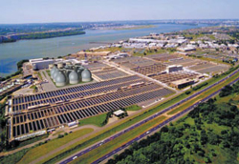
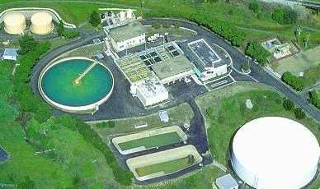
CWA/OPA-90
Discharges are allowed but not outside of a permit
Statute and Regulations exclude from the permit requirements (NPDES exclusions):
Discharges from Ships or Vessels
Discharges into Privately Owned Treatment Works (POTWs) that have an NPDES permit
Discharges from Nonpoint sources

Slide 24
CWA/OPA-90
Direct Discharge v. Indirect Discharge
Direct Discharge- discharge into navigable waters of the United States
Indirect Discharge- discharge into Privately Owned Treatment Works (POTWs), treated, then discharged into Navigable Waters of the United States
Point Source v. Non-point Source
Point Source Pollution- Pollution that can be traced to a particular conveyance (pipe)
Non-point Source Pollution- Pollution that can not be traced back to a particular conveyance because of it diffuse nature (water drainage from rain)

Slide 25
Industrial
Waste
Municipal
Waste
Industrial
Waste
Street Drain
Street Drain
Wastewater
Treatment
Plant
Storm
Water
Discharge
Untreated
Bypass
Treated
Effluent
Separate Storm Sewer
Sanitary Sewer
Combined Sewer
Notes:
So, what does this mean to you?
(1) Review your CWA permits and ensure that it accounts for all processes that result is a discharge into the waters of the US
(2) Take a tour of your facilities and see where your discharges take place

Slide 26
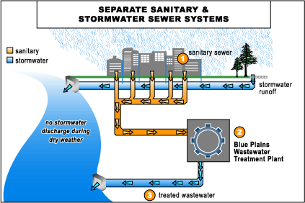

Slide 27
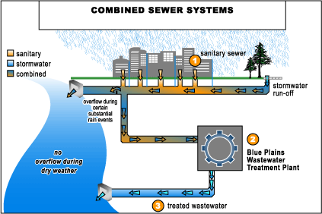

Slide 28
CWA/OPA-90
Point Source
Any discernible, confined, and discrete conveyance:
including, (but not limited to), any
pipe, ditch, channel, tunnel,
conduit, well, discrete fissure, container,
Rolling stock, concentrated animal feeding operation,
or vessel or floating craft ...
Does not include agricultural storm water discharges and return flows from agricultural irrigation (politics!)
Non-Point Source
Any diffuse source of pollutant discharge
Often the single largest remaining source of pollution
Regulation left mostly to states
see Coastal Zone Management Act
Notes:
What is a point source?”Point Source” - CWA §502(14) - any discernable discrete conveyance
Given the broad definition contained in the CWA, courts have given the term “point source” broad meaning
US v. Earth Sciences - point source is any identifiable conveyance
For example, if you push a bulldozer up to the water’s edge, or if you back a dump truck up to the water’s edge, and dump material into the water, the bulldozer or dump truck has become a point source. DC snow. Violation w/o permit.
Also been defined to include aircraft, manure spreaders, trains, dump trucks and backhoes. Does not yet include people. Think of a pipe jutting out from either a sewage treatment plant or some other facility discharging "used" but treated waters into a river.
Why is this definition important? B/C if you’re a point source, and you discharge pollutants into the waters of the US, you need a permit.
Last type of direct discharger we’ll talk about today. Here’s an example of an area that’s getting a hard look under current Congressional and EPA review of the CWA. Big problem as point sources are brought into control
No-brainer - nonpoint source is any source of pollution not a point source.
Examples - runoff from construction sites

Slide 29
CWA/OPA-90
Pollutant:
Dredged spoil, solid waste,
incinerator residue, sewage, garbage,
sewage sludge, munitions, chemical wastes,
biological materials, radioactive materials,
heat, wrecked or discarded equipment,
rock, sand, cellar dirt
and industrial, municipal, and agricultural waste
The term does not include ...
...‘sewage from vessels’
Notes:
10
10
“Pollutant” - CWA §502(6)
“Toxic Pollutant” - 33 US § 1314(b)(4)(B) (listed in 40 CFR § 401.15)
NRDC v. Train focused EPA priorities on control of toxic pollutants. EPA was sued / entered into consent decree.

Slide 30
CWA/OPA-90
Of the following Incidents when could the USCG assert CWA jurisdiction and authority?
An accident involving a semi-tanker truck occurs on an interstate overpass, discharging over 100 gallons from the trucks saddle tanks, but does not reach the waterway.
A vessel has been abandoned on a beach with less than 10 gallons on board.
A bread truck delivery man falls asleep at the wheel and ends up in a tidally influenced lagoon, a light sheen has been reported.
Well within EPA’s inland zone, a Shell Corp. tank farm secondary containment failed following an emergency pipeline shutdown, the fuel threatens a nearby stream that eventually feeds a tidally influenced waterway.
Would this qualify as a US Navigable Waterway?
Notes:
CWA regulations defining navigable waters include the term:
All other waters, such as intrastate lakes, rivers, streams (including intermittent streams), mudflats, sandflats, wetlands, sloughs, prairie potholes, wet meadows, playa lakes, or natural lakes . . . [that could affect interstate commerce and any tributaries of these waters]
In short, the Corps believed almost any water or waterway is an “other waters” navigable water
So Is this a Navigable water? . . . NO! (probably not)
Solid Waste Agency of Northern Cook County (SWANCC) 2001 USSC decision said non-hazardous landfill site containing isolated wetlands (actually trenches from former sand/gravel strip mining) not water of US just because migratory birds cross state lines and land there. EPA and Corps still sorting out what’s left, and interpreting it broadly.

Slide 31
CWA/OPA-90
Removal Provisions
Authority to respond to any ‘discharge’ of a recoverable amount of petroleum
FOSC-R should use common sense and evaluate costs of response versus mitigation of damage to environment
Remember goal of CWA was zero discharges by 1985
Any discharged petroleum is a problem and shall be evaluated by CG for removal and enforcement
Environmental Response shall include: notification, investigation, clean-up, cost documentation, & enforcement
Administrative Orders shall be used when directing RP to conduct any removal action

Slide 32
CWA/OPA-90
Liability Scheme
Responsible Party (i.e. Owner and/or Operator) liable for any spill that occurs from facility or vessel under their control
CWA/OPA-90 is a no-fault statute in terms of liability:
It doesn’t matter that it was an accident!
It doesn’t matter that it was not their fault!
It doesn’t matter that they didn’t know that a discharge was illegal!
It doesn’t matter that they responded quickly
The above items can contribute to the decision of potential enforcement action (administrative, civil, criminal and/or federal, state, or municipal)
Petroleum exclusion prevents CERCLA liability
CG responders must investigate each spill thoroughly for cost recovery purposes
PIs/FOSC-R should not confuse cost recovery for enforcement

Slide 33
CWA/OPA-90
Military Vessel Discharges (UNDS)
Uniform National Discharge Standards (§ 312) - preempt state standards
Incidental discharges from “vessels of the Armed Forces”
Will require marine pollution control devices
Joint DOD (USN)/EPA rulemaking
www.epa.gov/ost/rules/UNDS/
unds.bah.com (official site -no www)
Other Discharges
Sewage?
Greywater
Notes:
UNDS is an effort to control discharges from vessels of the armed forces
Need - discharge limits may vary from port to port
no comprehensive program prior to UNDS legislation to regulate vessel discharges
Application to federal vessels
Vessels are considered “point sources” under CWA
Def of “pollution” does not include “sewage from vessels or discharges incidental to normal operation of a vessel of the ArmedForces”
Vessels excluded from requirements to obtain permit for discharges incidental to the normal operation of a vessel
No sewage discharge (312)
What - DOD directed in 96 reauth act to study vessel discharges, determine what types of discharges should be regulated, and develop marine pollution control device technology. Navy lead in concert with EPA
MPCD - may be a piece of equipment, may be a BMP - any equipment/process that reduces/controls discharge. Have not been developed yet
Will be 26 types of regulated discharges, byproducts of normal shipboard ops - chain locker runoff, clean and dirty ballasting, CPP hydraulic fluid, deck runoff, firemain ops, hull coating leacheate (paint into seawater, erosion, dissolving)
Once published, will pre-empt state stds (already preempted with respect to 14 phase 1 discharges)
(UNDS website has good explanation)

Slide 34
Jurisdiction & Authority
1.6 Identify the phases of Haz-Sub incident
Phase I - Discovery and Notification
Phase II - Removal Site Evaluation
Phase III - Removal Action
Read: 2-C-1 & -2 pg. 2-2
Phase IV - Remedial Site Evaluation
Phase V - Establishing Remedial Priorities
Phase VI - Remedial Investigation
Phase VII - Remedial Action
Phase VIII - Procedures for Planning and Implementing Off-site Response Actions

Slide 35
Jurisdiction & Authority
1.6 CERCLA Responses
The CERCLA Paradigm
Inactive hazardous waste sites & intended to complement RCRA
Legally complex statute
Comprehensive method of addressing hazardous-waste sites
Contains unprecedented enforcement and liability provisions
EPA Title III List of Lists (read: 3-C-4)
CERCLA hazardous substances
RCRA hazardous wastes (more on this later)
Haz-substances & toxic pollutants under CWA
Hazardous air pollutants under CAA
Imminently hazardous substances under TSCA
EPCRA Section 313 Toxic Chemicals

Slide 36
CERCLA/SUPERFUND
Instrument of Redelegation (1.C pg. 1-1&2)
Limited CGs involvement in CERCLA processes
1. Any VESSEL Incident
2. The end of the Emergency Action Phase
3. RCRA TSD-F or Subtitle C Landfill; EPA arrival
D1 CERCLA Decision Memo
Established real world example for CG FOSC-Rs
COMDTINST 16465.29/30
Only CG CERCLA Policy (1983)
.29 still valid and correct
.30 outdated and should not be utilized
EPA & CG have different operational paradigms; but work from the same statute!
Recommend coordination with local EPA OSCs
EPA training and resources specific to CERCLA

Slide 37
CERCLA* INCIDENT RESPONSE CONTINUUM
Emergency Response Operations (29CFR 1910.120)
Post-Emergency Response Operations
Emergency Response
Enforcement/Cost Recovery/ Litigation
Emergency Action Phase/ Removal Action
Time Critical Removal Action
Example Actions: Establishment of safety/security zones, evacuation, shelter in place orders, mass casualty/triage, firefighting operations
Example Actions:
Berms, air monitoring, soil/water sampling, drum over-packing, segregation of chemicals, specialized teams to temporarily stop release, or to eliminate IMMEDIATE threat of release & environmental contamination.
Example Actions:
Continuous air monitoring & soil/water sampling, actions begin within 6 months and last less than 12 months. Full PA/SI required, part of a NPL site, and/or include non-time critical removal action.
Example Actions:
Documentation review, search warrants, cost recovery proceedings, sworn testimony, trial preparation, and technical briefings.
OSHA Guidelines & CG/EPA Recommendations
CG Training:
24 Hour FRA/FRO
EPA/External Training:
24-40+ Hour HAZWOPER
EPA/External Training:
40-80+ Hour HAZWOPER
No OSHA Training Required
Government/Agency Jurisdiction:
PRIMARY: Local/State
SECONDARY: Federal
PRIMARY: Federal/State/RP
SECONDARY: Local/State
PRIMARY: Federal/State/RP
SECONDARY: State
PRIMARY: Federal/State
SECONDARY: State
*Based upon response authorities found in CERCLA §104(a) and the NCP 40 CFR §300.400.
Notes:
Use this slide to discuss what they just learned in the previous slide.
USCG has response and enforcement authority that begins when Federal jurisdiction is evaluated and assumed and somewhere before a full removal action is completed, except for responses involving vessels.

Slide 38
CERCLA/SUPERFUND
Pollutant or Contaminant
Read: 3-D-1,2,3 pg. 3-8,9
‘a release or substantial threat of release … of any pollutant or contaminant which may present an imminent and substantial danger to public health or welfare…’
Such substances will or may reasonably be anticipated to cause certain specified harmful health effects
Substantial Threat
Read: 3-E pg. 3-10,11
Determining substantial threat is the FOSCs responsibility
Threat of release judgment is critical element in determination

Slide 39
CERCLA/SUPERFUND
Removal Provisions
(read: 3.F.1,2,3 pg. 3-11,12)
EPA/CG cleanup and cost recovery
Section 104(a)(1):
Any haz-sub is released or threat of release
Likewise for pollutant or contaminant
Removal Action
Less than 1 year and 2 million
Exceptions exist
Need for Prompt Action
Harm Warranting Removal (4-A-2.a-c. pg. 4-1,2)
Acting in Doubt (4-B)
An OSC need not determine with certainty that a hazardous substance has been released before initiating removal measures under the authority of the Act.
Compel cleanups
Notes:
REMOVAL Action Exemptions: Emergency action, immediate risk to public health and environment, part of larger remedial action, continuation of removal consistent with remedial action…

Slide 40
CERCLA/SUPERFUND
Documenting a decision to act under CERCLA
Pollution Report
Incident Specific Action Plan and Statement of Work
Finding of Imminent and Substantial Endangerment
Responses projected to call less than $50K
Simple documentation based on CERCLA and NCP language
Action Memorandum
Every EPA FOSC must do an action memo for removal activities
CG FOSC-R must do a Action Memo for any response over $250K
Documenting decision key to ensuring that FOSC has established the basis for a response and threat to public health, welfare, and environment
Review example EPA’s FI&E and CG Action Memo

Slide 41
CERCLA/SUPERFUND
Incidental Releases (4-C pg. 4-3)
OSHA Standards
Internal vs. external releases from private property
Will be reviewed in detail during Site Safety section
Appropriate Extent of removal (4-D pg. 4-3)
Degree of Harm
How clean is clean? Section 121
Applicable or Relevant and Appropriate Requirements
Any standard, requirement, criteria, or limitation under any environmental law
Or…state environmental or facility siting law that is more stringent than any federal standard
Case by case determination using best judgment
Consult with special forces, affected state environmental professionals and the RRT
Notes:
Questions regarding incidental releases should be tabled until full OSHA discussion can take place wrt Section 6 of the FOSC-R PQS.

Slide 42
CERCLA/SUPERFUND
RCRA is THE ‘ARAR’
RCRA significantly amended by Hazardous & Solid Waste Amendments of 1984 (HSWA)
RCRA designed as a “cradle to grave” regulatory scheme
RCRA applies to ACTIVE facilities that generate haz-waste
Notes:
More on the HSWA later…

Slide 43
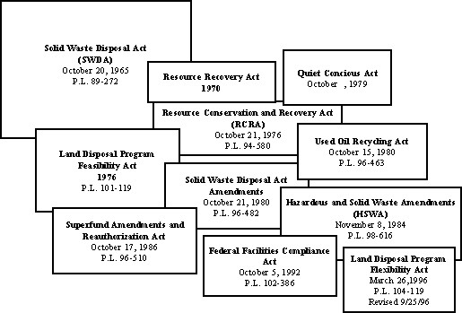
The Solid Waste Disposal Act of 1965 and its Amendments or "The Resource Conservation and Recovery Act"

Slide 44
RCRA
RCRA regulations 40 CFR 261-299
Divided into 10 subtitles, A-J
Imposes extensive management and tracking requirements on
Generators and transporters of haz-wastes
Owners & operators of treatment, storage, and disposal (TSD-F)
Subtitle C is most significant
Defines hazardous wastes
By listing specific hazardous wastes
By establishing characteristics of haz-waste
Requires generators or producers of haz-wastes must
Handle wastes properly
Preparing manifests to track shipments to treatment recycling or disposal facilities

Slide 45
RCRA
§ 261.2 Definition of solid waste.
(a)(1) A solid waste is any discarded material that is not excluded by § 261.4(a) or that is not excluded by variance granted under §§ 260.30 and 260.31.
(2) A discarded material is any material which is:
(i) Abandoned, as explained in paragraph (b) of this section; or
(ii) Recycled, as explained in paragraph (c) of this section; or
(iii) Considered inherently waste-like, as explained in paragraph (d) of this section; or
(iv) A military munitions identified as a solid waste in 40 CFR 266.202.
(b) Materials are solid waste if they are abandoned by being:
(1) Disposed of; or
(2) Burned or incinerated; or
(3) Accumulated, stored, or treated (but not recycled) before or in lieu of being abandoned by being disposed of, burned, or incinerated.
Notes:
These general statutory definitions have been greatly amplified and explained by EPA regulations that implement RCRA….
Example of generic law, that is the basis for interpretive regulations…

Slide 46
RCRA
Complexity of RCRA applicability determinations
Determine if ‘solid waste’ or regulatory exclusion
Domestic sewage or material that passes through a POTW
Industrial wastewater point source discharges under CWA
Irrigation return flows
Special nuclear material under Atomic Energy Act
Then, discarded material is “inherently waste-like”
A material is inherently waste-like if EPA so defines it by reg
Even recycled or reclaimed material that will not be disposed of may still be considered solid waste, therefore haz-waste

Slide 47
RCRA
Determine if ‘hazardous-waste’ or regulatory exclusion
Automatic exemptions for certain solid wastes
Household waste
Agricultural wastes that will be returned as fertilizer
Mining overburden returned to mine
Utility wastes from coal combustion
Oil and natural gas exploration
Wastes from ore processing
Cement kiln dust waste
Arsenic treated wood wastes generated by end users
Certain chromium bearing wastes
Petroleum-contaminated media and debris that fail TCLP
Recycling of Hazardous Secondary Materials
NEW October 2008 Solid Waste Exclusion: allows for recycling of materials that are generated and legitimately reclaimed by the generator
Notes:
Other includes any material gathered for testing to determine characteristics or composition, or to conduct treatability tests…
Materials that are generated and legitimately reclaimed under the control of
the generator (i.e., generated and reclaimed on-site, by the same company, or under
“tolling” agreements);
• Materials that are generated and transferred to another company for legitimate
reclamation under specific conditions; and,
• Materials that EPA or an authorized state determines to be non-wastes through
a case-by-case petition process.

Slide 48
RCRA
2 types of hazardous waste determinations
Three hazardous waste lists (listed wastes)
‘F’-wastes
‘K’-wastes
‘P’ and ‘U’ wastes
Companies may request de-listing; prove non-hazardous
Four types of characteristic hazardous waste
Ignitability
Corrosivity
Reactivity
Toxicity
‘D’-wastes
Notes:
F-listed waste: hazardous waste from non-specific sources…spent solvents MEK or toluene
K-Listed Wastes: specific sources…bottom sediment sludge from the treatment of wastewaters by the wood preserving industry
P-listed wastes: are acutely hazardous wastes that require substantial management
U-Listed wastes: are considered toxic, and hazardous when discarded.
IF wastes are NOT listed as hazardous it MAY still be considered RCRA hazardous if it exhibits one of four characteristics…

Slide 49
RCRA
Ignitibility (4 determinations)
one pertains to ignitable liquids using a specific EPA-approved method for flash point
one pertains to oxidizers as defined in 49 CFR 173.115(a)
one pertains to ignitable compressed gas as defined in 49CFR173.127
The other property, ignitable solids is described as the following: “It is not a liquid and is capable, under standard temperature and pressure, of causing fire through friction, absorption of moisture or spontaneous chemical changes and, when ignited, burns so vigorously and persistently that it creates a hazard.”
Corrosivity
Aqueous: pH is less than or equal to 2
Aqueous: pH is greater than or equal to 12.5
Liquid: corrodes steel certain rate & conditions
Reactivity
Extremely unstable substances
Tendency to react or explode during management
Narrative definition established by EPA

Slide 50
RCRA
Toxicity
Identifies wastes that leach hazardous concentrations of specific toxics; Toxicity Char. Leaching Procedure (TCLP):
Extracts toxics from wastes similar to leaching action within landfills
(25) Organics, (8) Inorganic, (6) insecticides/herbicides
Trigger levels are health based concentrations
TCLP uses models that factor for
Dilution & attenuation of subsurface fate & transport of contaminants in groundwater
D-004 thru D-043 on manifest
Note: SW 846 defines all EPA approved environmental testing procedures
http://www.epa.gov/epaoswer/hazwaste/test/sw846.htm
Notes:
The EPA publication SW-846, entitled Test Methods for Evaluating Solid Waste, Physical/Chemical Methods, is OSW's official compendium of analytical and sampling methods that have been evaluated and approved for use in complying with the RCRA regulations. SW-846 functions primarily as a guidance document setting forth acceptable, although not required, methods for the regulated and regulatory communities to use in responding to RCRA-related sampling and analysis requirements. SW-846 is a multi-volume document that changes over time as new information and data are developed. It has been issued by EPA since 1980 and is currently in its third edition. Advances in analytical instrumentation and techniques are continually reviewed by OSW and incorporated into periodic updates to SW-846 to support changes in the regulatory program and to improve method performance and cost effectiveness. To date, EPA has finalized Updates I, II, IIA, IIB, III, IIIA and IIIB to the SW-846 manual, and the updated and fully integrated manual contains approximately 3500 pages.

Slide 51
RCRA
Generators
First step in cradle-to-grave regulatory system
Records indicating generation of haz-waste, lab analysis etc.
Must be retained for 3 years, (reality is forever)
EPA ID# for ALL TSD-Fs and generators
Responsible for initiation of UHW Manifest
MUST manifest all hazardous waste
Obey DOT regulations
Sign manifest (should be done by responsible official)
Generator must certify of waste minimization plan
Once waste reaches a TSD-F, manifest MUST return to generator within 45 days, or submit exception report to EPA
Generators can store haz-waste on-site under certain conditions
Must file biennial ‘waste-minimization’ report w/ EPA
Record keeping extremely important under CERCLA liability scheme

Slide 52
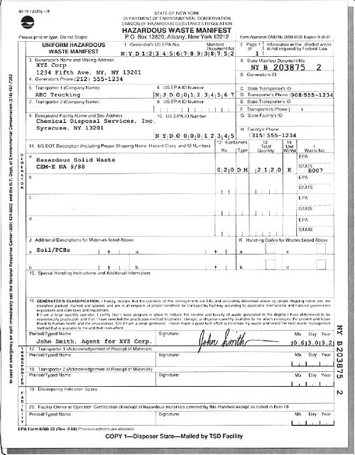
Hazardous waste manifest, New York State Dept. of Environmental Conservation

Slide 53
CERCLA/SUPERFUND
Removal Techniques (4-E pg. 4-8)
FOSCs should attempt to remove the contaminant vice containing in place
Facility release with additional Hazardous waste issues may need to be referred to EPA’s RCRA Inspectors for Corrective Action
Referring Releases to EPA
Develop relationships with EPA OSCs (task forces, exercises)
EPA OSCs are not first responders, don’t have lofty expectations
Initiate interaction early during an incident were hand-off may be required
Four occasions exist for which the CG may refer to EPA for action
Read: 4-F-1,2,3,4 pg. 4-8,9

Slide 54
CERCLA/SUPERFUND
CERCLA §106 Administrative Orders
Read: 5-A-1 pg. 5-1
Conditions for Issuance
Does not extend to releases from vessels
Exception to this rule defines ‘facility’ as where vessel releases came to rest
Unilateral Administrative Orders
Largest contributors of waste at a site
Financially viable
Substantial evidence of liability
Failure to comply up to $37,500/day of violation
Defenses to Admin orders
Defenses to Liability
Notes:
Defenses to Admin orders: A party must show that the applicable provisions of CERCLA EPA regs and policy statement, and any formal or informal hearings or guidance the EPA may provide, give rise to an objectively reasonable belief in the invalidity or inapplicability of the cleanup order….
Only few cases to date have had occasion to construe the term sufficient cause.
Defense to Liability: An act of God, an act of War,
An act of omission of a third party (as long as the defendant exercised due care and took precautions against foreseeable acts of the third party

Slide 55
CERCLA/SUPERFUND
CERCLA §107 sets forth liability scheme & cost recovery
Applies to any party having some involvement w/ creation, handling, or disposal of a hazardous substance at a site
Response actions occur and liability attaches
A release or substantial threat of release into the environment from vessel or facility
Any quantity, however small, triggers CERCLA
Substantial threat of release interpreted broadly by EPA
Facility and vessel is broadly defined

Slide 56
CERCLA/SUPERFUND
CERCLA §107 sets forth liability scheme & cost recovery
Strict, Joint and Several, and Retroactive
NO requirement that a party’s hazardous substance have been the cause for the response
Liability found for actions taken prior to CERCLA
An individual corporate officer or a parent corporation can be found liable if either has exercised control of hazardous waste handling
Sometimes just control over environmental concerns is enough
Or simply having the authority to control is enough
EPA uses threat of admin. penalties to force compliance

Slide 57
Jurisdiction & Authority
1.7 Define the jurisdiction that the following agencies have:
USCG
Discharges of oil; release of hazardous substances, pollutants and/or contaminants into the environment in the coastal zone
US EPA
Discharges of oil; release of hazardous substances, pollutants and/or contaminants into the environment in the inland zone
Department of Defense
Discharges of oil; release of hazardous substances, pollutants and/or contaminants into the environment from military operated facilities, installations, munitions and/or military vessels (COI must be in-place)
Department of Energy
Discharges of oil; release of hazardous substances, pollutants and/or contaminants into the environment from DOE facilities or non-DOD radiation sources
Notes:
Discussion should center around DoD and DoE FOSC authority:
Vessels being assembled for DOD are NOT DOD vessels until their CoI is in place by the USCG.
Non-military, non-nuclear radiation sources should be treated like any other chemical response EPA/USCG authority.
NRC is not a bureau for the DOE, NRC regulates Nuclear Power facilities and will take lead on response…but no FOSC authority.

Slide 58
Jurisdiction & Authority
1.8 Identify the source of FOSC Authority
Statutory Authority:
Federal Water Pollution Control Act as amended by
Clean Water Act
Oil Pollution Act
Comprehensive Environmental Response, Compensation, and Liabilities Act as amended by
Superfund Amendments and Reauthorization Act
Regulatory Authority
40CFR300 The NCP
33CFR
CG Policy Guidance
MSM Volume 9, Chapter 5 (outdated and inaccurate)
M16465.29 (still accurate review of CERCLA authority)

Slide 59
Jurisdiction & Authority
1.9 Identify the source of COTP authority
33 CFR 6.04-5 (“Super 6”)
The COTP may prevent any person, article, or thing from boarding or being taken or placed on board any vessel or entering or being taken into or upon or placed in or upon any waterfront facility whenever it appears that such action is necessary in order to secure such vessel from damage or injury or to prevent damage or injury to any vessel, or waterfront facility or waters or the US, or to secure the observances of rights and obligations of the US.
The COTP regulates access of personnel, movement of vessels and operations of facilities in order prevent or minimize damage or injury.

Slide 60
Jurisdiction & Authority
1.10 Explain FOSC and COTP authority to prevent access of personnel to vessels or waterfront facilities
COTP can take possession of any vessel whenever it is necessary to secure the vessel to prevent damage or injury to the vessel, waterfront facilities, or waters itself of the US.
FOSC may enter private property
To minimize the possibility of a spill
To minimize the damaging effects of a spill
To determine the severity of a spill
To determine the source of a spill
To decide possible courses of action to mitigate spill damage
FOSC may obtain Administrative Order that requires certain action prior to resuming on-site activities or operating vessel

Slide 61
Jurisdiction & Authority
1.11 Explain FOSC and COTP authority to control vessel and facility operations
33CFR160 subpart B: The vessel or any transfer can be stopped if:
the history of the vessel creates reason to believe that the vessel is unsafe or poses a threat to the environment,
the vessel/transfer fails to comply with regulations,
oil or hazardous material is discharged,
the vessel does not comply with vessel traffic service requirements,
operates without a deck officer who speaks English.
Entry onto Private Property (6-A-1,2,3,4 pg. 6-1,2)

Slide 62
Jurisdiction & Authority
1.12 Explain FOSC and COTP authority to control vessel movement
33CFR6.04-8 and 33CFR160 subpart B
The COTP may supervise and control the movement of any vessel and shall take full or partial possessions or control of any vessel or any part thereof…
Control of Private Activities and Property (6-C-1,2 pg. 6-2,3)
For all actual or potential releases the FOSC may:
curtail or prohibit private activities, such as near-by plant operations or use of a railway line…
control the movement, or use, of the source of a release, or potential release, and undertake any corrective measures…
If a release or threatened release poses an imminent threat of substantial harm, the FOSC may:
Requisition private property…
Destroy the facility or vessel which is the sources of the release…

Slide 63
Jurisdiction & Authority
1.13 Explain FOSC and COTP authority to enlist aid from other local and government agencies
The COTP may enlist the aid and cooperation of federal, state, county, municipal, and private agencies to assist in the enforcement of regulations of 33 CFR 6.04-11.
40CFR300.175 During preparedness planning or in an actual response, various federal agencies may be called upon to provide assistance in their respective areas of expertise…consistent with agency legal authorities and capabilities.
DOD, USACE, DOI/NPS/BLM/USFW, SUPSALV, FEMA, USDA, DOC/NOAA, HHS/CDC/ATSDR, DOJ, DOL/OSHA, NRC
Special Teams
Resource Trustees

Slide 64
Jurisdiction & Authority
1.14 Explain how a Safety Zone may be used to manage a pollution incident
Guidance for drafting a Safety Zone or COTP Order can be found in Marine Safety Manual vol. VI and 33 CFR 165.5 (Establishment Procedures for Regulated Navigation Areas and Limited Access Areas).
Safety Zones protects the area outside the zone from danger within the zone.
Limiting access
Site control
Human Health/Welfare and environmental protection
Security Zone protects the area inside the zone from danger outside zone.

Slide 65
Jurisdiction & Authority
1.15 Describe procedures for obtaining a Flight Restriction Zone
Very difficult to obtain
Must work through local AIRSTA
FR approved and enforced by FAA

Slide 66
Jurisdiction & Authority
1.16 Draft a COTP Order
COTP order is authority to enforce Super 6 authorities (such as through safety zones or as independent order).
COTP Order designed to restrict activities CANNOT be used to compel clean-up activities
Sector San Diego examples and discussion
1.17 Draft an Administrative Order
CERCLA or OPA Administrative Orders are clean-up and abatement documents that allow the RP to conduct clean-up operations under specific circumstances and timeframes in accordance with the NCP
Violation of Order will lead to fines and defaults clean-up to FOSC
Administrative Orders may be either oral or written. If oral, follow up with written version.

Slide 67
Additional Resources
http://www.clu-in.net
http://www.trainex.org/
http://response.restoration.noaa.gov/index.php
http://www.nrt.org/
http://www.ert.org/mainContent.asp?section=About&subsection=Overview
http://cameochemicals.noaa.gov/
http://epaosc.net
https://www.netionline.com/Default.asp

Slide 68
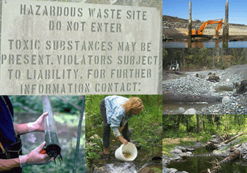
QUESTIONS?

