Slide 1
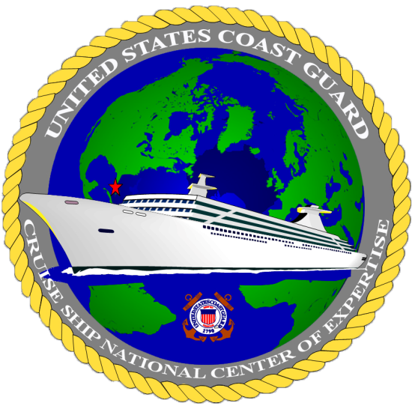
Our Mission is to provide the Coast Guard and the industry an exclusive global source of unsurpassed expertise and support
Welcome to the Cruise Ship National Center of Expertise (CSNCOE)
2. Our Vision is to be recognized experts leading the Coast Guards Foreign Passenger Vessel Program

Slide 2
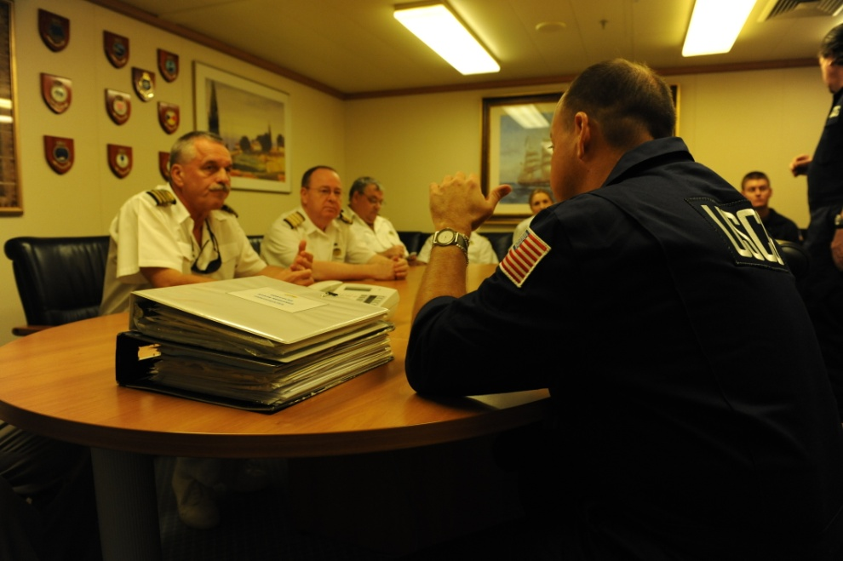
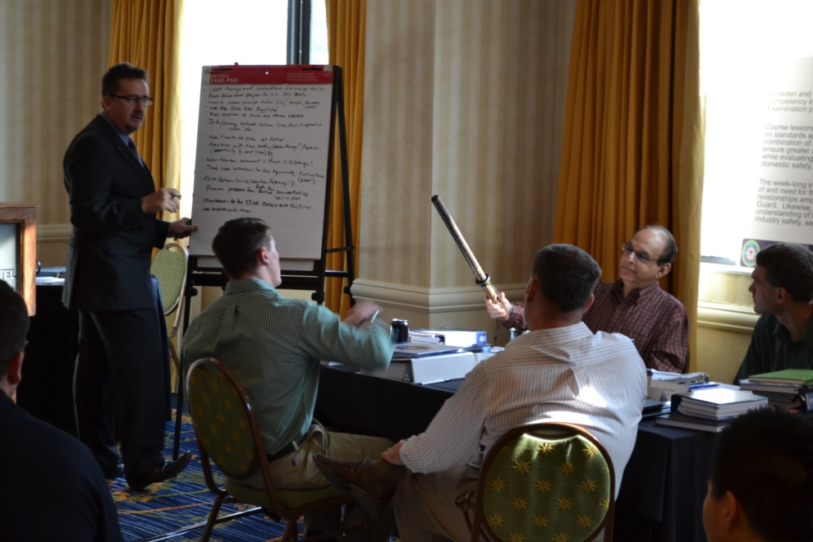
Who is the CSNCOE
Why was the CSNCOE established
What is the CSNCOE
When was the CSNCOE established
Where is the CSNCOE located
How is the CSNCOE utilized

Slide 3
Who is the CSNCOE
Comprised of 8 personnel;
3 active duty
Detachment Chief, CDR Jenkins
National Technical Advisor, LCDR Thomas Gibson
Port State Control, LT Kimberly Glore
5 civilian staff
Scott Elphison
Brad Schoenwald
Daniel Brehm
Eric Jesionowski
Jim Garzon

Slide 4
Why was the CSNCOE established
In 1993 the Marine Safety Office Miami began administering the Passenger Vessel Control Verification Course out of local necessity.
As the cruise industry grew, so did interest in this course.
The office began to be considered a “center of excellence” for the USCG’s cruise ship safety program.

Slide 5
What the CSNCOE does
?
?
Advanced Foreign Passenger Vessel Course administrator
Tactics, Techniques and Procedures (TTP) development
Performance qualification standard development
Nexus of subject matter expertise
Exam augmentation
Public Affairs
?
?
?
?
?

Slide 6
When was the CSNCOE established
In 2008, the USCG’s Marine Safety Enhancement Plan memorialized the concept of “Centers of Expertise”
Their attention would be focused on a particular facet of the marine industry. One of those seven Centers was established in Miami and focused on the Cruise Shipping Industry.
Because of its existing foundation, the Cruise Ship COE was established first, 0n Sept 30, 2008 as a sub-unit of Sector Miami.

Slide 7
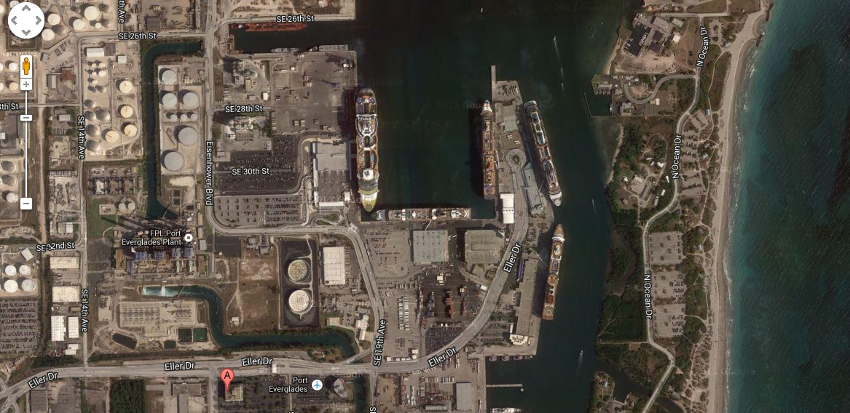
Where is the CSNCOE located
The CSNCOE is located conveniently next to Port everglades
26 miles north of the Port of Miami
1800 Eller Dr.
Suite 420
Fort Lauderdale, FL
33316

Slide 8
How is the CSNCOE utilized
Promoting field consistency and proficiency
Field assessment program
3 advanced courses annually
Basic training
Subject Matter Expertise
Policy, procedure and training development

