Slide 1
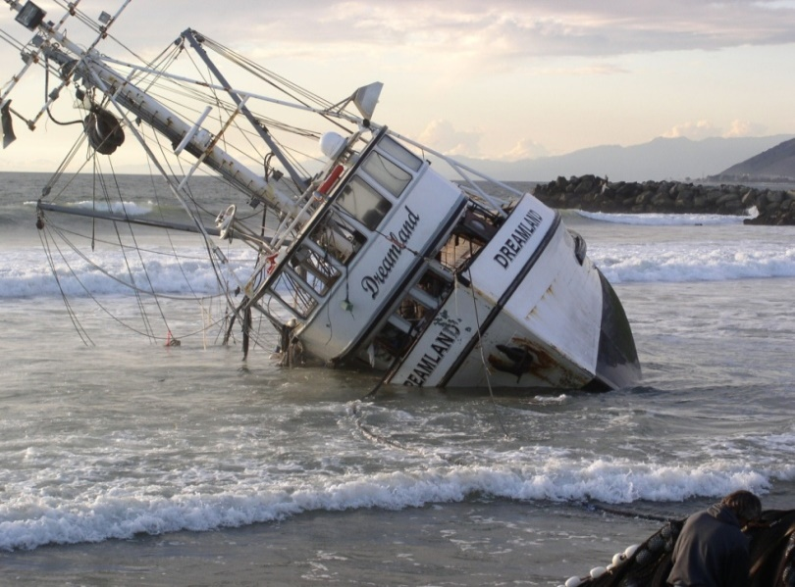
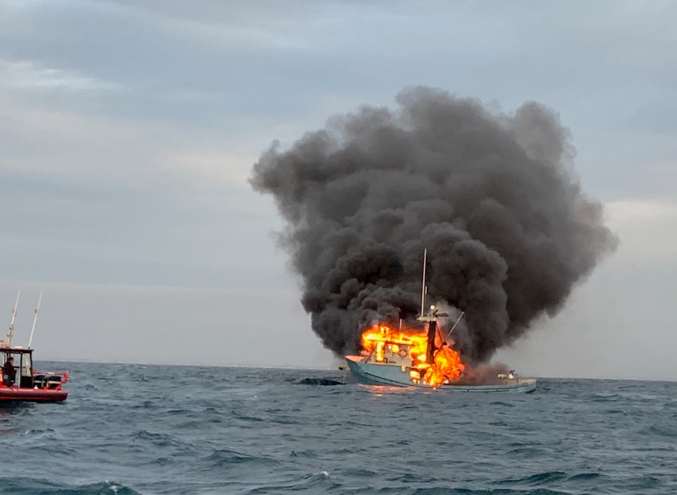
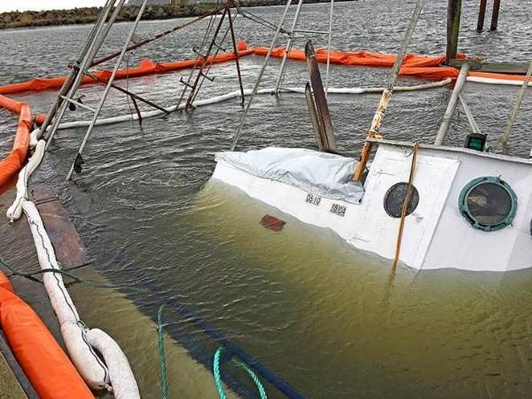
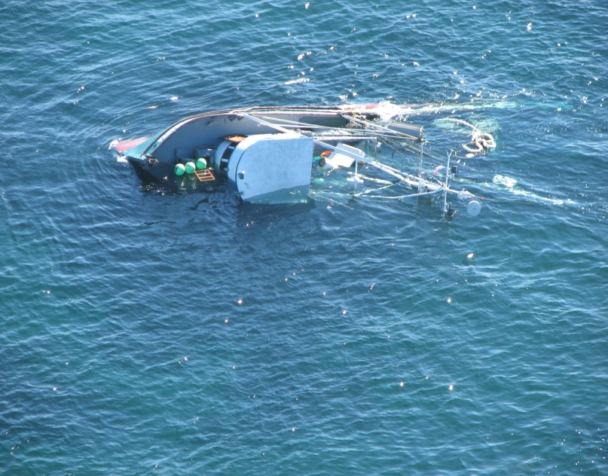
D11 Commercial Fishing Vessel Safety -Peg Murphy, CFVS Specialist-
Notes:
Commercial fishing continues to be one of the most dangerous jobs in America and it has the highest fatality rate of all the maritime industries. To address this, Congress created the Commercial Fishing Industry Vessel Safety Act, aka CFIVSA, in 1988.
The COMDT’s goal is to make commercial fishing safer and no more dangerous than any other segment of the maritime community.
D11 has approximately 3,000 commercial fishing vessels employing about 9,000 workers that operate out of 6 major ports in California: Eureka, San Fran, Monterey, Oxnard/Ventura, Los Angeles, and San Diego.

Slide 2
D11 CFVS Program Overview -2024
AOR covers 1,100 miles of coastline + Channel Islands.
9 major ports – San Diego to Crescent City.
Approximately 2,500 commercial fishing vessels with roughly 4,000 workers.
80% of fleet between 30-50 feet in length.
Majority fish outside 3NM.
2022: Landings= 187 million pounds $208 million dollars
6 full-time civilian CFVS Examiners along coast.
1 CFVS Program Specialist in Alameda, CA.

Slide 3
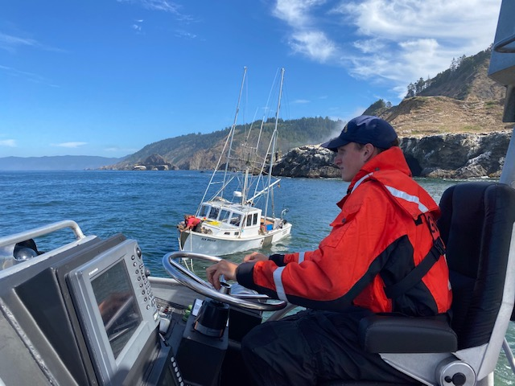
D11 CFVS Casualties and SAR – 2023
Total Casualties: 6
Fatalities: 2
Vessel Loss: 4 Lives Saved by CFIVSA: 13
MOB: 1
Sinking: 1
Grounding: 3
Fatal Injury: 1
Total SAR Incidents: 70
Disabled: 60
Sinking (at dock): 1
MOB (recovered): 1
Soft Grounding: 2
False EPIRB: 1
TOW: 5
Fire: 0
Notes:
2023: F/V Matador – Sank, Redondo Beach. Vessel loss.
F/V Defiance – MOB, San Diego. Single operator. Fatality
F/V Sacred Island - Dive Injury, San Miguel Island. Fatality
F/V Fair Seas– Grounding, Half Moon Bay. Vessel loss.
F/V Sea Harvester – Grounding, Monterey Bay. Vessel loss.
F/V Pacific Knight – Grounding, Catalina Island. Vessel loss.
**Note: All groundings were human error caused by fatigue.

Slide 4
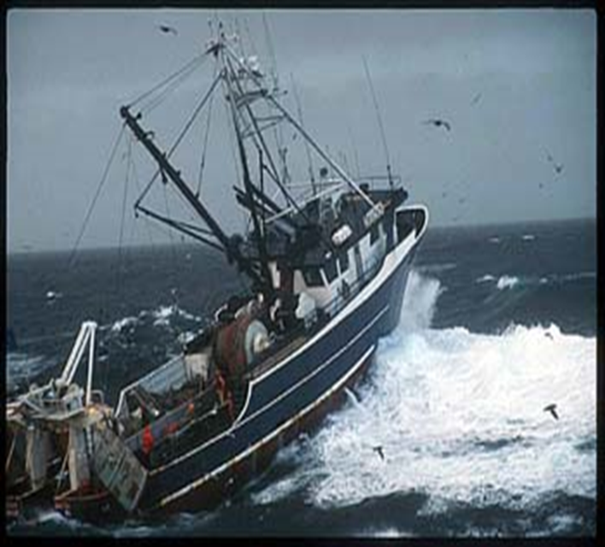
D11 CFVS Dockside and At-Sea - 2023
Total Exams: 403
Total Decals Issued: 245
Fleet w/current 5-year exam: 1010
W/current 2-year decal: 503 HRV’s: 123 In Compliance: 106
NOAA Observer: 53
Total CFV Boardings: 102 Fleet Boarded: 4%
With Violations: 16
No Violations: 86
CFVS Terminations: 3
Civil Penalty: 1

Slide 5
D11 CFVS Initiatives and Training 2023:
*OP SAFE CRAB December 5-7, 2023 Team Coast Guard
-Active-duty, Reserve, Auxiliary and Civilian dockside pulse-ops pre-season.
-Goal: Heighten safety awareness in the D11 fleet.
-Solicit dockside exams and safety checks for compliance.
*CFVS Training
Active-Duty: 83
Reserve: 0
Auxiliary: 0
CG Civilian: 0
Fishermen: 31
NOAA Observers: 26
NMFS: 0
Total: 132 Stakeholders
**Note: The California commercial salmon season was completely closed in 2023. The salmon return numbers for 2023 were dismal to the point of as few as 50 returning King salmon for key spawning areas on the Sacramento river system. Smolts from these areas were collected to be maintained at UC Davis research facilities to preserve that genetic line - to give an idea of how bad things are. The commercial salmon season in CA is expected to be closed again this year (2024).
2023 revenue loss estimated at $45 million.

