Slide 1
Re-Classing Existing Diving Systems
Jess G. Totten| October 16, 2017
Washington DC

Slide 2
Diving Systems Over 20 Years Old
Will not be considered for class
No exceptions
© Dondui

Slide 3
Diving Systems Less than 20 Years Old, Previously ABS Classed
Owner contacts their local ABS survey office
Survey office contacts divisional survey department
Divisional survey issues instructions for a Preliminary Condition Survey to consider the vessel for re-classification

Slide 4
Pre-Condition Survey
General internal and external examination
Condition documented with photographs
Service history and dive record review
Review viewport documentation
Additional examinations as needed or directed by divisional survey office
No charge to owner

Slide 5
Outcome of Pre-Condition Survey
Surveyor makes recommendation to divisional and corporate survey department whether or not to class the system
Engineering office may be asked for their input
Corporate survey office, with input from attending surveyor and divisional survey office, makes the final decision to proceed with re-classing

Slide 6
Next Steps
Divisional survey department will issue instructions for re-classing the submersible
Local survey office presents owner with list of requirements as well as fee quote
Any modifications must be submitted to the technical office for review
Modifications performed while out of class
Modifications required to comply with the rules
Surveyor to witness any required repairs or tests, typically including a special periodical survey based on age
Any due and overdue surveys as well as previous recommendations will need to be complied with

Slide 7
Special Periodical Survey
Required by section 7-11-4 of the ABS Rules for Survey After Construction for classed diving systems at three year intervals
Required of formerly ABS classed diving systems if the due date has passed
Includes pressure testing of life support piping systems and gas storage containers

Slide 8
Special Periodical Survey (cont.)
Viewports to be removed and inspected, replaced if service life or cycles have been exceeded
Gauges and monitoring instruments shown to have been calibrated recently
Electrical systems examined
Pressure hull inspected and NDT in highly stressed areas
Internal and external exam of other pressure retaining components
Test dive per requirements of Underwater Rules

Slide 9
Diving Systems Less than 20 Years Old, not Previously ABS Classed
Preliminary condition survey
Process is similar to that for a previously ABS classed submersible
PVHO hulls and acrylic windows can only be accepted when built under survey by an IACS member class society or recognized Flag Administration per section 1/3.4 of the Underwater Rules

Slide 10
Diving Systems Less than 20 Years Old, not Previously ABS Classed (cont.)
Instructions from corporate survey department will be based on the quality and completeness of documentation proving the submersible was built under survey
Documentation includes, but is not limited to:
Welding procedures and performance qualification records
NDT records
Material mill test reports
Special periodical survey is mandatory

Slide 11
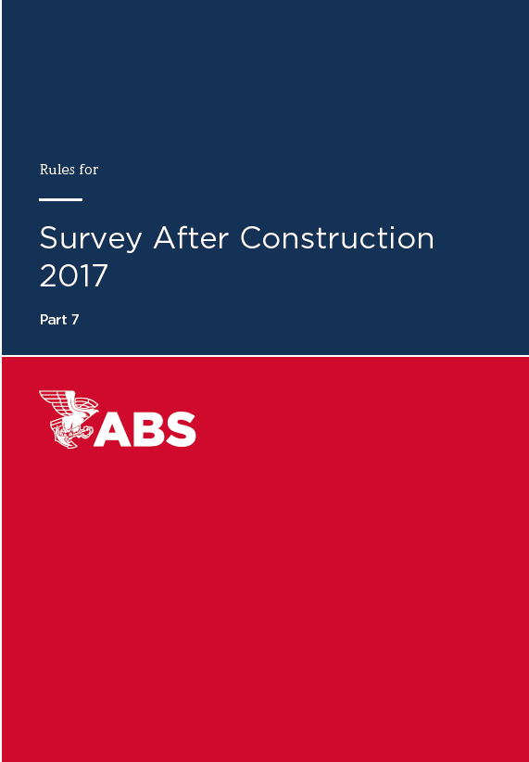
What Edition of the Rules Applies?
Agreed to between owner, corporate survey department, and engineering office in each case
For formerly ABS classed vessels, typically apply same edition of rules in place when submersible was initially classed
For non-ABS classed vessels, typically apply current edition of rules

Slide 12
Owner Responsibilities
Agree to fee quote
Complete a Request for Class (RFC) form
Provide a signed affidavit detailing system’s class status, modifications or repairs, and any other items of note
Provide all required documentation for the subject diving system, including class certificates, survey reports, viewport PVHO documentation, and manuals
Submit details of any modifications for review
Complete all required repairs

Slide 13
Questions?
© amasterphotographer / Shutterstock

Slide 14
Thank You!
www.eagle.org

