Slide 1
Time-Based Modeling of Ship Ballasting for Increased Performance
Dominik Fry, P.E.
Business Development Engineer
Engineered Software Inc.
October 16, 2017

Slide 2
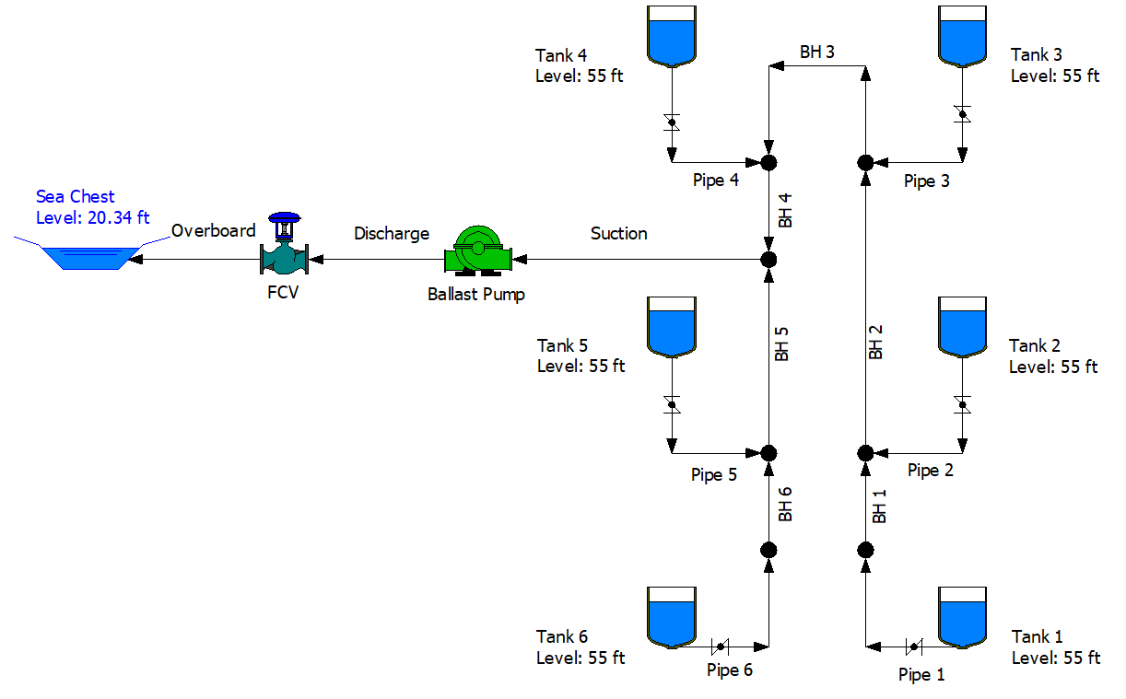
Introduction
Ship Piping Network
Mission
  12 hour deballasting
Problem
  Current procedure inadequate
Solution
  System efficiency
  Multiple scenario simulations

Slide 3
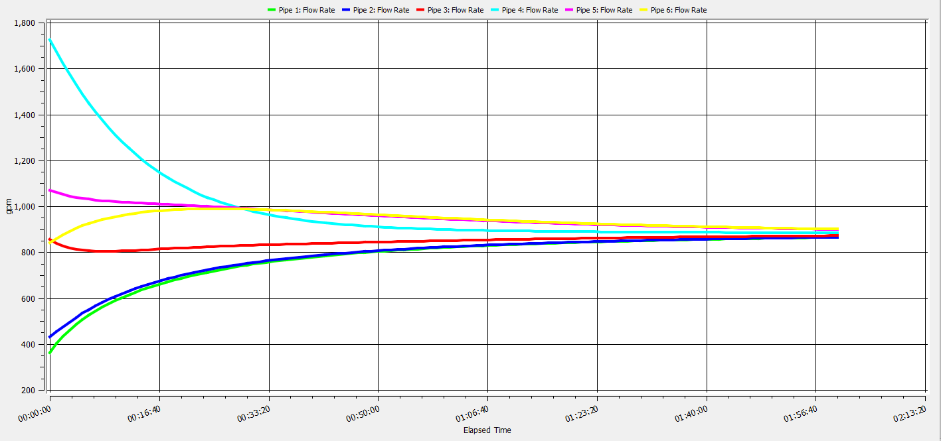
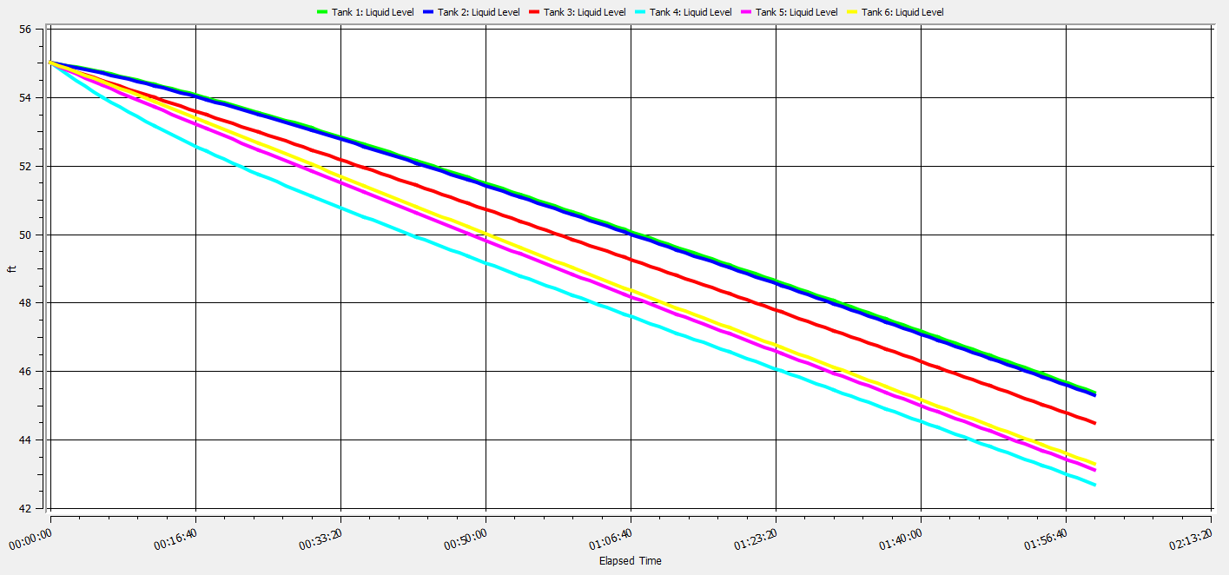
Asymmetrical Design
What happens if we start pumping from ALL the tanks simultaneously?

Slide 4
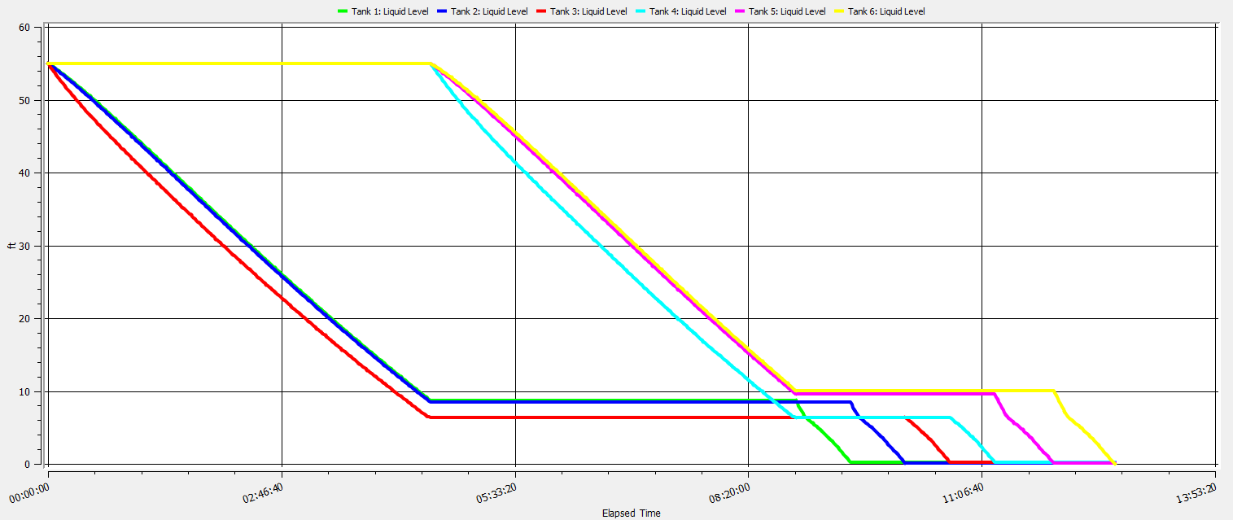
Current Procedure Inadequacy
Current Procedure
  Pump down first three tanks to 6.5 ft
  Pump down second three tanks to 6.5 ft
  Pump down individually to 0.5
Flow control valve 100% open until cavitation is heard
13-15 hour time to completion

Slide 5
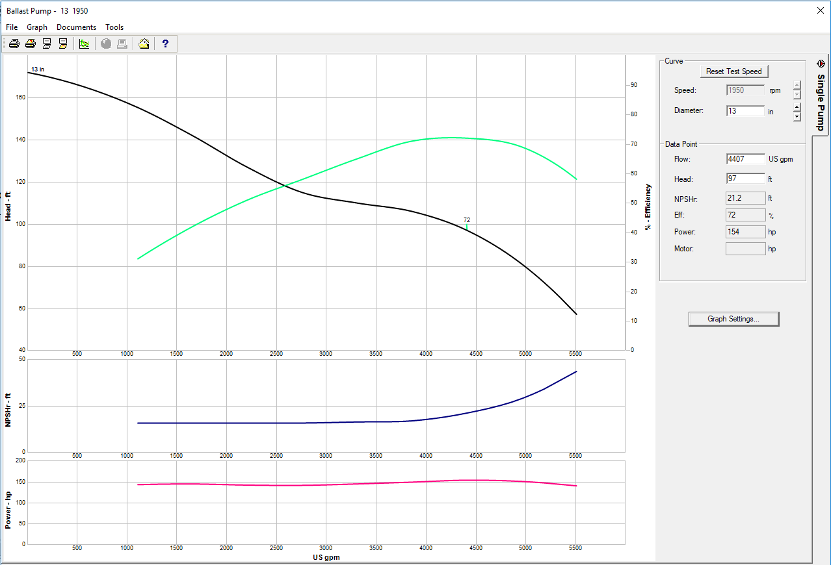
Pump Cavitation

Slide 6
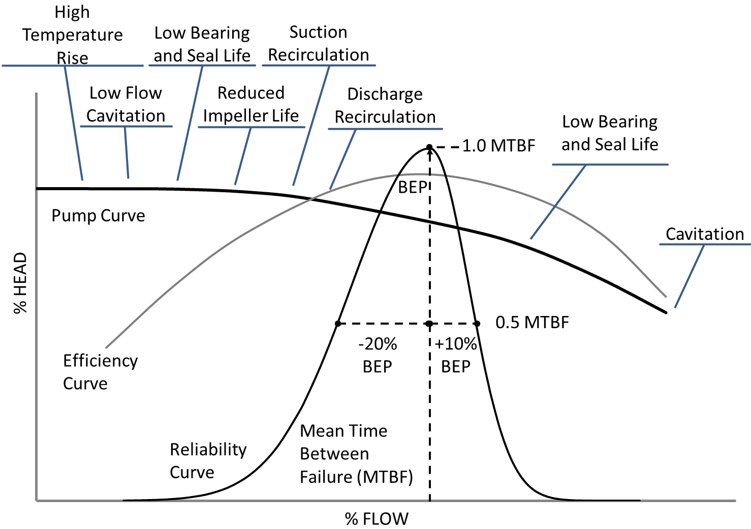
Barringer Curve
Barringer Curve – Efficiency and Reliability are related

Slide 7
Optimization Options
Keep 30% NPSHr margin ration (30% safety factor)
Option A
  Pump all tanks down together to pre determined level
  Finish by pumping each tank individually
Option B
  Pump down all tanks to 0.5 ft
  Isolate each tank when minimum level is reached

Slide 8
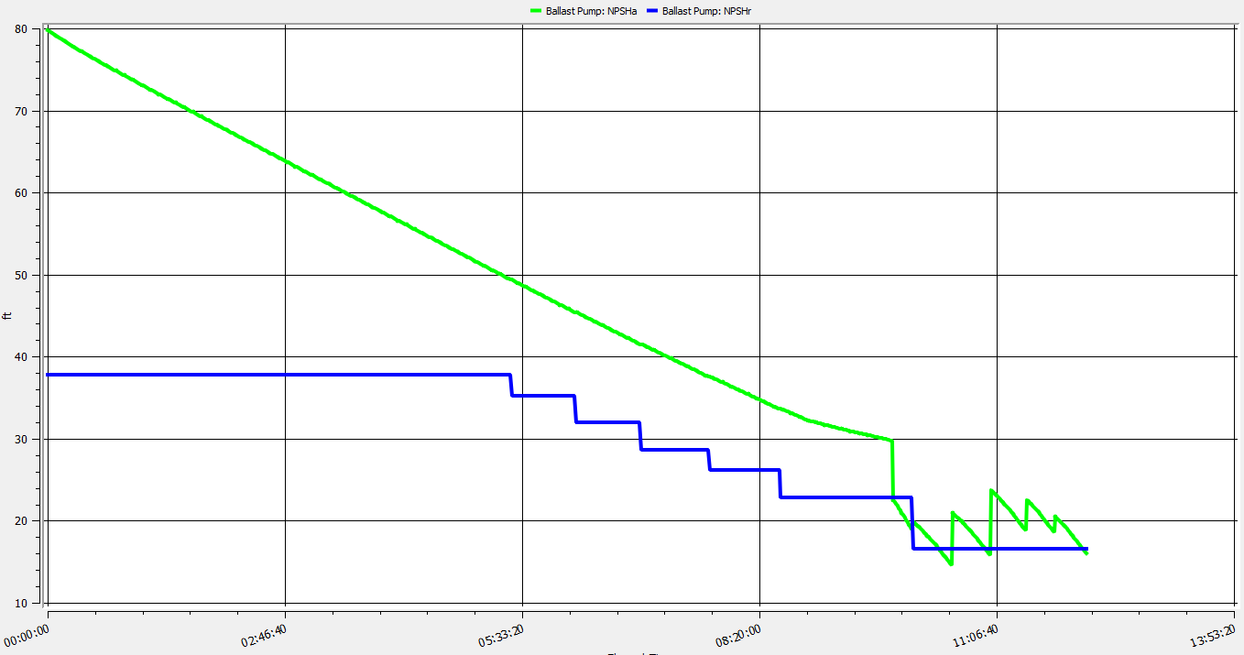
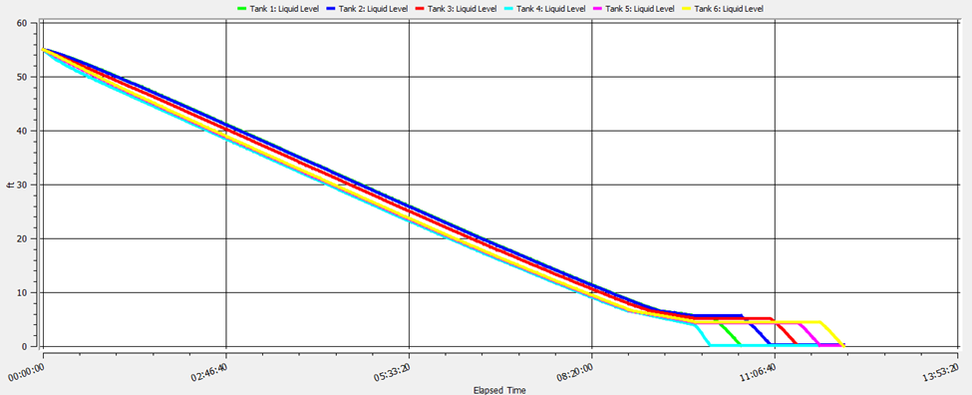
Option A
12:10 of total pumping time

Slide 9
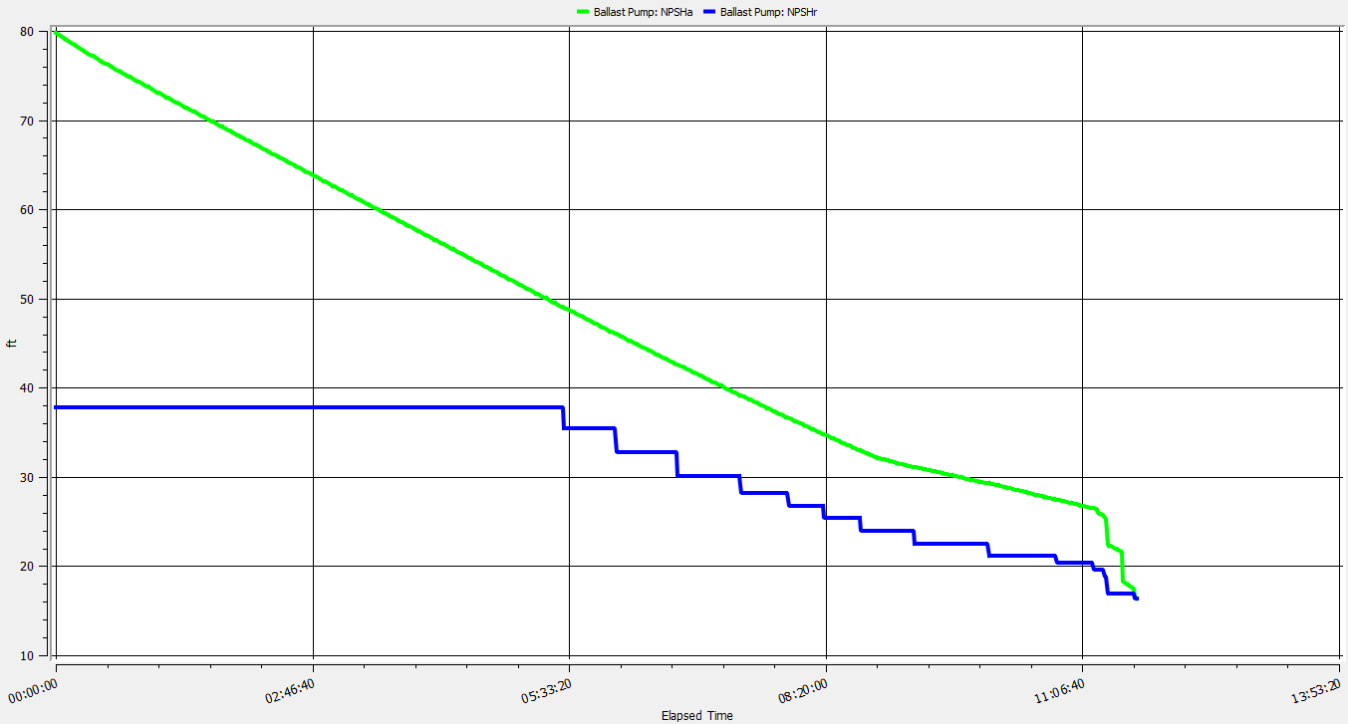
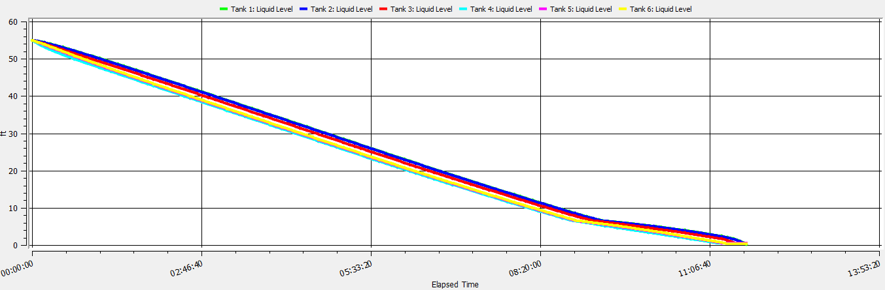
Option B
11:41 of total pumping time
Least possible cavitation

Slide 10
Simulation

Slide 11
Thank You
Questions?

