Slide 1
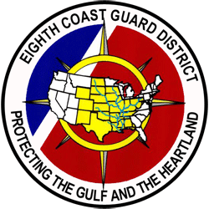
Eighth Coast Guard District
Commercial Fishing Vessel Safety Program Coordinator’s
FY-2019 Report

Slide 2
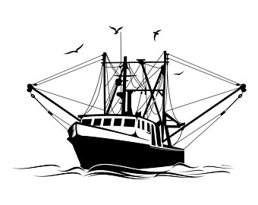
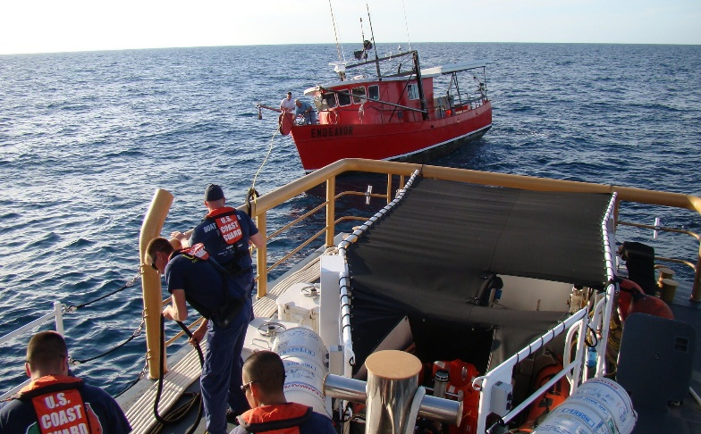
FY-19 CFVS Coordinator’s Report (D8)
CFV Losses FY19: 14
CFV Fatalities FY19: 8
CFV Injuries FY19: 6
CFV Population (State/Doc): 9,441 / 4,319
Dockside Exams: 889
Eighth Coast Guard District
Commercial Fishing Vessel Safety Program

Slide 3
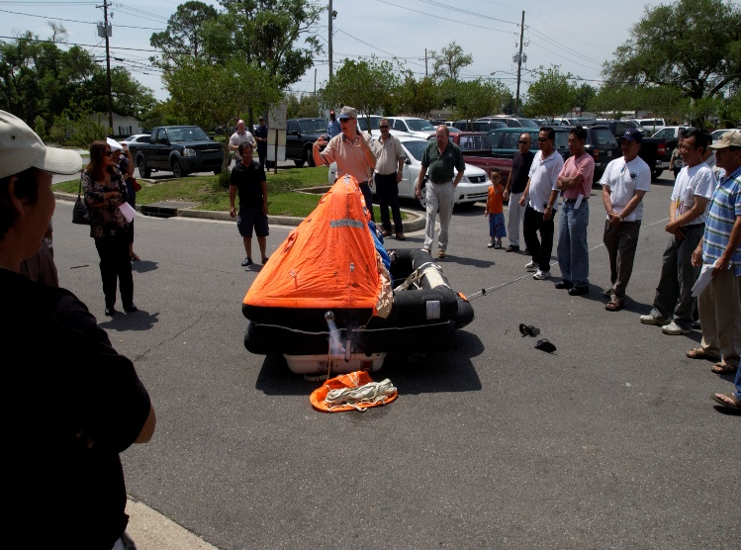
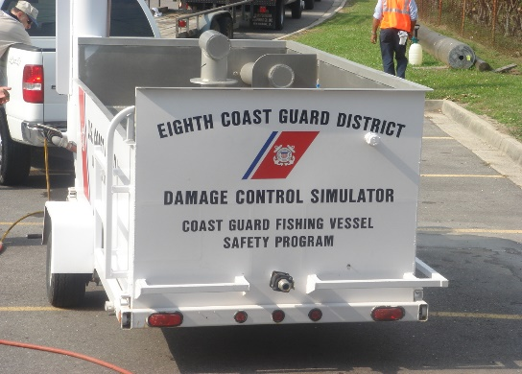
FY-19 CFVS Coordinator’s Report (D8) con’t
Outreach Initiatives:
Actively participate with GSMFC and GMFMC to communicate with industry and sharing lessons learned concerning our CFVS Program(s).
Partner with Sea Grant and Gulf Area Universities in conducting CFVS Studies on Life Saving Equipment.
Team with Gulf Area Spanish and Vietnamese Communities to enhance communication of CFVS best practices and translation services in the event of at sea emergencies.

Slide 4
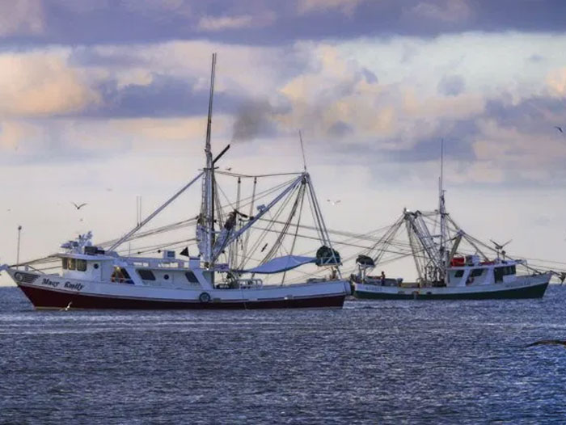
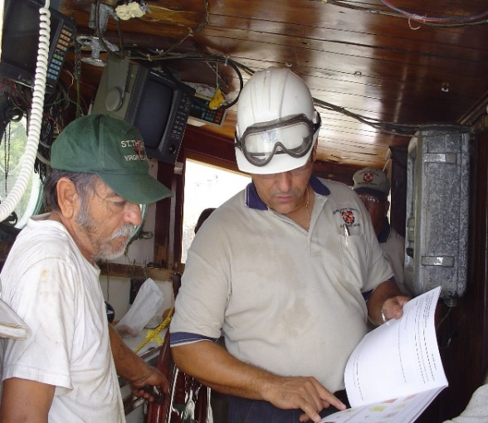
FY-19 CFVS Coordinator’s Report (D8) con’t
Priorities:
Aggressively seek CFVS Examination opportunities to educate industry on best safety practices and ensure compliance with all applicable CFVS Regulations.
Reduce/eliminate preventable CFV casualties, injuries and deaths within the fishing community through outreach and partnerships to enhance safety culture.
Improve Database entry for all related CFVS Activities to better assess strengths or gaps/shortfalls and appropriately address identified shortcomings with training, outreach and partnerships.

Slide 5
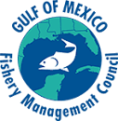
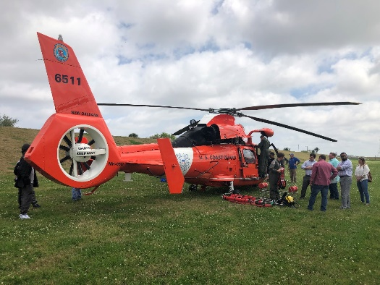
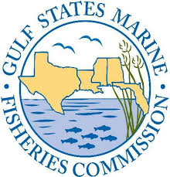
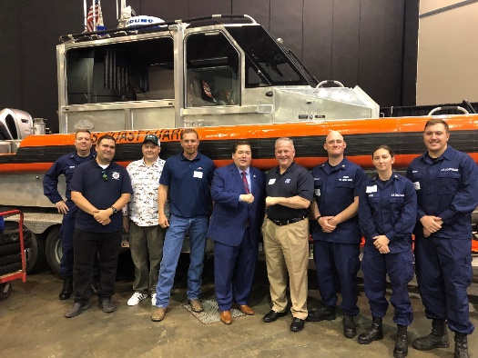
FY-19 CFVS Coordinator’s Report (D8) con’t
Sponsoring Fishing Industry Expos
Active Participants at the Gulf of Mexico Fisheries Management Council Meetings.
Participation with CFV Industry to share the importance of CFVS at Louisiana Marine Expo.
Excellent opportunity for Fishers to also share perspectives with attending participants as well as Louisiana’s Lt. Governor
Active partners with the Gulf States Marine Fisheries Commission.

