Slide 1
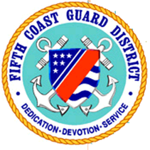
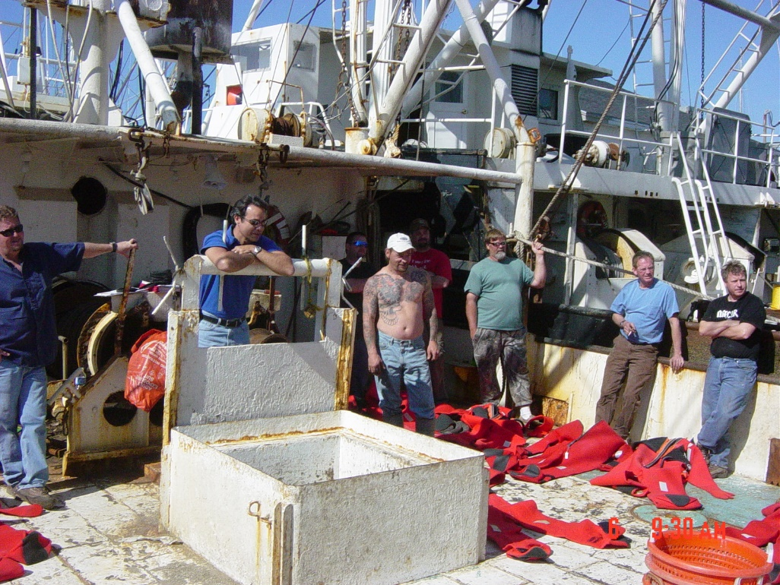
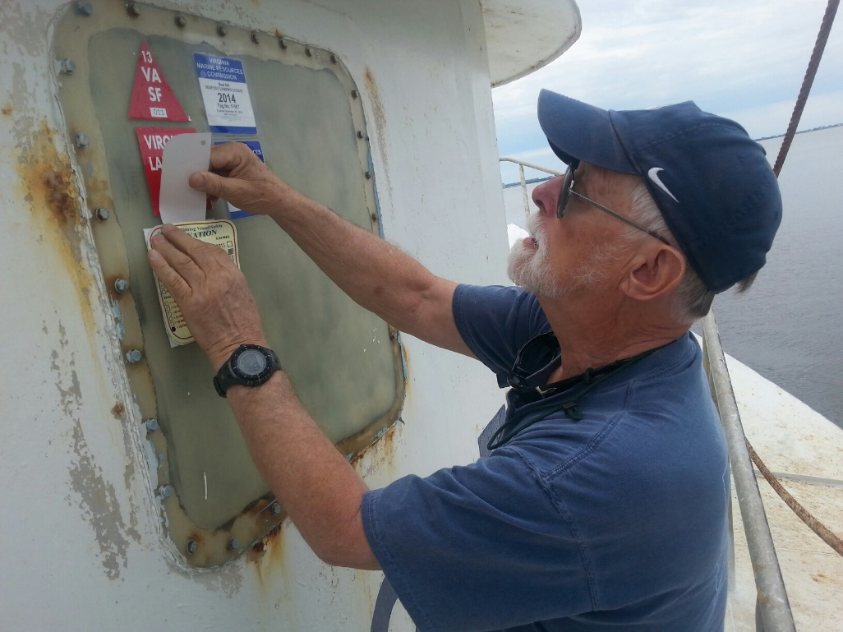
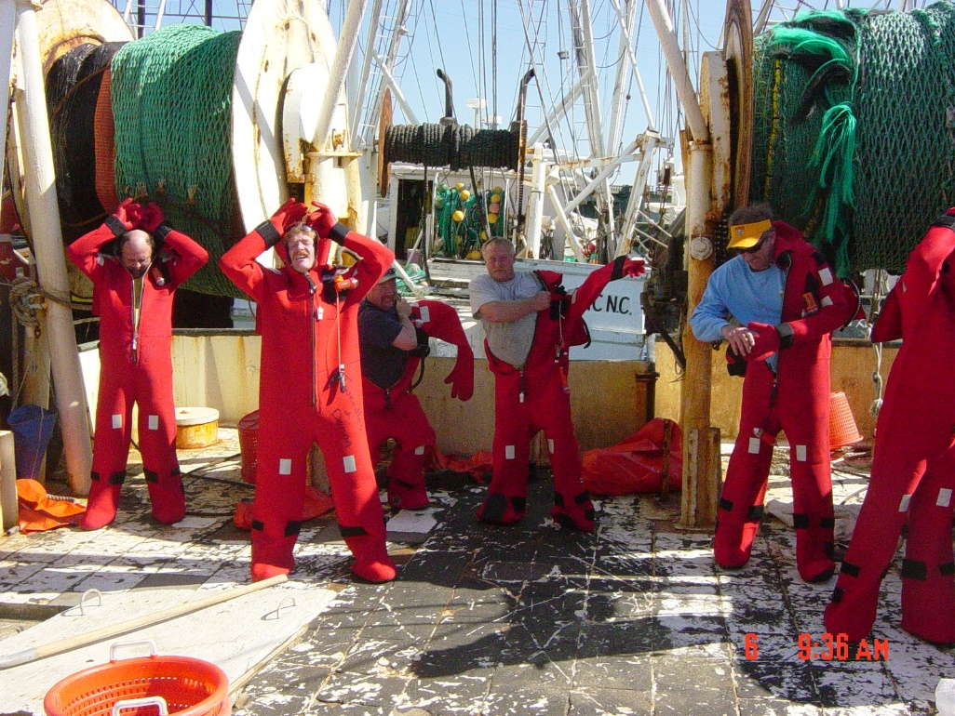
Fifth District Coordinator Report

Slide 2
Fifth District Coordinator Report
CFV Losses - 4
CFV Fatalities - 5
CFV Injuries - 2
CFV Population Within District (State/Documented) – 5,192
Dockside Exams Completed - 261
Outreach Initiatives:
Leveraging CG External Affairs to augment commercial fishing vessel community outreach
New recruitment and training of CG Auxiliary personnel
District Priorities:
Locating and examining CVC identified at-risk commercial fishing vessels
Enhancing CG Boarding Officer competency/effectiveness through annual Examiner led training
Conducting Port Access Route Study to evaluate impact of offshore renewable energy on the safe navigation of commercial fishing vessels and other waterways users
District Sponsored Fishing Industry Expos, Forums, and Meetings:
Mid Atlantic Fishery Management Council meetings
Ocean City Waterman’s Aquamarine Expo

Slide 3
Fifth District Coordinator Report

