Slide 1

Introduction to
The Maritime Transportation Security Act (MTSA) and
The International Ship and Port Facility Security Code (ISPS)

Slide 2
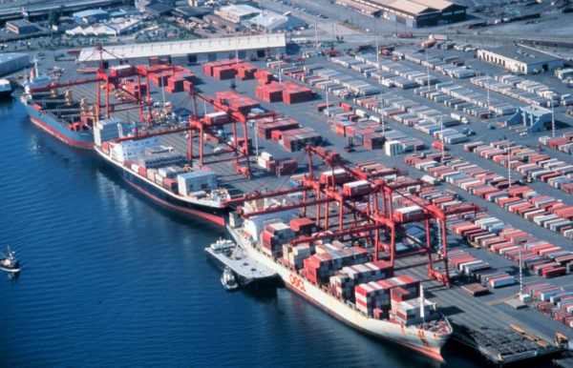
Maritime Transportation Security Act (MTSA)
MTSA is major legislation that changed the security culture of the maritime community
MTSA aligns with ISPS
It impacted
    361 ports
    3,200 facilities
    11,000 U.S. vessels
Protects the U.S. maritime industry and commerce
Notes:
MTSA was a significant piece of legislation. It changed the security culture of the entire maritime community, both domestically and internationally.
It was signed into law November 25, 2002. About two weeks later on December 12, 2002 the International Ship and Port Facility Security Code (ISPS) was adopted by the Conference of Contracting Governments to SOLAS. At that time there were about 102 countries that were signatories. MTSA became effective July 31, 2004 and the ISPS Code July 1 of the same year. (Currently about 159 states are signatories of the ISPS Code)
MTSA regulations impacted 361 ports, 3,200 facilities and 11,000 vessels in the U.S.
MTSA’s goal is to protect US ports & waterways from acts of terrorism – but it also takes into account all security issues, including piracy.
Key industry players participated in the development of MTSA such as The American Waterways Operators, the International Chamber of Shipping, the International Council of Cruise Lines, and labor organizations.
Why is it so important to protect our ports? Because the US is the most active trading nation in the world accounting for 1 billion metric tons or nearly 20% of the world’s annual ocean-borne trade.
Our maritime environment is vulnerable, even a small incident could have a large economic impact.

Slide 3
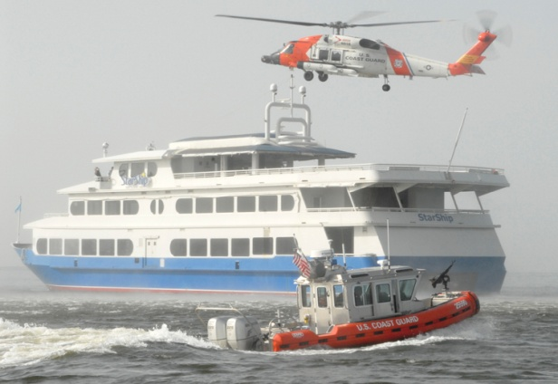
MTSA’s Goal
Preventing Transportation Security Incidents (TSI)
  Loss of Life
  Environmental Damage
  Transportation System Disruption
  Economic Disruption to a Particular Area
Notes:
MTSA was enacted to prevent a Maritime Transportation Security Incident (TSI) and is defined as any incident that falls within the 4 categories listed on the slide.
In the maritime domain, preventing incidents has been a core mission of the CG for a long time. MTSA emphasized the Coast Guard’s security-specific mission and gave it broad authorities for MTSA implementation in the maritime arena.
While the CG is uniquely positioned to carry out those responsibilities, no one agency can do it all.
Maritime security is an all-hands evolution requiring coordination and partnerships. The Coast Guard initiated productive, collaborative relationships among Federal, state and local agencies as well as with maritime industry to develop the security culture that provides appropriate protection yet facilitates commerce.
Finally, MTSA cannot be successful unless it meshes with International Ship and Port Facility Security Code (ISPS) because trading vessels sail to ports all over the world.

Slide 4
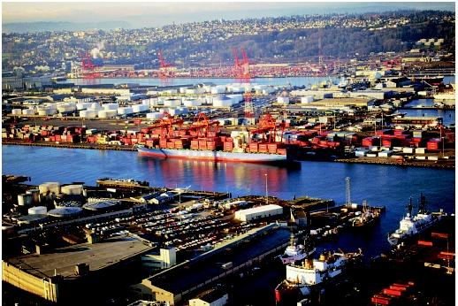
Security and the Free Flow of Commerce
Preventing Transportation Security Incidents (TSI)
  Loss of life
  Environmental Damage
  Transportation System Disruption
  Economic Disruption to a particular area
Notes:
In 2011 the US had a total of $4.8 trillion dollars in imports & exports of goods and services. Ports are transfer hubs for this trade.
There is such diversity among ports – not just whether they are small or large but the types of activities that occur there. The same is true of vessels – they run the gamut.
The Coast Guard must also take other waterfront dependent activities & structures into consideration, which have their own challenges. To name a few:
Parks and marinas
Recreational boating
Other commercial vessels (passenger and fishing)
Residential areas
Tourist attractions
Railroads
Bridges
Tunnels
The Coast Guard must apply the regulations in such a way as to maintain an appropriate balance between security and the facilitation of commerce.

Slide 5
Major Components of MTSA
  Maritime Security General – 33 CFR 101
  Area Maritime Security – 33 CFR 103
  Vessel Security Plans (VSP) – 33 CFR 104
  Facility Security Plans (FSP) – 33 CFR 105
  OCS Facility Plans (OCS) – 33 CFR 106
Notes:
Listed on the slide are the parts of the Maritime Transportation Security Act.
The cornerstone of MTSA is the security plan and contained in MTSA is guidance for vessels, facilities and OCS facilities.
33 CFR 101 – Maritime Security: General - has definitions, discusses alternatives and equivalencies, MARSEC levels & MARSEC Directives, and introduces TWIC.
33 CFR 103 – Maritime Security: Area Maritime Security - is necessary to comply with ISPS Code – it contains all Area Maritime Security (AMS) information.
33 CFR 104 - Maritime Security: Vessels - covers security requirements for vessels.
33 CFR 105 – Maritime Security: Facilities - covers security requirements for facilities.
33 CFR 106 – Marine Security: Outer Continental Shelf (OCS) Facilities - covers security requirements for offshore facilities.

Slide 6
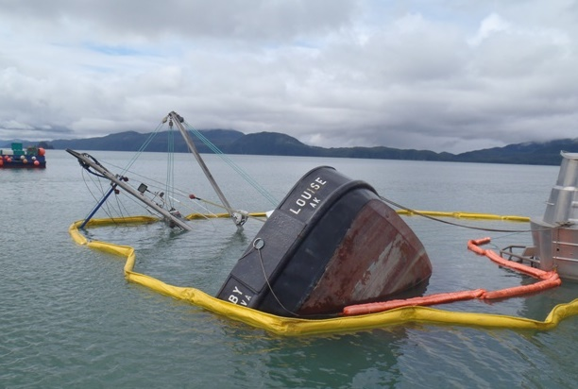
Security Plans and Risk-Based Decision Making
  Security Assessments includes:
    Critical Assets/Infrastructure info
    Types of Attacks
    Likelihood of Occurring
    Consequences
    Mitigation
Notes:
We are all involved in risk assessment every day – before stepping off a curb we assess the “risk” of crossing the street.
Risk can loosely be defined as being the chance, in quantifiable terms, of the occurrence of a security incident.
In order to mitigate risks – we have to know what they are. This is done by performing a security assessment.
A security assessment for a vessel/facility is a written document based on the collection of background information, an on-scene survey and an analysis of that information.
When a security assessment is conducted critical assets are identified.
The potential types of attacks that could occur need to be quantified along with the probability of an occurrence. Another factor to consider is: what are the consequences of an attack?
Once all of the pertinent info has been gathered and analyzed, a risk-based security plan can be created that mitigates the identified security risks.
Security assessments should be ongoing. Risks can change based on a number of factors.
The security requirements for the facility or vessel are based upon a facility or vessel specific security assessment.
A security plan CANNOT be effective without a GOOD security assessment. You must know your weaknesses in order to prepare and/or prevent them.

Slide 7
When is a Facility Security Plan Required?
33 CFR 105.105
Facilities subject to 33 CFR 126, 127, or 154
Facilities receiving commercial vessels certificated to carry more than 150 passengers
Facilities receiving commercial vessels subject to SOLAS
Facilities receiving cargo vessels greater than 100 gross register tons
Barge fleeting facilities receiving barges carrying cargoes in bulk regulated in 46 CFR
Notes:
MTSA regulated facilities must submit Facility Security Plans (FSP) to the appropriate Coast Guard Captain of the Port (COTP) and get approval before beginning operations.
MTSA regulated facilities that handle packaged and bulk solid dangerous cargo (126), liquefied natural gas (127) and bulk oil or other Hazmats in bulk (154) are applicable to MTSA.
MTSA regulated facilities that receive commercial passenger vessels certificated to carry more than 150 passengers – or passenger vessels that are over 100 gross tons. Facilities receiving passenger vessels that go on international voyages must also operate under an approves FSP. There are a number of small passenger vessels that operate in the Caribbean that have SOLAS documents even though there passenger capacity is very low.
MTSA regulated cargo facilities must submit an FSP – based on the size of the cargo vessel and whether or not they receive foreign flagged vessels. And, some barge fleeting facilities.
Some facilities not applicable to 33 CFR 105 include isolated facilities with no road access; U.S. owned and/or operated facilities used primarily for military purposes; some shipyards, some facilities engaged solely in the support of exploration, development, or production of oil and natural gas; and Public Access Facilities (33 CFR 105.110).
What is SOLAS? - International Convention for the Safety of Life at Sea (SOLAS), 1974: The main objective of the SOLAS Convention is to specify minimum standards for the construction, equipment and operation of ships, compatible with their safety. Flag States are responsible for ensuring that ships under their flag comply with its requirements, and a number of certificates are prescribed in the Convention as proof that this has been done. Control provisions also allow Contracting Governments to inspect ships of other Contracting States if there are clear grounds for believing that the ship and its equipment do not substantially comply with the requirements of the Convention - this procedure is known as port State control.

Slide 8
When is a Vessel Security Plan Required?
33 CFR 104.105
Cargo vessels, both domestic and foreign, weighing more than 100 gross register tons
Passenger vessels certificated to carry more than 150 passengers
Passenger vessels weighing more than 100 gross register tons
Vessels subject to SOLAS
Barges carrying certain dangerous cargos
Mobile Offshore Drilling Units
Notes:
MTSA regulated vessel owners/operators must submit a Vessel Security Plan (VSP) to the Coast Guard Marine Safety Center for approval.
Exemptions include towing vessels that shift barges within a fleeting facility; and, warships or other vessels owned or operated by a Federal government and used only on government non-commercial service.

Slide 9
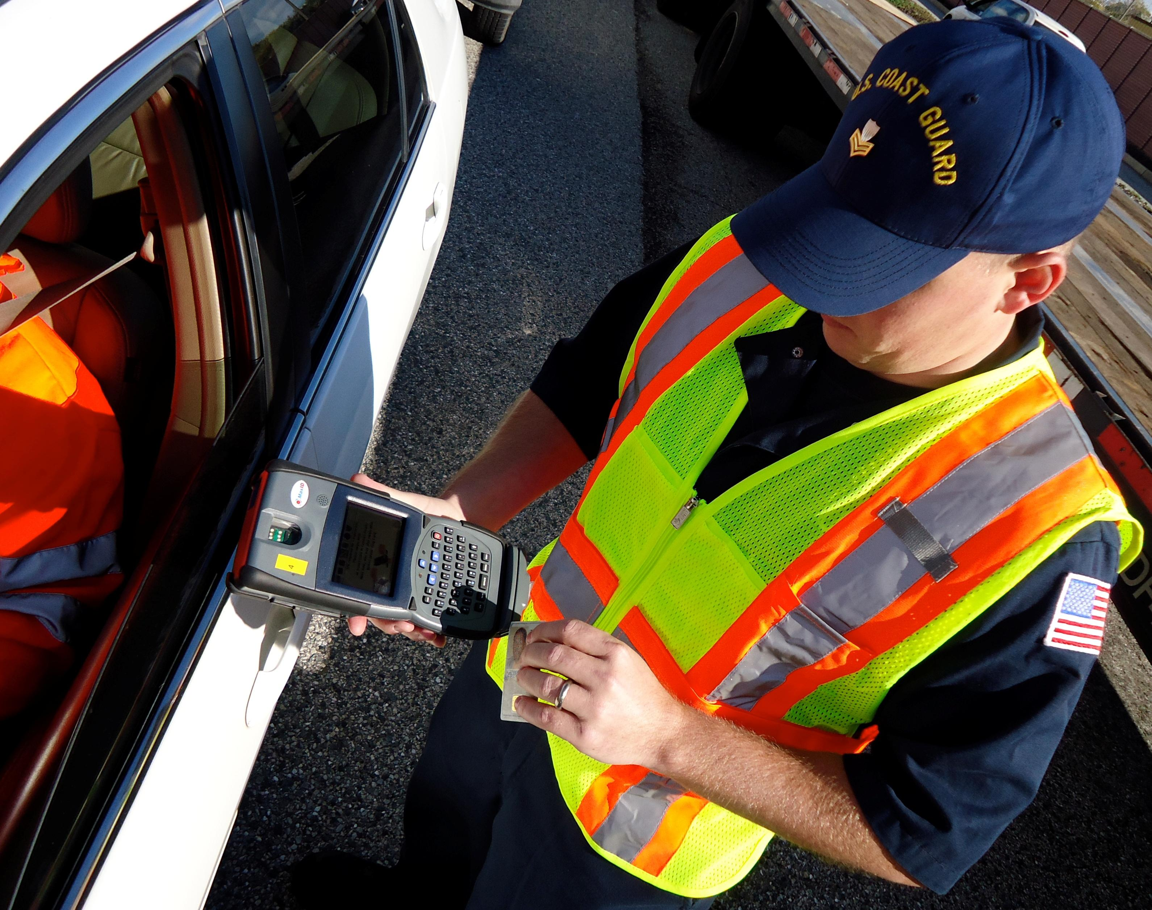
The MTSA Security Plan
Security Plans contain two different types of Information: administrative and sensitive:
Administrative sections include:
  Responsibilities and duties of CSOs, FSOs, VSOs
  Training requirements for all
  TWIC requirements
  Drill & exercise requirements
  Recordkeeping requirements*
  Maintenance of security equipment &
  means of communications
  Declaration of Security (DoS)*
  Requirements for audits & amendments
Notes:
Security Plans are the cornerstone of vessel, facility and port security. Access control is likely the most important element. If you keep unauthorized persons from gaining entry – many possible security issues are eliminated.
Security Plans contain measures designed to mitigate vulnerabilities, but they are more than that and require additional information in order to be compliant with MTSA.
As the slide states some of the contents are administrative – a list of training requirements and responsibilities for security officers and personnel; what is necessary in performing drills and exercises; what records must the vessel/facility keep for CG examination; and how owners/operators submit changes to their security plan.
These sections could actually be copied straight from the regulation and pasted directly into a security plan. However, the items marked with a red asterisk may contain SSI after they are filled out. i.e., Records of incidents and breaches of security must be kept– very probable for containing SSI. And, the Declaration of Security (DoS) spells out specific security duties to be performed by the vessel and the facility during interface.

Slide 10
The MTSA Security Plan (continued)
Sensitive Security Information (SSI) sections include:
  Security measures for access control
  Security measures for restricted areas
  Security measures for handling cargo
  Security measures for stores & bunkers
  Security incident procedures*
  Security measures for monitoring
Sensitive Security Information
WARNING: This record contains Sensitive Security
Information that is controlled under 49 CFR parts 15
And 1520. No part of this record may be disclosed tto
Persons without a need to know, as defined in 49 CFR
[arts 15 and 1520 except with the written permission of
The Administrator of the Transportation.
Notes:
Sensitive security information is governed by 49 CFR 1520.
SSI is information obtained or developed in the conduct of security activities, including research and development, the disclosure of which would 1) constitute an unwarranted invasion of privacy, 2) reveal trade secrets or privileged or confidential information obtained from any person, or 3) be detrimental to transportation security.
The sections listed above, if revealed to a nefarious person could result in a breach of security – or worse.
Security incident procedures may or may not be SSI. Some security plans simply copy this section – others have specific security measures for various security incidents: i.e., unauthorized person gains access, bomb threat, etc.
Access control is THE cornerstone of a security plan. The Transportation Worker Identification Credential (TWIC) is key component of access control.

Slide 11
The MTSA Security Plan (continued)
VSPs of vessels that go on international voyages must also address:
Ship Security Alert System (SSAS)
Procedures when interfacing with a port of a non-contracting government.
Interfacing with a vessel from a non-contracting government.
Procedures covering the implementation of a Declaration of Security (DoS).
Notes:
Since the United States is a signatory nation to SOLAS, our vessels and facilities must comply with the ISPS Code.
Vessels that go on international voyages must have installed a Ship Security Alert systems. An SSAS is used when the vessel is in complete distress; perhaps it has been boarded by pirates. This signal alerts the vessel’s next port of call – there is a problem and this vessel should be thoroughly investigated before allowing it into port.
Not all governments follow the requirements of the ISPS Code. U.S. vessels that interface with ports/vessels of those countries must included in their VSP security measures to be implemented during the period of the interface.
Contracting governments determine when a Declaration of Security (DoS) is required by assessing the risk of the ship/port interface (or ship/ship). ISPS Chapter XI-2 Part A.5 covers the use of DoS documents. Although U.S. vessels operating in domestic territory must, under certain circumstance, agree to a DoS with the facility, ISPS Code requires that vessels and facilities be prepared to implement a DoS should they be asked to do so.

Slide 12
Facility Security Officer & Vessel Security Officer
  Facility Security Officer (FSO) – The person designated as responsible for the development, implementation, revision and maintenance of the Facility Security Plan and for liaison with the Coast Guard COTP and Company and Vessel Security Officers.
  Vessel Security Officer (VSO) – The person onboard the vessel, accountable to the Master, designated by the company as responsible for security of the vessel, including implementation and maintenance of the Vessel Security Plan, and for liaison with the FSO and the vessel’s Company Security Officer.
Notes:
FSOs and VSOs assign all security duties as appropriate.
All personnel working on a MTSA regulated facility or vessel should know who are their applicable FSOs and VSOs. These individuals are key to the application of security measures designed to protect the facility or vessel, their cargos and persons onboard the facility or vessel.
Security is no accident, it’s everyone’s job! All personnel working on a MTSA regulated facility or vessel should cooperate fully with the applicable FSOs and VSOs and know and understand all security procedures. The vigilance of all personnel has kept our nation’s ports and waterways safe and secure.

Slide 13
Alternative Security Programs (ASP)
ASPs are a third party or industry organization- developed standard that the Commandant has determined provides an equivalent level of security to that established by MTSA.
They are security PROGRAMS – not security plans.
Why have them?
  ASPs allow members of like organizations to address MTSA requirements in ways unique to their operations.
Notes:
The Maritime Transportation Security Act (MTSA) defines an Alternative Security Program as: a third-party or industry organization-developed standard that the Commandant has determined provides an equivalent level of security to that established by parts 104 and 105 of Title 33 of the Code of Federal Regulations (33 CFR parts 104/105)
ASPs were offered as a means of addressing the intent of MTSA as appropriate for a specific industry segment. ASPs are written to address a group of owner/operators based on a BUSINESS MODEL. Thus, a security standard for the small passenger industry will be different from the industry standard for chemical ships, simply based on the difference in their respective vulnerabilities and the associated consequence of a transportation security incident.
ASPs allow end-users to implement an existing security program – as an alternative to creating an individual facility or vessel-specific security plan.
As the slide mentions, ASPs allow members of sponsoring organizations to address MTSA requirements in ways unique to their operations. Gaming vessels that are members of the American Gaming Association do not check IDs because they take photographs of all who enter. Commandant agreed this was equivalent to checking identification.
Vessels/facilities may choose to become members of an organization and implement the organization’s ASP rather than create an individual Vessel Security Plan (VSP) or Facility Security Plan (FSP). However, since not all vessels or facilities have the exact same level of risk – an individual vessel/facility-specific security assessment must be conducted.
ASPs lessen the numbers of security plans that must be reviewed and approved by the Coast Guard. They also allow member companies to utilize a program already approved by the Coast Guard.
Guidance
33 CFR 101.120(b)
Compliance Verification Policy Letter 11-04
Homeport ASP Community

Slide 14
10
Alternative Security Programs ASP)
(continued)
What must facilities do to use an ASP?
  A facility or vessel wishing to implement an ASP must be “appropriate” to the organization and be a member in good standing.
What if an ASP is fully implemented and there are deficiencies?
  The COTP must send a letter to HQ for determination of the need for an amendment. If an amendments is needed HQ will contact the parent organization and make this request.
Notes:
A facility or vessel wishing to implement an ASP must be “appropriate” to the organization and be a member in good standing. The word ‘appropriate’ means – they must fit the business model. (A passenger vessel could not use the American Waterways Operators (AWO) ASP because it is designed for tugs & barges.)
Since all facilities and vessels have differing levels of risk, operators must conduct a vessel/facility specific security assessment.
Vessels must submit a letter to the Coast Guard Marine Safety Center (MSC) stating their intent to use a specific ASP and that it has been fully implemented.
Facilities must submit this letter to the appropriate COTP along with an Facility Security Assessment report and a completed Facility Vulnerability and Security Measures Summary (Coast Guard form 6025) – listing all vulnerabilities found during the security assessment and how they are to be addressed.
If amendments are needed to the ASP, they must be submitted to the Coast Guard Commandant by the sponsoring organization. Individual users may not alter the security program. Once the amended program is approved it is implemented by all members of the organization.

Slide 15
10
Alternative Security Programs (ASP)
(continued)
ASP Guiding Rules:
  Alternative Security Programs are not Vessel Security Plans or Facility Security Plans, they are Security Programs.
  Alternative Security Programs will not “mirror” the regulations. Most VSPs and FSPs do.
  If deficiencies exist and the ASP has been FULLY implemented, the facility or vessels may not be penalized. HQ should be contacted via the appropriate COTP.
  ASP approvals DO NOT EXPIRE for the end user.
Notes:
A facility or vessel wishing to implement an ASP must be “appropriate” to the business model and be a member in good standing of the organization.
Since all facilities and vessels have differing levels of risk, operators must conduct a vessel/facility specific security assessment.
Vessels must submit a letter to the Coast Guard Marine Safety Center (MSC) stating their intent to use a specific ASP.
Facilities must submit this letter to the appropriate Coast Guard COTP along with an FSA report and a completed Facility Vulnerability and Security Measures Summary (Coast Guard form 6025) .

Slide 16

Differences Between MTSA & ISPS Code
    Vessel Size
    Vessel Type
    Declarations of Security (DoS)
    Definition of Facility
    Ship Security Alert System (SSAS)
Notes:
Both ISPS Code and MTSA are designed to promote maritime security but there are a few differences
ISPS Code applicability extends to passenger ships, cargo ships of 500 gross tons or more that engage in international travel, and offshore drilling units.
MTSA applies to any fixed or floating mobile offshore drilling unit, passenger vessels that carry more than 150 passengers, cargo vessels weighing greater than 100 GT, most vessels that engage on international voyages, tank ships and towing vessels. MTSA also covers barges that carry regulated and certain dangerous cargos. Foreign vessels that have onboard a valid ISSC are deemed to be fully compliant with MTSA. Foreign flagged cargo vessels greater than 100 GT but less than 500 GT that wish to do business with the US, may submit a security plan to the CG for approval.
MTSA requires that regulated vessels and facilities agree upon and sign a Declaration of Security (DoS) before embarking or disembarking of passengers or beginning any cargo handling activities. The DoS assures that all security needs are properly addressed during the time of the interface between vessel & facility. ISPS Code directs vessels & port facilities to be prepared to engage in a DoS if asked or if determined to be necessary by the contracting government.
MTSA defines facility as “any structure of any kind located in, on, under, or adjacent to any waters subject to the jurisdiction of the US . . .” A facility is a single building, a single unit. ISPS does not refer to a single building or unit – the term in ISPS is “Port facility.” MTSA uses the term Facility Security Officer. ISPS Code uses the term Port Facility Security Officer. Basically the U.S. looks at a facility as a single unit within a port, ISPS Code refers to the entire port. ISPS Code does not use the word “facility,” ISPS uses the term Port Facility and Port Facility Security Plan and Port Facility Security Officer. Because of this difference MTSA includes 33 CFR 103 – Area Maritime Security.
SSAS or equivalency for small passenger vessels with SOLAS documents.

Slide 17
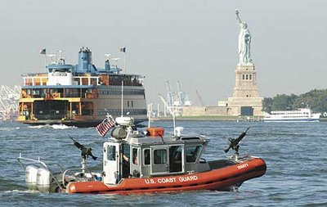
Area Maritime Security (33 CFR 103)
Basic requirements of Area Maritime Security
  Federal Maritime Security Coordinator
  Area Maritime Security Committee
  Area Maritime Security Assessment
  Area Maritime Security Plan
Notes:
Because of the difference in the definition of “facility” US ports must implement Area Maritime Security (AMS) in order to be compliant with ISPS Code.
A major component of the AMS is the Coast Guard Captain of the Port who is also Federal Maritime Security Coordinator (FMSC). All ports located within the COTP’s area of responsibility must adhere to the rules of AMS as described in MTSA. The COTP appoints members and directs the AMS Committee (AMSC). Along with the AMSC, the FMSC / COTP develops, implements the AMS Plan and maintains all necessary records.

Slide 18



Layered Security
Foreign Ports,
Facilities &
Territorial Seas
International Actions
IPSP Country Visits &
Container Security Initiative
Offshore Actions
Surveillance, Tracking
& Interdiction
International
Waters
U.S. Exclusive
Economic
Zone (200 NM)
U.S. & Foreign Vessels
(MTSA & ISPS Enforcement)
Coastal Actions
Interdiction & Boardings
U.S. Contiguous
Zone (24 NM)
Comprehensive Suite of Enabling Authorities
U.S. Territorial
Sea (12 NM)
Internal Waters / Port Actions
- COTP Authorities
- AMS Committees & Plans
- Federal, State and Local
Partnerships
- MTSA Enforcement
- Boardings, Escorts, &
maritime CIKR Visits
Sector
U.S. Internal
Waters,
Ports & Maritime
Critical
Infrastructure
Notes:
The term “layered security” refers to the full suite of actions taken by government and the private sector to promote maritime security.
In U.S. ports, the Captain of the Port, as Federal Maritime Security Coordinator, directs Area Maritime Security (AMS) efforts to:
Develop maritime security partnerships
Address local maritime security issues
Assist in the development, review, and update of the Area Maritime Security Plan for areas of responsibility.
There are 43 AMS Committees (AMSC). Some sectors have more than one, and many AMSCs are broken into specialized sub-committee AMSCs, e.g., Port Security Grant Program, TWIC.
The AMS Committee is composed of no fewer than seven members but may have more members. They may be selected from Federal, state government, local public safety personnel, law enforcement, emergency response agencies, maritime industry or any port stakeholders affected by security practices and policies. At least 7 of the members must have 5 or more years of experience related to maritime or port security operations. Members serve for 5 years, they must have a background check & must maintain a TWIC. This Committee identifies critical port infrastructure and operations; identifies threats, determines mitigation strategies, continually reassesses overall port security. Members of this committee are responsible for disseminating security information, communicating threats and changes in MARSEC levels to port stakeholders. They provide advice to and assist the COTP in the development of the AMS Plan.
The AMS Plan is developed in much the same way as a vessel or facility security plan. A risk-based security assessment is conducted; vulnerabilities and their consequences are identified and described in a written report along with a description of risk reduction strategies. Based on the results of this security assessment an Area Maritime Security Plan is created. The AMS Plan must also include procedures to facilitate the recovery of the Marine Transportation System after a TSI.
The COTP and the AMSC coordinate and participate in exercises and all record keeping. Exercises are a comprehensive training event that involves several elements of the Area Maritime Security Plan.
Coast Guard and other agencies conduct patrols to deter, detect, and respond to security threats.

Slide 19
Maritime Security (MARSEC) Levels
33 CFR 101.200
ISPS Code 2.1.9 and US MTSA definitions are the same
MARSEC Level 1: minimum appropriate protective security measures
MARSEC Level 2: appropriate additional protective security measures
MARSEC Level 3: further specific protective security measures
United States has been at MARSEC 1 since 2009
Notes:
Maritime Security (MARSEC) Levels advise the maritime community of the level of risk to the maritime elements of the national transportation system. Ports, under the direction of the local COTP, will respond to changes in the MARSEC Level by implementing the measures specified in the AMS Plan. Similarly, vessels and facilities required to have security plans shall implement the measures specified in their approved security plans for the applicable MARSEC Level.
Unless otherwise directed, each port, vessel, and facility shall operate at MARSEC Level 1.
The Coast Guard Commandant sets the MARSEC Level consistent with the equivalent National Terrorism Advisory System (NTAS) Threat Condition and that Threat Condition’s scope of application. The Commandant retains the discretion to adjust the MARSEC Level when necessary to address security concerns related to the maritime elements of the national transportation system.
The COTP may temporarily raise the MARSEC Level for a port, a specific marine operation within the port, or a specific industry within the port to address exigent circumstances.
The MARSEC Level may be raised nationally for a particular industry or a particular cargo or, as stated above, for certain geographic areas.
The ISPS code has the same requirements for maritime security levels.

Slide 20
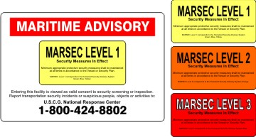
Maritime Security Levels (MARSEC)
MARSEC NTAS
1 Normal
2 Elevated
3 Imminent
Notes:
The first alert system designed and implemented by the U.S. Department of Homeland Security was called the Homeland Security Alert System (HSAS). After it had been in use for a while – lessons learned were used to create a new system for informing the public of possible terror events. It has been changed to the National Terrorism Advisory System (NTAS). HSAS had 5 security levels denoted by colors, the new NTAS has only three, more in line with the Maritime Security Levels.
The MARSEC Level can be raised without affecting the National Terrorism Advisory System.

Slide 21
Introduction to the
Transportation Worker
Identification Credential
(TWIC)

Slide 22
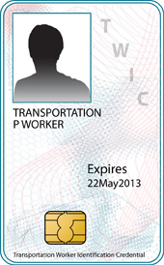
The Transportation Worker Identification Credential (TWIC)
TWIC is a common identification credential for all personnel requiring unescorted access to secure areas of MTSA regulated facilities and vessels.
Individuals who meet TWIC eligibility requirements will be issued a tamper-resistant credential containing the worker's biometric (fingerprint template) to allow for a positive link between the card and the individual.
Possession of a TWIC does not guarantee access. Person must have facility and/or vessel authorization to access regulated areas.
TWIC is a Transportation Security Administration (TSA) managed initiative.
Notes:
The Transportation Worker Identification Credential (or TWIC) program is a Transportation Security Administration and U.S. Coast Guard initiative in the United States. The TWIC program provides a tamper-resistant biometric credential to maritime workers requiring unescorted access to secure areas of port facilities, outer continental shelf facilities, and vessels regulated under the Maritime Transportation Security Act of 2002, or MTSA, and all U.S. Coast Guard credentialed merchant mariners. Those seeking unescorted access to secure areas aboard affected vessels & facilities, and all Coast Guard credentialed merchant mariners, must obtain a TWIC. The new measures were fully implemented on April 15, 2009. To obtain a TWIC, an individual must provide biographic and biometric information such as fingerprints, sit for a digital photograph and successfully pass a security threat assessment conducted by TSA
The issued card contains a computer chip, known as an Integrated Circuit Chip (ICC), which stores the holders information and biometric data. The chip can be read by inserting it into a reader or holding it near a "contactless" reader. There is also a magnetic strip (similar to a credit card) and a linear barcode on the back as alternative reading methods.
While TWIC will be implemented across other transportation modes, the TWIC Final Rule, published on January 25, 2007, sets forth regulatory requirements to implement this program in the maritime mode first.
The program's goals are:
Positively identify authorized individuals who require unescorted access to secure areas of the nation's maritime transportation system;
Determine the eligibility of an individual to be authorized unescorted access to secure areas of the maritime transportation system;
Enhance security by ensuring that unauthorized individuals are denied unescorted access to secure areas of the nation‘s maritime transportation system; and,
Identify individuals who fail to maintain their eligibility qualifications after being permitted unescorted access to secure areas of the nation's maritime transportation system and revoke the individual's permissions

Slide 23
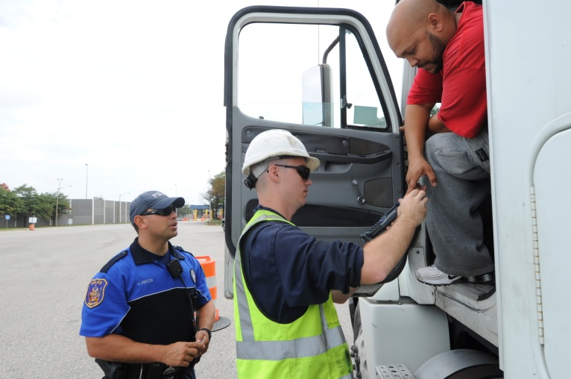
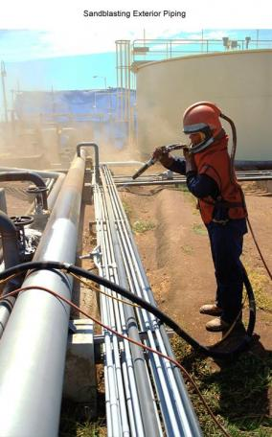

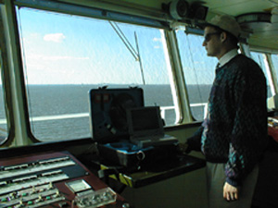
Who is Required to Have a TWIC?
All persons requiring unescorted access to MTSA regulated facilities and vessels. Examples include truck drivers, longshoreman, merchant mariners, contractors, etc.
Notes:
Anyone requiring unescorted access in a secure area within a facility or onboard a vessel must possess a valid TWIC. If an employee needs to access only non-secure areas (for example: employee access areas or public access areas) they would not need a TWIC.
Facility & vessel owners/operators are required to inform employees of their responsibility to possess a TWIC and describe what parts of the facility/vessel are secure areas.
Company, vessel and facility security officers and company, vessel and facility personnel responsible for security duties are required by regulation to obtain a TWIC.
Possession of a TWIC does not guarantee unescorted access to secure areas; permission must be granted by the vessel or facility owner/operator or the FSO/VSO.

Slide 24
How Do I Get a TWIC?
Eligibility Requirements:
An individual must be a U.S. citizen or fall into an eligible immigration category.
Applicants must not be convicted of certain disqualifying crimes and cannot be connected to terrorist activity or determined to lack mental capacity.
Applicants who are denied a TWIC will be sent a letter explaining the reason for denial with instructions on how to apply for an appeal or waiver.
Notes:
A lawful permanent resident and other non-U.S. citizens as per 49 CFR 1572.105
Any individual who is wanted for any crime, under indictment for one of the disqualifying felonies listed in 49 CFR 1572.103 or has been incarcerated for those disqualifying felonies within prescribed time periods will be disqualified from obtaining a TWIC.
Any individual who is identified as having a connection to terrorist activity is considered to be a security threat and will be denied a TWIC.
[Navigation and Vessel Inspection Circular (NVIC) 03-07]

Slide 25
How Do I Apply for a TWIC?
An individual may pre-enroll online or by calling 1-866-DHS-TWIC and schedule an appointment at a nearby TWIC Enrollment Center.
Visit the TWIC Enrollment Center with identification document, then complete the paperwork, have digital phone taken and undergo fingerprint collection.
TSA completes a background check and produced the TWIC. Once ready, the applicant picks up the TWIC at the Enrollment Center.
For more information:
https://twicprogram.tsa.dhs.gov/TWICWebApp/
Notes:
The enrollment process consists of 5 components: pre-enrollment (optional), enrollment, fee collection, security threat assessment & notification of the results and issuance of the TWIC to the applicant.
The time from enrollment to credential availability is expected to take approximately 30 days, not including potential appeal or waiver processing.
A visit to an enrollment center is required so the applicant can provide biometric information and a complete set of fingerprints.
TSA conducts a security threat assessment on all applicants consisting of: a fingerprint based criminal history records check; an intelligence-related check to identify potential ties to terrorism; and immigration status.
A list of enrollment centers may be found online.

Slide 26
Responsibilities
To promote security for everyone, the Coast Guard expects that anyone working on or visiting a MTSA regulated facility cooperate with the Facility Security Officer and established security procedures.
This includes:
  Reporting suspicious behavior
  Reporting safety and security hazards, such as damaged security equipment
Notes:
Security is everyone’s job. The Coast Guard expects that everyone who works on a MTSA regulated vessel or facility do their share by cooperating with established security procedures, reporting suspicious behavior, and helping to identify threats and vulnerabilities.
TWIC procedures are an important part of a vessel or facility’s security program. If you have questions about the program contact the vessel or facility security officer.
Promptly report suspicious behavior, dangerous substances or devices, or suspected damage to security equipment to facility or vessel security personnel.

Slide 27
Responsibilities (continued)
  Recognition of dangerous substances and devices
  Compliance with TWIC procedures
  Understanding that additional security measures may be necessary at times of increased MARSEC
  Familiarity with the portions of the Facility or Vessel Security Plan applicable to the individual’s normal job requirements

Slide 28
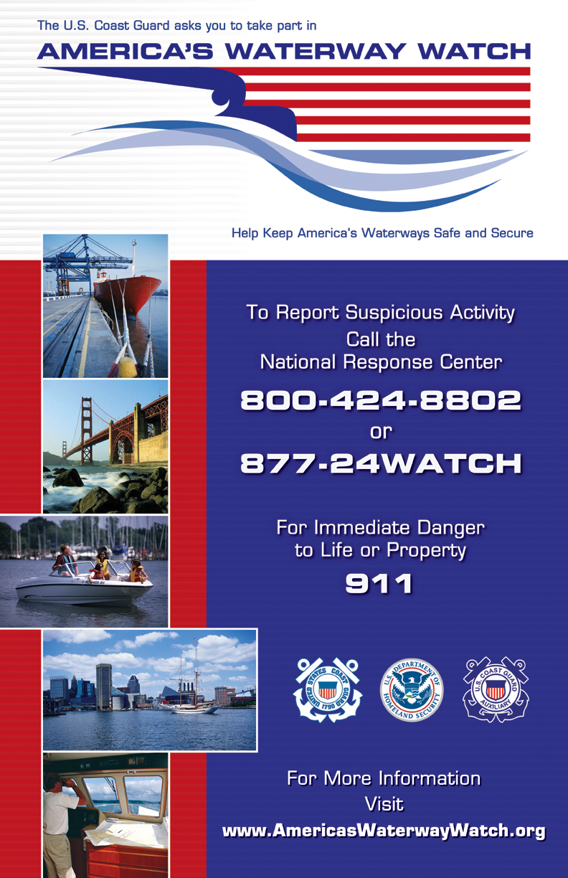
America’s Waterway Watch
With more than –
95,000 miles of shoreline
300,000 square miles of water*
Countless homes, businesses, bridges, terminals, and other critical infrastructure located near the water
Security is a job the U.S. Coast Guard
and local first responders can’t do alone.
*Source: National Oceanic and Atmospheric Administration,
National Ocean Service and CIA World Factbook
Notes:
America's Waterway Watch is a public outreach program encouraging participants to simply report suspicious activity to the Coast Guard and/or other law enforcement agencies. Unlike some Neighborhood Watch programs, for example, you are not formally joining an organization -- there are no meetings, membership cards or membership requirements -- and you do not become an agent of the Coast Guard or any other law enforcement agency.
If you are a tow boat operator, a recreational boater, a marina operator, or otherwise live, work or engage in recreational activity around America's waterways, the United States Coast Guard wants your help in keeping these areas safe and secure. You can do this by participating in its America's Waterway Watch (AWW) program, a nationwide initiative similar to the well known and successful Neighborhood Watch program that asks community members to report suspicious activities to local law enforcement agencies.
As a person who spends time on or near the water, you already know what is normal and what is not, and you are well suited to notice suspicious activities -- activities possibly indicating threats to our nation's homeland security. As participant in America's Waterway Watch, we urge you to adopt a heightened sense of awareness toward unusual events or individuals you may encounter in or around ports, docks, marinas, riversides, beaches, or waterfront communities.

Slide 29
What is America’s Waterway Watch?
A "force multiplier" for the Coast Guard and local law enforcement.
A national program that builds on many local and regional programs.
Targeted at people who live, work, or recreate on or near the water.

Slide 30
How is a Report Made?
America’s Waterway Watch Hotline:
(877) 24-WATCH
Report suspicious activity to local law enforcement.
Calls are received by the National Response Center (NRC), tasked with taking suspicious activity reports via phone, manned 24/7.
For more information visit http://aww.uscg.mil

Slide 31
Security is no accident,
it’s everyone’s job.
If you SEE something,
SAY something!
In Case of an Emergency
call 9-1-1
Notes:
The “See Something, Say Something Act of 2011” is a bill that amends the Homeland Security Act of 2002, which provides immunity for reports of suspected terrorist activity or suspicious behavior and response.

