Slide 1
S A R O P S
FY11/12 Plans
Robert Netsch, C3CEN 2/17/11
Notes:
This presentation is an overview of what is going on with SAROPS in the near and not so near term.

Slide 2
Organization Chart for C3CEN Command Center Product Line
Command Center Product Line : PL-C
CDR Ponseti
PL-C1 Integrated Systems
LCDR Lamont Bazemore
PL-C2: Viewers, Applications, & infrastructure
LCDR Derrek Burrus
PL-C3: Support & Implementation
LCDR Brad Cook
Watchkeeper
CGVTS
PAWSS
PCSS
COP (UCOP, C2PC,GCCS-J,CWSS, WEBCOP)
SAROPS
CCDS (Wall of Knowledge)

Slide 3
History
you can’t know where you’re going if you don’t know where you’ve been
CASP (70’s, 80’s, 90’s)
GDOC (90’s)
C2PC/SARTools (y2k thru 2007)
SAROPS (03 RCP, 1.0 fielded in 2007)
  1.0 (01/07, ArcGIS, SARTools, Sim/Planner, EDS..)
  & patches for (.sar xport, POS report, POS fix, TOC layer improvements)
  1.1 (03/08, ArcGIS 9.2, Grid auto recalc, sunrise/sunset, min track spacing, read only cases,
  summary report enhancements, EDS 1.1, SARSAT, SAP)
  1.2 (04/09, ArcGIS 9.3, River drift, Reverse drift, SO update, slippery shoreline, SARSAT fixes)
  1.3 (04/10, AMVER, PSDA, LOB Scenario, Anchoring Initial, Single SRU optimization, fav toolbar)
  _ 1.4 (04/11; R21 interface, Flare Scenario, Anchored SOs, Interactive Planner, Better Basemap)
SAROPS 2.0 (GIS Framework upgrade)
Notes:
“It’s a process…”
------------------------------------------------------------
CASP blazed the way for probabilistic modeling.
GDOC provided a then modern GUI with interactive map, CASP front end and automated manual solution.
C2PC/SARTools evolved GDOC capabilities (plus tracks) in a common and supportable framework.
SAROPS stepped up the simulation/optimization and moved into CJMTK (ArcGIS Desktop) framework…partly to align with R21 and to stay close to industry advancements.
In the 3 years since SAROPS rollout there has been a steady flow of improvements for usability, reliability, performance and features. This spiraling out of features has been in line with sponsor vision and priorities.

Slide 4
New
Basemap
Options
NOAA/River/CYC Charts
Topographic (ArcGIS Online)
Imagery Hybrid (Bing)
Aeronautic
User Configurable
Yes – Old School Grey Scale still available

Slide 5
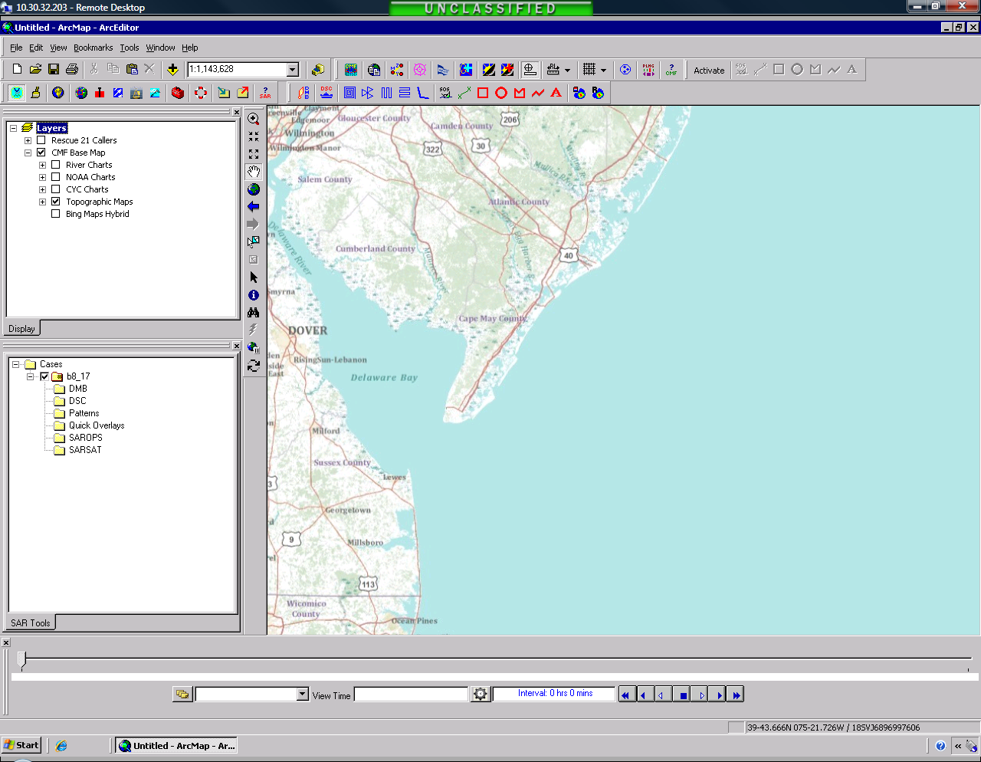
Notes:
Topo basemap option…pastel colors allow overlay graphics to stand out.
Note new layers in CMF Base Map…very convenient for user to pick what they want.

Slide 6
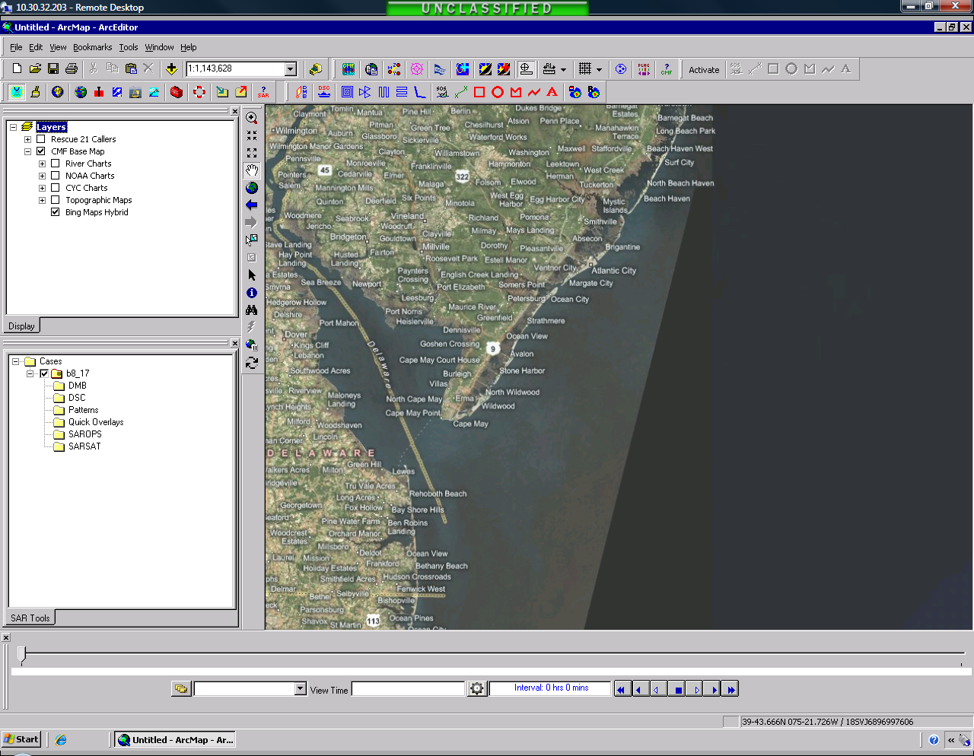
Notes:
Same extent with Bing Imagery

Slide 7
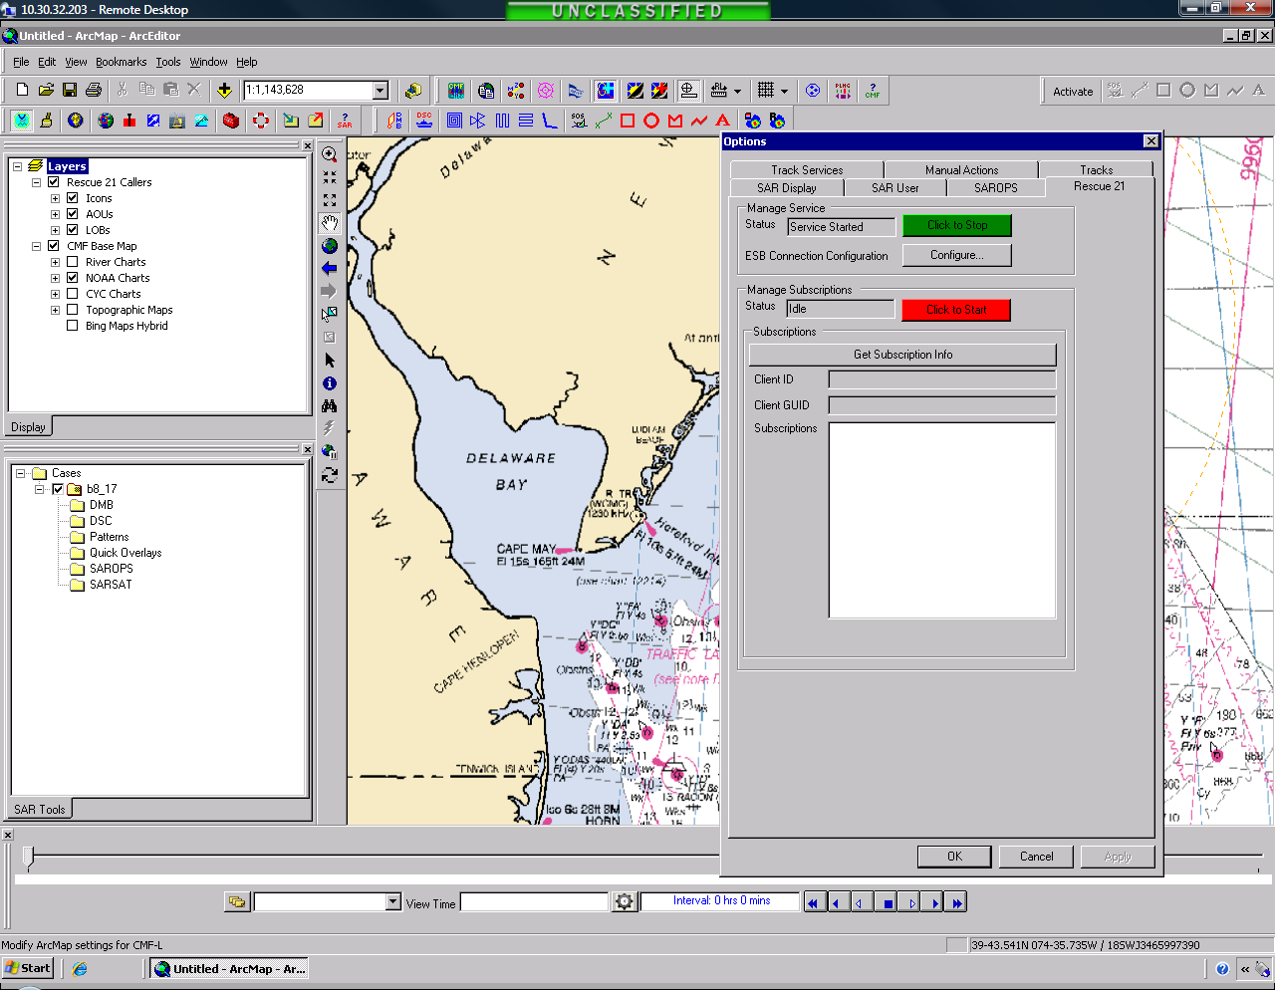
Notes:
And now with NOAA chart.
The dialog box shows the configuration setup are for the new R21 Interface.

Slide 8
R21
Select (user selected) LOB/Ellipse sent from R21 to SAROPS
Publisher/subscriber model executed over the ESB
LOB/Ellipse displayed on SAROPS as a layer
SAROPS allows LOB to inserted as a scenario in an open
or new case and used to define an LOB scenario
Yes, Audio is included too.
Notes:
R21 Interface summary
We are treating the R21 ellipse dimensions as the 95% containment contour. To be consistent with LKP and general SAR terminology, we probably should display the 50% (probable error) containment contour as a solid, filled ellipse and the three-times-probable-error (99%) containment contour as a dashed ellipse. Both values may be computed from the "95%" data we are being given by using simple equations.

Slide 9
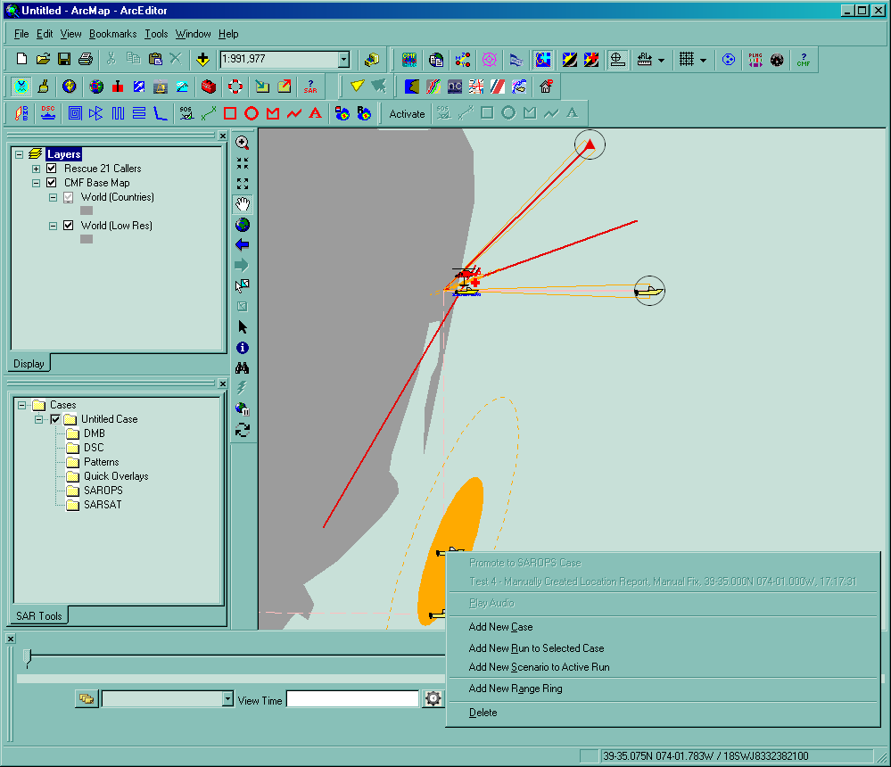
Notes:
Sample R21 graphic layer and how it can directly feed SAROPS drift scenarios.

Slide 10
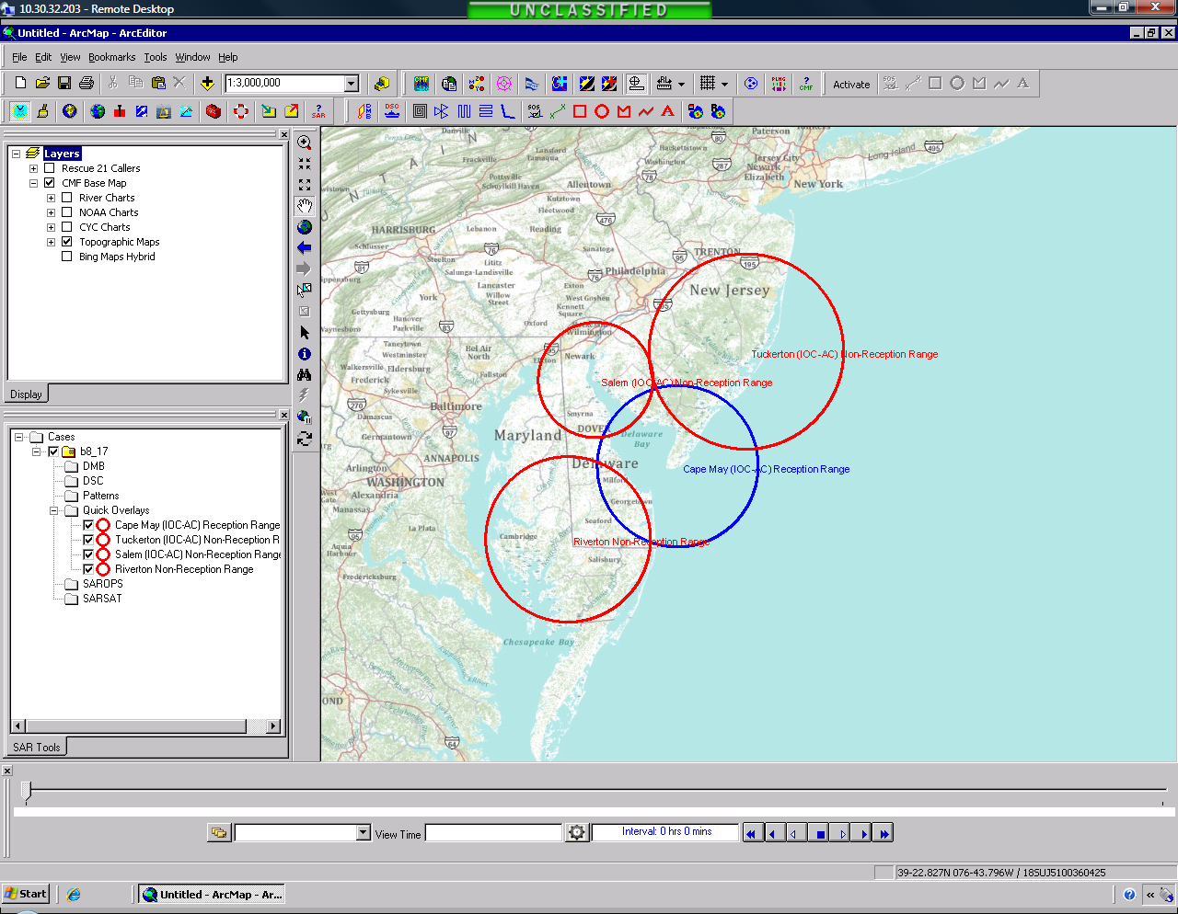
Notes:
Better late than never..RFF based range rings.

Slide 11
Flare
Scenario
No more separate Flare Cone Calculator
No more tracing
Flare calculator fully integrated as SAROPS scenario
Notes:
Flare Scenario summary…segways into anchored particles.

Slide 12
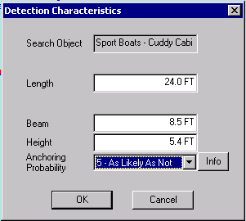
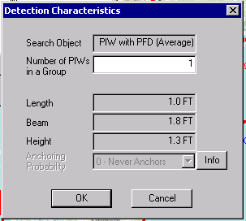
Anchored
Search Objects
Flare scenario was impetus
Search Object property, applies to any scenario type
Search Object is eligible to anchor (statistically) based on bathymetry
Notes:
Anchored is no longer a flare scenario unique quality…it is available to some SO’s for all scenarios.
Note PIWs can be grouped (detection corrects as sqrt of number of persons). 4 persons is twice as easy to see as 1.
Sweep widths are adjusted for unaided (no NVGs) visual search at night (additional correction factor = 0.1 applied to daylight visual sweep width), adjustments to dimensions if boat is swamped/capsized (adjustments not displayed, but each dimension is multiplied by 0.4 before computing sweep width), and multiple PIWs grouped together (additional correction factor = square root of the number of PIWs is applied).

Slide 13
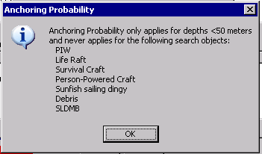
Notes:
Just in case the question comes….

Slide 14
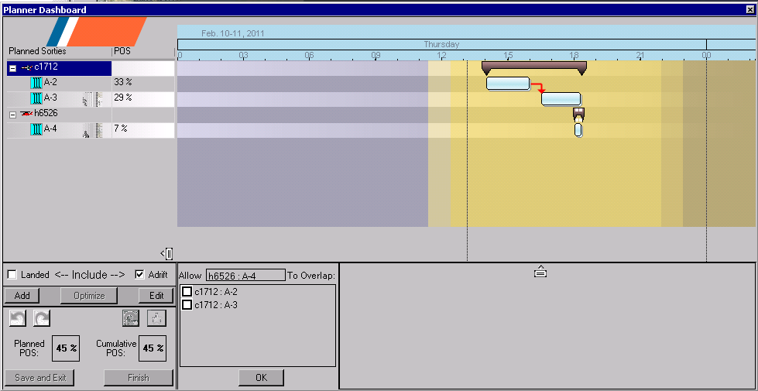
Planner is not always RIGHT or WRONG
Issues:
- mysterious solutions - 90s (or 20s) downtime
- clunky to add/remove effort
Interactive
Planner
Initial quick & dirty pattern generated up front (single SRU), essential data collection
Ability to add, split, remove resource/sru’s one by one or in a batch
Optimize at anytime, in smaller time chunks. POS scores available all along.
Dashboard interface
Notes:
Why an interactive planner?
Take care of two predictive failures. Not-so-good user created plans (w/no POS) & subsequent search disasters.

Slide 15
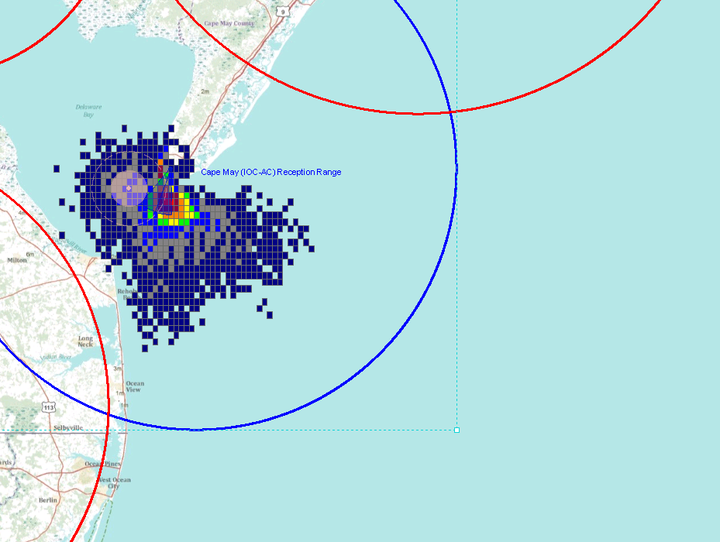
Notes:
Sample case to illustrate new features.

Slide 16
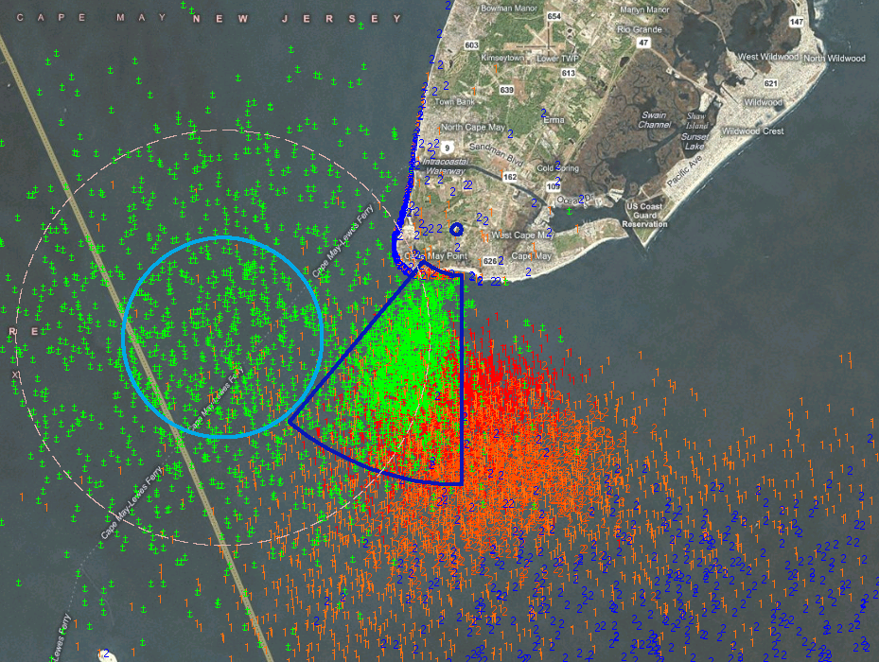
Notes:
Particle properties can be set to color code by search object type, no longer locked into scenario type. Its now easy to see anchored vs piw vs boat adrift.

Slide 17
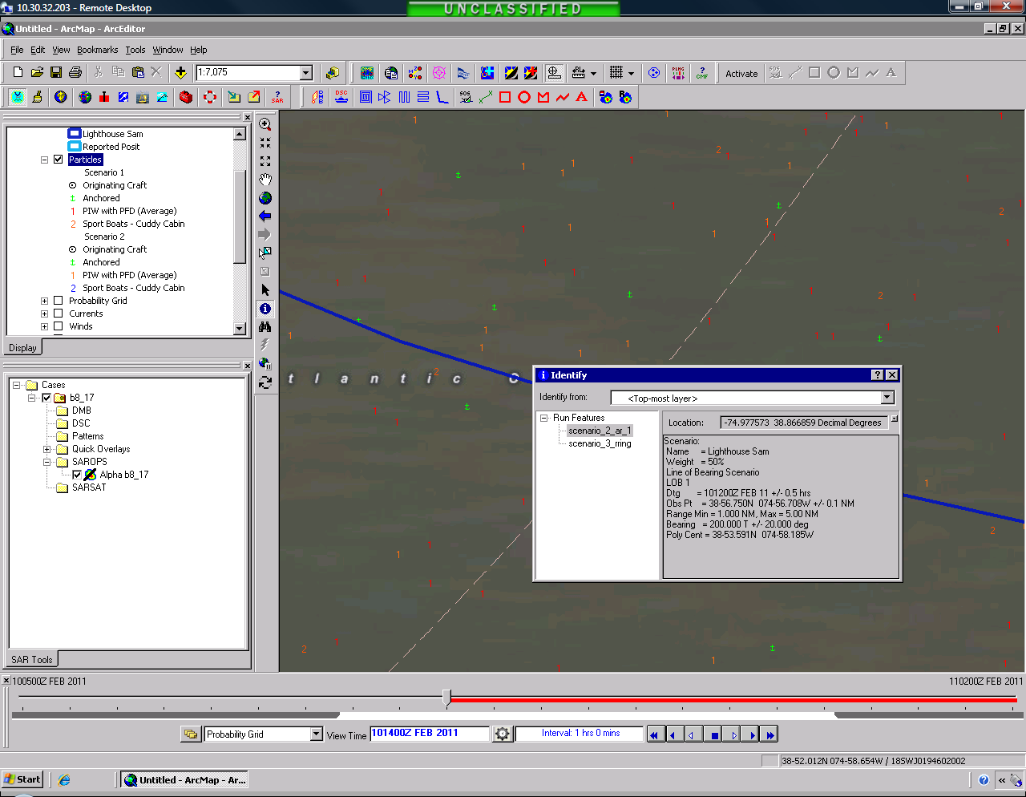
Notes:
Particle display is easily associated with the legend and identify provides the particulars for those inclined to inspect them.

Slide 18
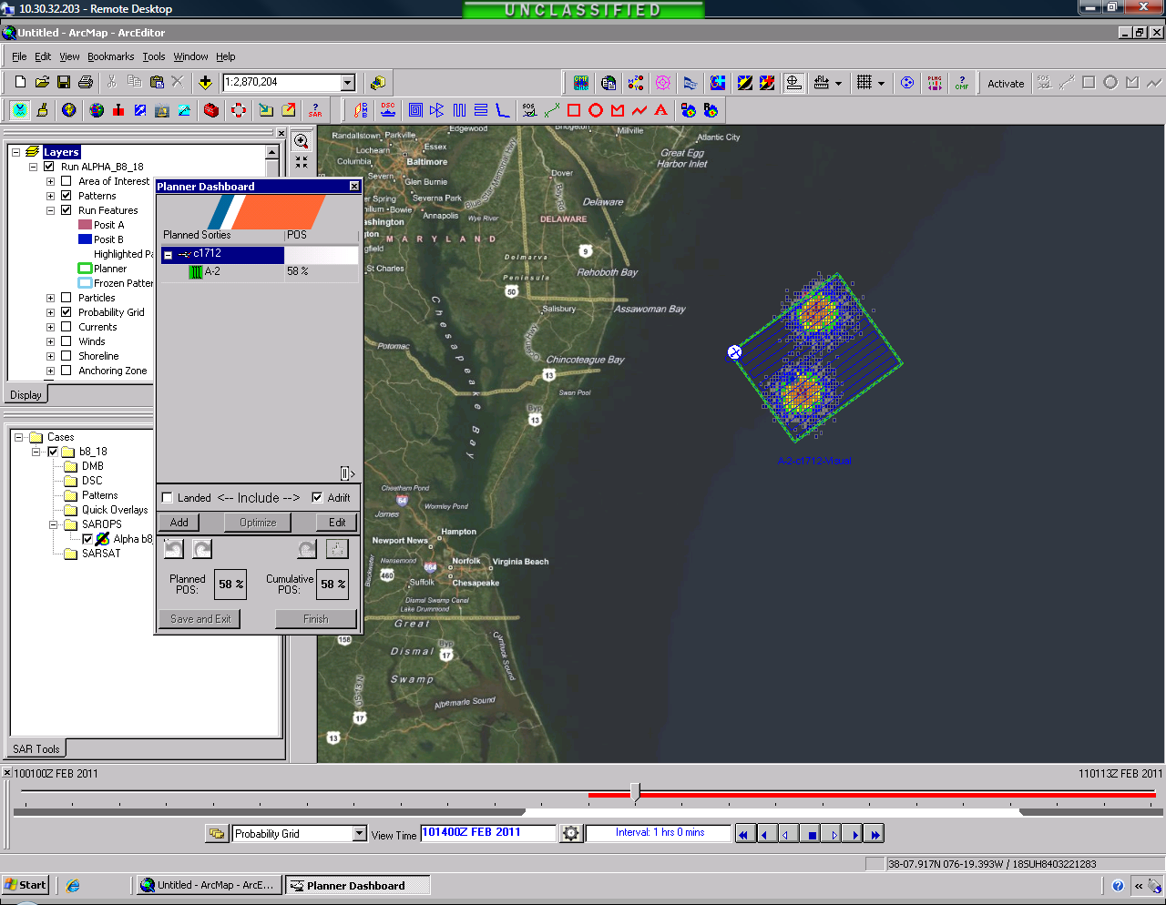
Notes:
Planner dashboard with 1 sortie and 1 pattern to cover a bi-modal distribution (2 scenarios)…maybe not the best use of effort?

Slide 19
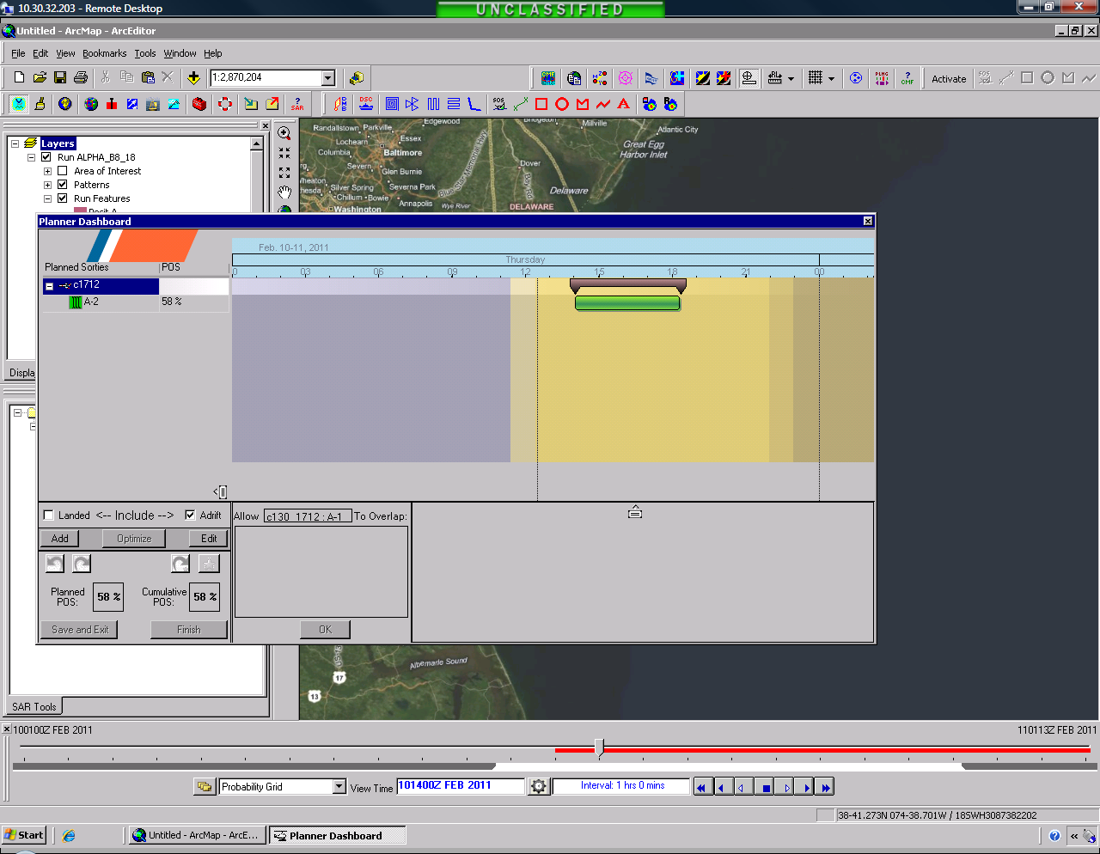
Notes:
Dashboard lets the user “interact” now with the planner algorithm. No longer just a big batch of effort to be reallocated en-masse.

Slide 20
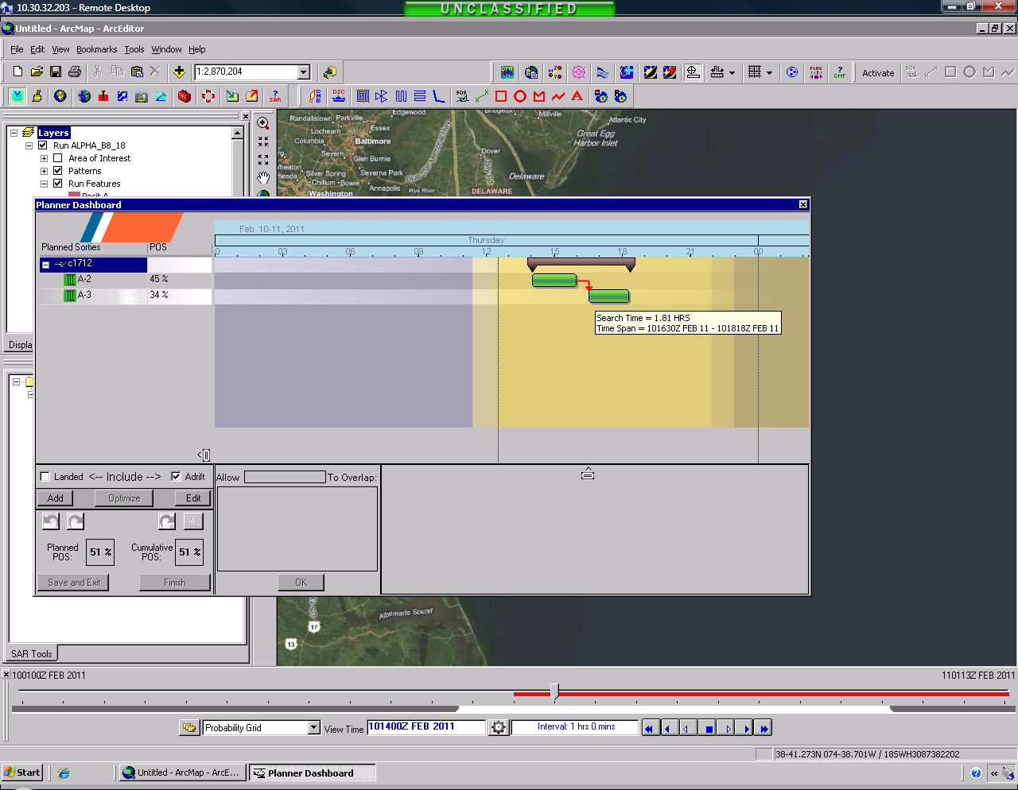
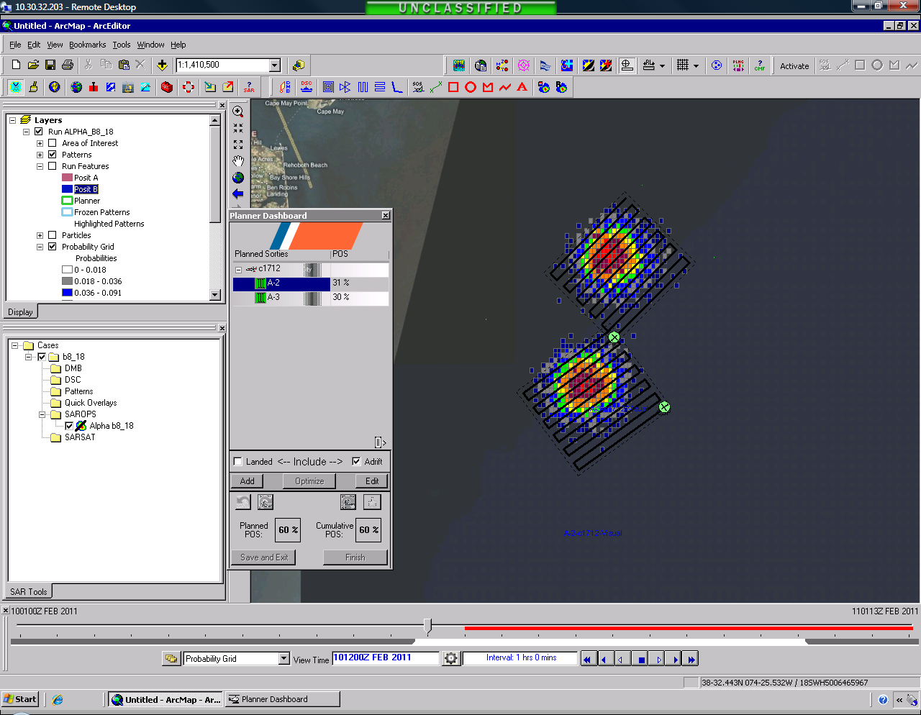
Notes:
An SRU’s effort can now be split up.

Slide 21
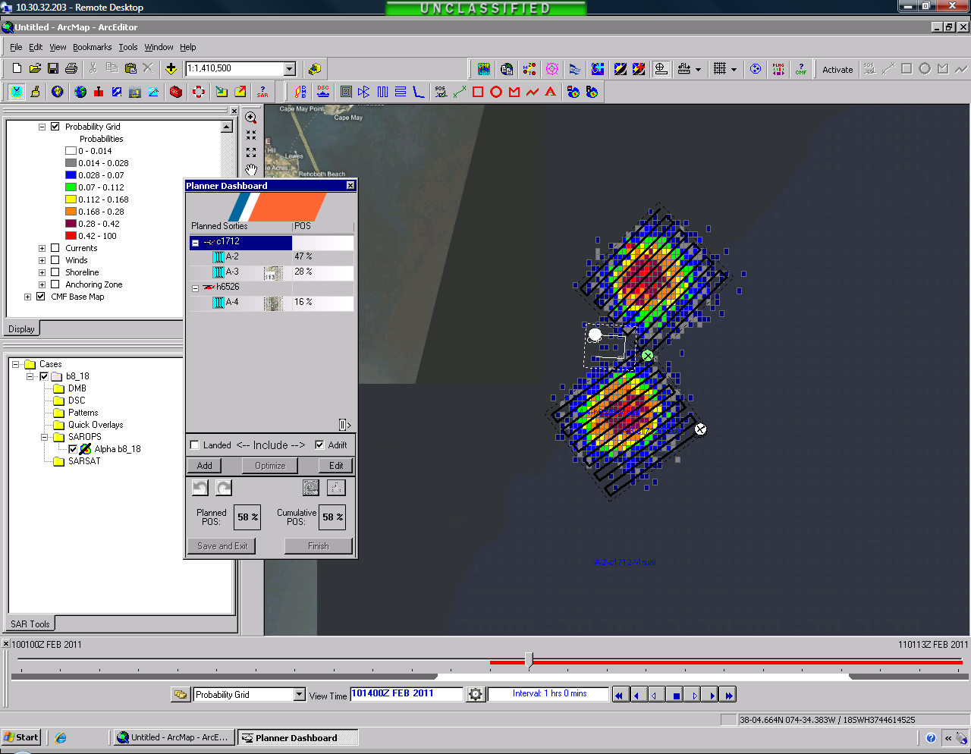
Notes:
More effort can be added (or removed) while retaining part of the plan.

Slide 22
Notes:
The plan can be viewed over time and changed by dragging bars on the Gantt chart.
Normally POS values how in the lower right corner but this development version did not have that module functioning.

Slide 23
Other
- GSHHS (Sim map) improvements
- Prevent case import overwrite
- Non-zero defaults for time/location uncertainties
- Pattern summary as KML
- Pattern summary as shape
- Minimum track spacing and rounding to 0.1NM
- AMVER url change
LKP and other scenario display modification
- Moon phase calculator
- Tracking server and manual action enhancements
FTP to FTPS
NAIS and LRIT track data feed…soon!
Notes:
Other changes/fixes coming in v14.
Then for v2 we hope to:
Consolidate to reduce # of disparate GIS displays, fuse data, streamline training/support overhead.
Eliminate (2) of our greatest remaining predictive failures…user access issues (TS logons and relocations) and case file mgmt.

Slide 24
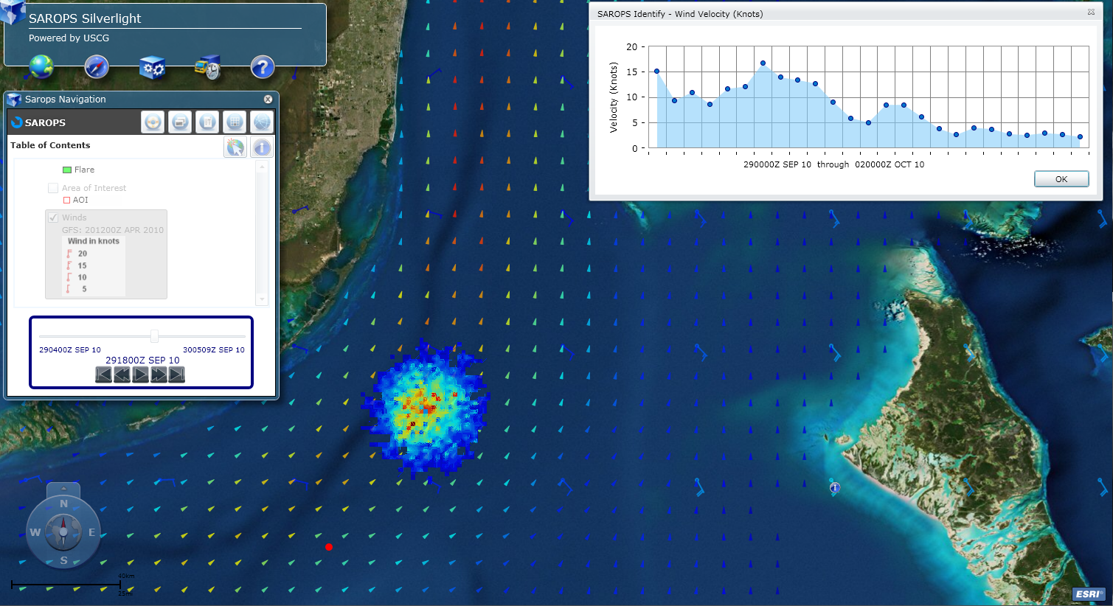
2.0
Better Integration/Standardization with the Enterprise
SAROPS
eGIS data/layers
UCOP track data
Actions:
GIS Framework Switch (Silverlight)
Web Browser based.
Better integration w/eGIS, CWSS, CART, WK …
Cases in DB vs. FS method used now
MISLE connection (.sar deposit via ESB)
Quality Track Data Feed, 2-way
http://staging.asascience.com/sarops/

Slide 25
Schedule
V1.4 (this Spring)
  Delivery from contractor oa 3 March
  Testing, Documentation, CM (6 weeks)
  Training/Staggered rollout starting as soon as mid April
V1.4.1 (this summer)
  Minor corrections/tweaks.
Freeze
  Emergency patches only
V2.0
  Development starts Spring 11
  Anticipated deployment 18-24 months later
25
Notes:
2/16/2011
R21 Interface summary
We are treating the R21 ellipse dimensions as the 95% containment contour. To be consistent with LKP and general SAR terminology, we probably should display the 50% (probable error) containment contour as a solid, filled ellipse and the three-times-probable-error (99%) containment contour as a dashed ellipse. Both values may be computed from the "95%" data we are being given by using simple equations.

Slide 26
EDS
The Environmental Data Server continues to evolve forward also with new data elements
  Waves
  Cloud Cover
  Temperature
  Ice
  Visibility
  & new data products
26
Notes:
2/16/2011
GBOFS (Galveston Bay)
NYOFS (New York/New Jersey)
SJROFS (St John's River)
LEOFS (Lake Erie)
LHOFS (Lake Huron)
LMOFS (Lake Michigan)
LOOFS (Lake Ontario)
LSOFS (Lake Superior)
Here's what I know of the OFSs so far without googling (from a Peter Stone email back in November)...
CO-OPS has been developing several new operational hydrodynamic models over the last couple of years and will be continuing this development for the next 5 years at least.
As part of this development work CO-OPS has replaced the CBOFS system with a new model (recently renamed from CBOFS2 to CBOFS, displacing the latter). The original CBOFS was based on 2D modeling technology that was at least 10 -15 years old and did not accurately capture the nonlinear dynamics in the northern Chesapeake Bay. The new CBOFS has been implemented in 3D with the standardized ROMS modeling system. CBOFS produces 3D outputs of currents, water levels, water temp, and salinity.
Additionally, CO-OPS has rolled out similar, ROMS based systems for Tampa Bay and Delaware Bay.
When the USCG was setting up the SAROPS system CO-OPS worked with us to get CBOFS incorporated into the EDS.
By the end of FY11 CO-OPS expects to expand of coastal ocean model coverage to include the nearshore areas of the Gulf of Mexico from Mobile Bay to the Rio Grande.
Here's what I found googling:
Field Surface Currents Forecast Guidance
The forecast is for the next 48 hours of current velocities as simulated by CBOFS, TBOFS and DBOFS when the bays are forced by forecast products from the National Weather Service's North American Model (NAM) and Extra Tropical Storm Surge (ETSS), and the Navy's Coastal Ocean Model (NCOM).

Slide 27
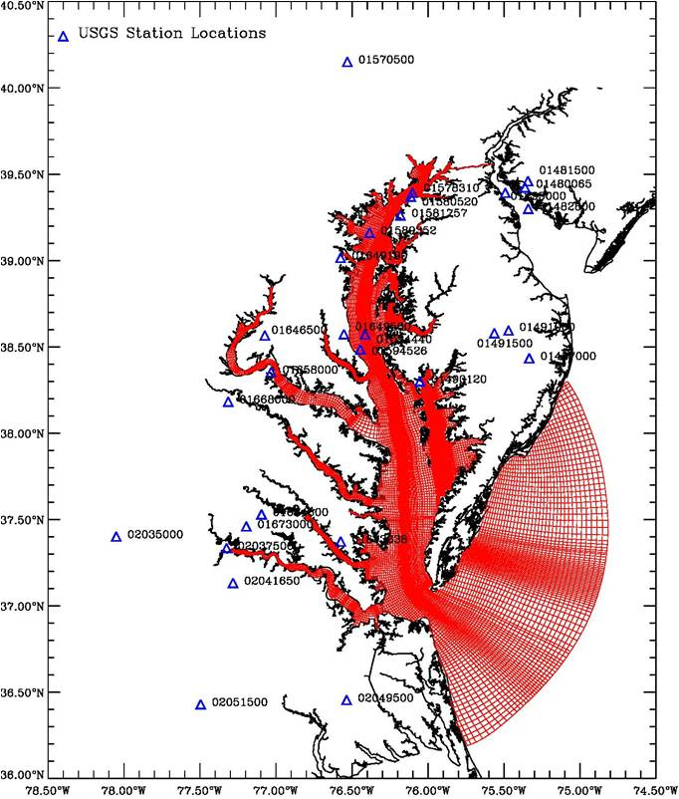
EDS
Chesapeake Bay
27
Notes:
2/16/2011

Slide 28
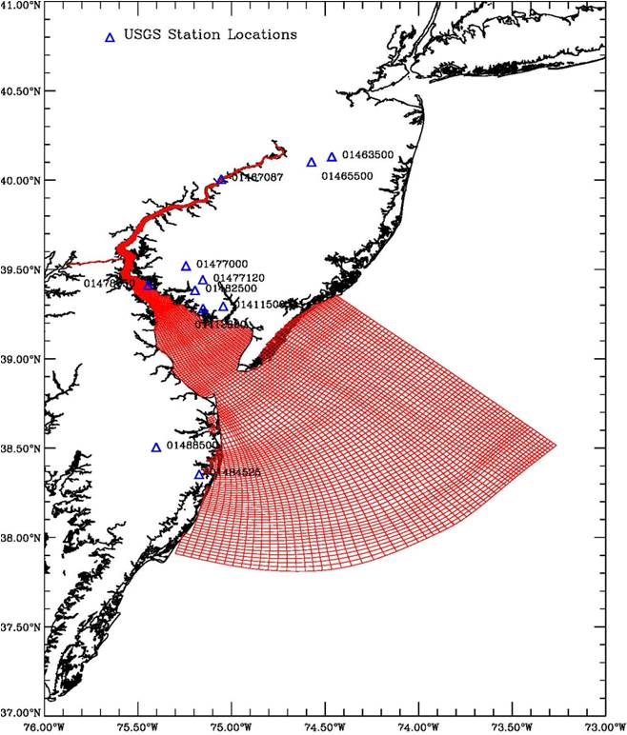
EDS
Delaware Bay
28
Notes:
2/16/2011

Slide 29
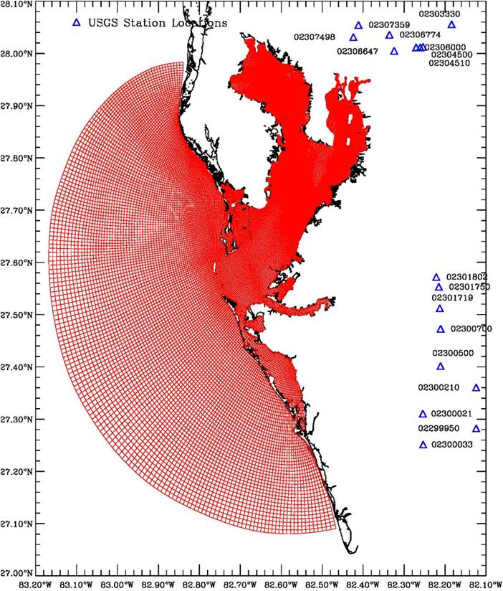
EDS
Tampa Bay
29
Notes:
2/16/2011

Slide 30
Support
What can C3CEN do improve our SAROPS support?
Notes:
Suggestions:
Edit AOI
Don’t make patterns outside of SAROPS wizard (or minimize those that you do) Times are important
Edit AOI
Don’t be shy about letting in some position or time uncertainty…helps to smooth things out.
Save and Export cases at key points. (MISLE)
Practice make Proficient. Cases with more than just an Alpha drift too. Complicated cases frequently start their lives as ‘simple’ cases.
Call C3CEN sooner than later. Small issues tend to compound.
Edit AOI
Please take advantage of the C3CEN teams when they visit. They will attend watches and adjust to your needs/schedules. They visit each server location (some at Districts some at Sectors) every year. Districts do well to invite their sectors in for this.

Slide 31

SAROPS Problems?
C2CEN SMEF DESK: (757) 686-2156 or D05-SMB-C2CENSMEF@USCG.MIL
The SMEF Desk
Provides a single point of contact
Provides immediate service for all incidents.
Sees that all calls receive attention, including
follow-up calls.
Keeps the customer informed.
Provides performance and failure trend
monitoring.
1. John Squires
757-686-4253 or 757-438-6424
2. Daniel Mewhorter
757-295-2056 or 757-621-7632
3. Cordell Viehweg
757-686-4148 or 757-274-7195
Command Duty Officer
757-615-3834 (call if no response from 1-3)
* after hours
757-438-6424*
Notes:
Who you gonna call?

Slide 32
Thank You.
Robert Netsch
Robert.c.netsch@uscg.mil
C3CEN

