Slide 1
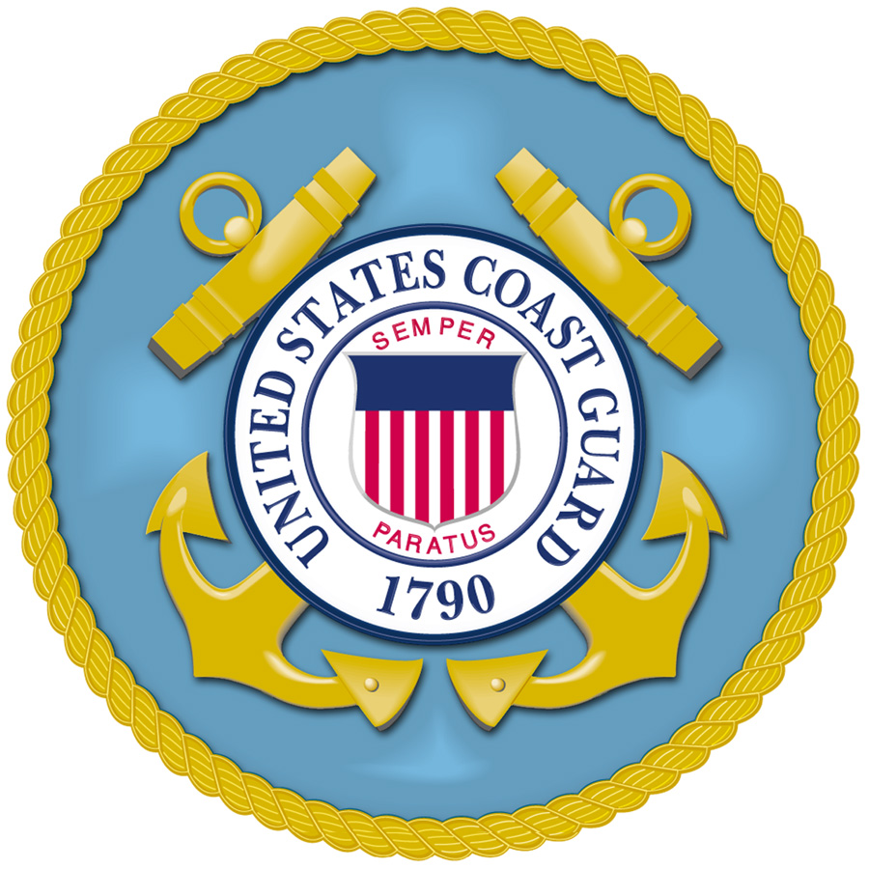
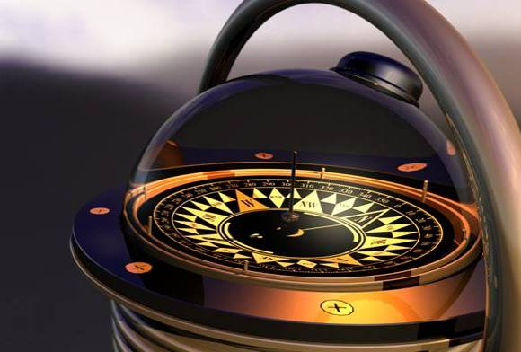
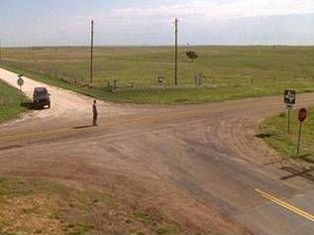


Marine Safety Engineering / AY2020
loading…
At a crossroads in your career?
What heading will you choose?
Next

Slide 2


Put your Coast Guard career on the
fast track
fast track
Prepare for tomorrow
Prepare for tomorrow
earn a Postgraduate Engineering Degree today.
earn a Postgraduate Engineering Degree today.
Marine Safety Engineering
What can I study?
Where can I go to school?
What will I do when I graduate?
How can I get more information?
Exit

Slide 3
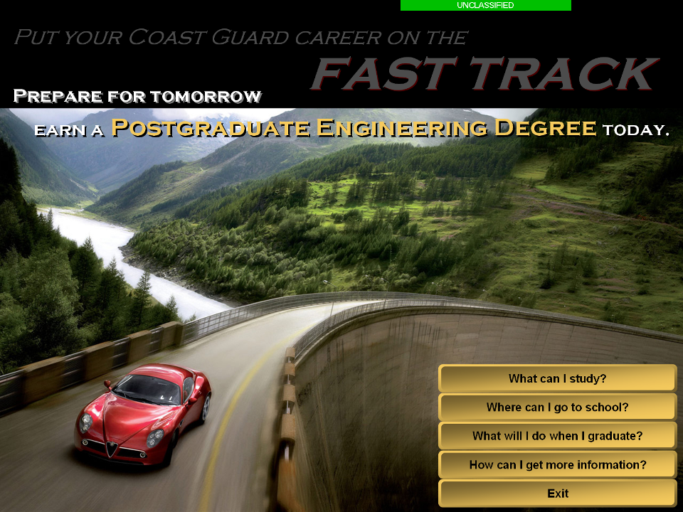
Marine Safety Engineering
What can I study?
Where can I go to school?
What will I do when I graduate?
How can I get more information?
Exit
Notes:
3

Slide 4
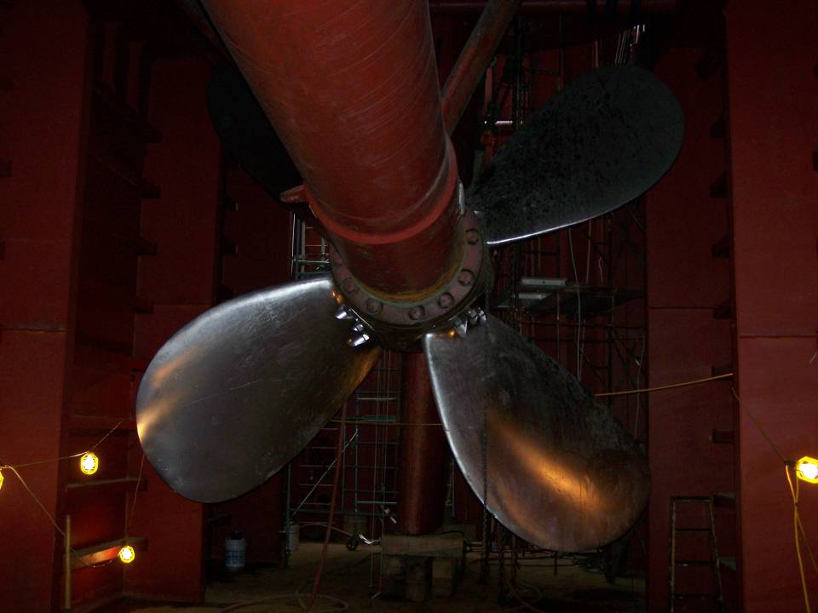
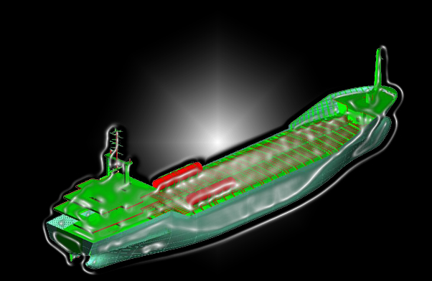
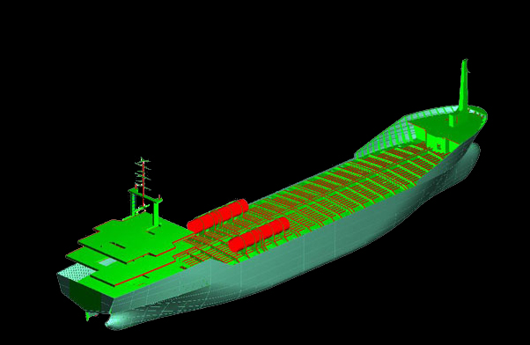
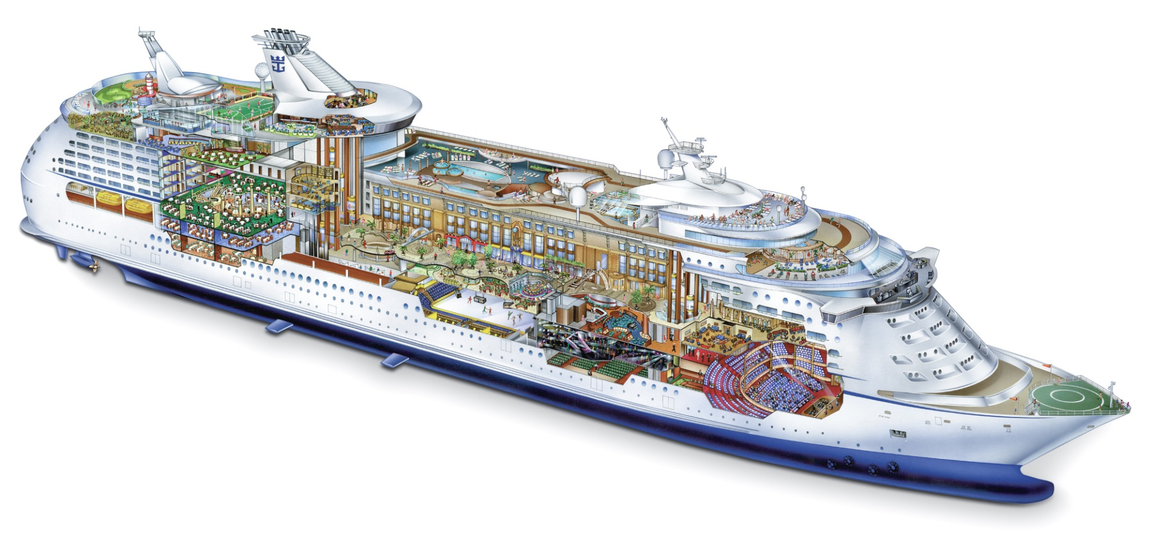
Naval Architecture & Marine Engineering
it’s your call
choose your major
The Marine Engineering Advanced Education Program offers selectees the
opportunity to choose a specialized discipline of expertise. For example, a Graduate
Degree in Naval Architecture and Marine Engineering emphasizes the design, manufacture,
and use of marine vehicles and structures. Primary emphasis is on the scientific, engineering, and design
aspects of ships, small boats, and other surface craft, as well as submersibles, platforms, and other marine systems.
Next
Notes:
4

Slide 5
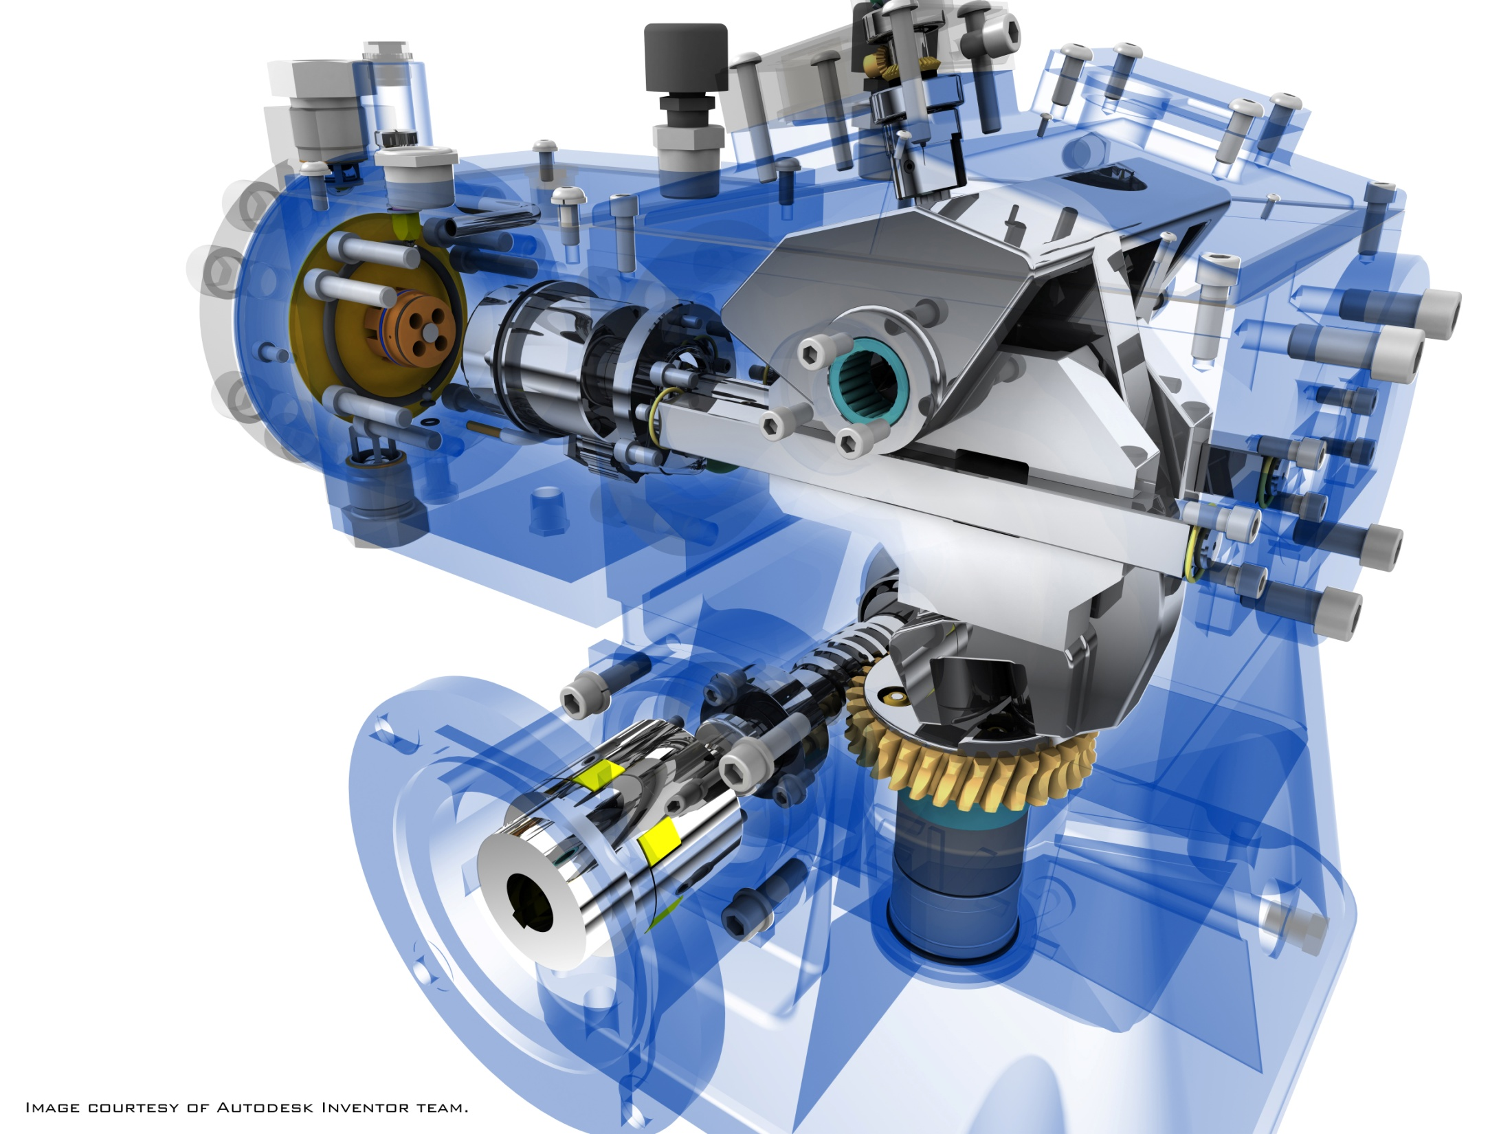
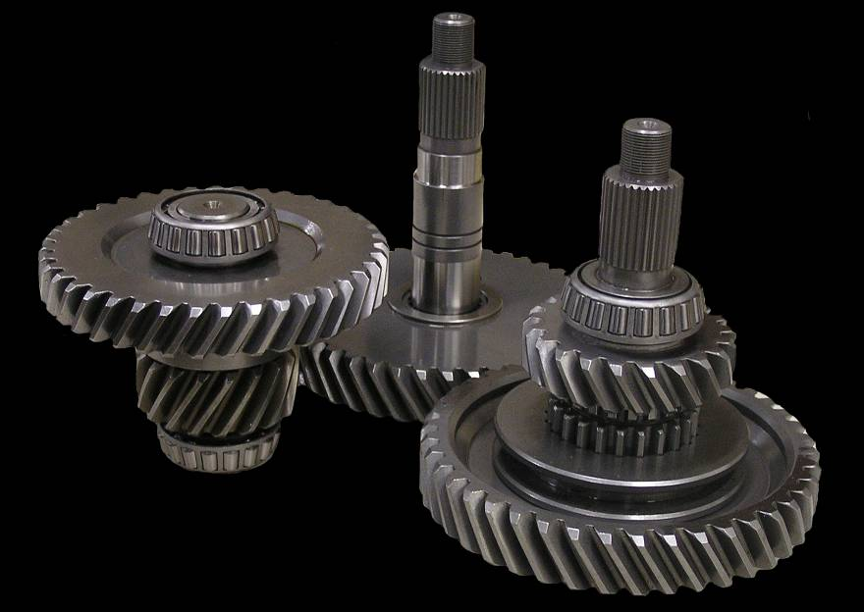
Naval Architecture & Marine Engineering
Mechanical Engineering
Mechanical Engineering applies scientific principles in the design and analysis of mechanical and energy conversion systems.
Core concepts include mechanics, kinematics, thermodynamics, and
fluid mechanics.
Marine applications
include responsibility for
the main propulsion plant and the mechanical aspects of ship functions such as steering and anchoring.
The Marine Engineering Advanced Education Program offers selectees the
opportunity to choose a specialized discipline of expertise. For example, a Graduate
Degree in Naval Architecture and Marine Engineering emphasizes the design, manufacture
and use of marine vehicles and structures. Primary emphasis is on the scientific, engineering, and design
aspects of ships, small boats, and other surface craft, as well as submersibles, platforms, and other marine systems.
Next

Slide 6



Human
Factors
Engineering
Human Factors Engineering
is concerned with ways of
designing jobs, machines,
operations, environments
or work systems so they
are compatible with
human capabilities
and limitations.
Fire Protection Engineering applies science and engineering principles to protect life, property, and the environment from fire and smoke. Core concepts include fire fundamentals, fire experimentation and research, and structural fire protection risk.
Fire Protection Engineering
Next

Slide 7
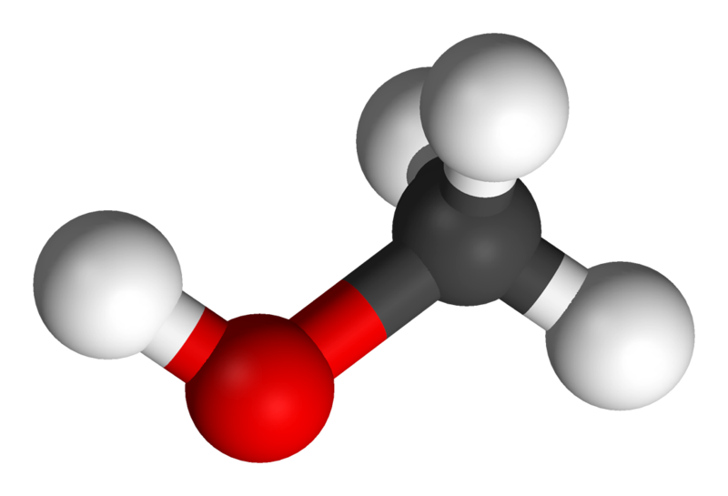
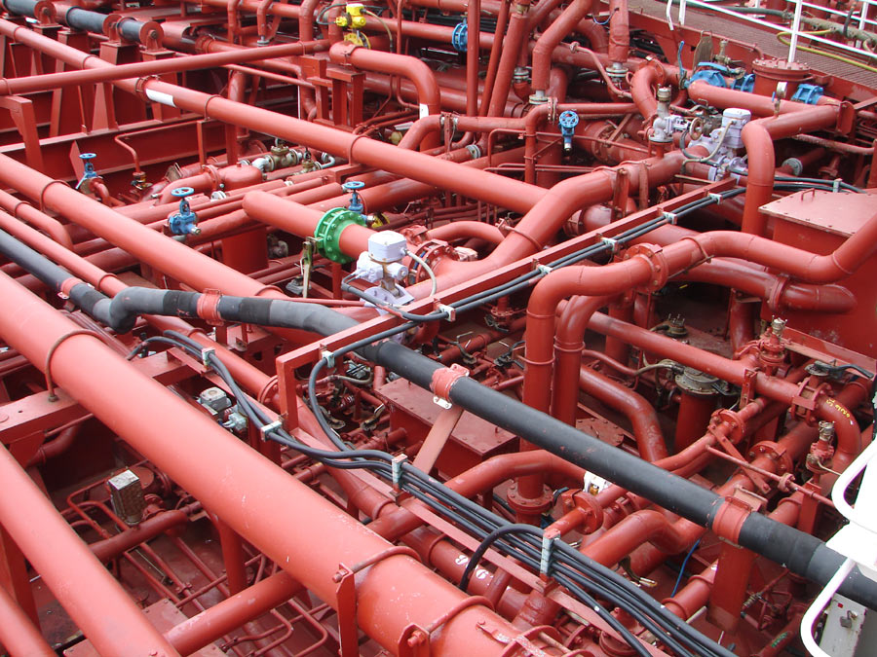
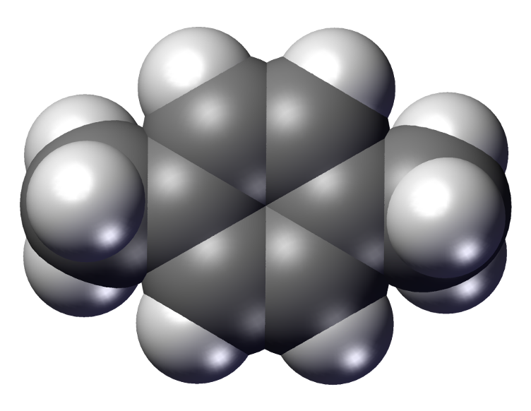
Chemical
Engineering
USCG Chemical Engineers help ensure safe transportation of bulk liquid, solid, and liquefied gas hazardous materials by sea. They lead exciting and technically challenging projects including design review of vessels and marine facilities, analysis of new chemical cargoes entering the market, and participation with the marine industry on Federal advisory committees. In addition, they assist field personnel with marine inspections and investigations and conduct oversight of third parties to ensure compliance with U.S. and international safety standards.
Next

Slide 8
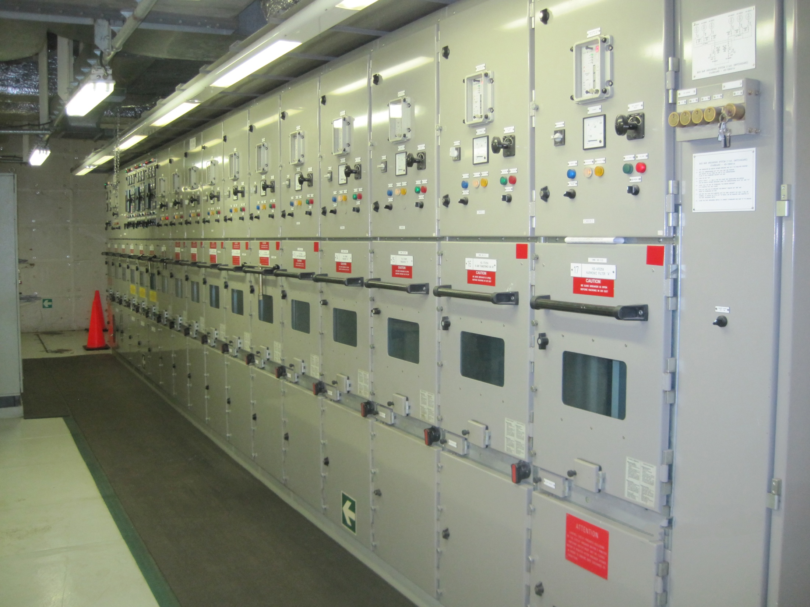
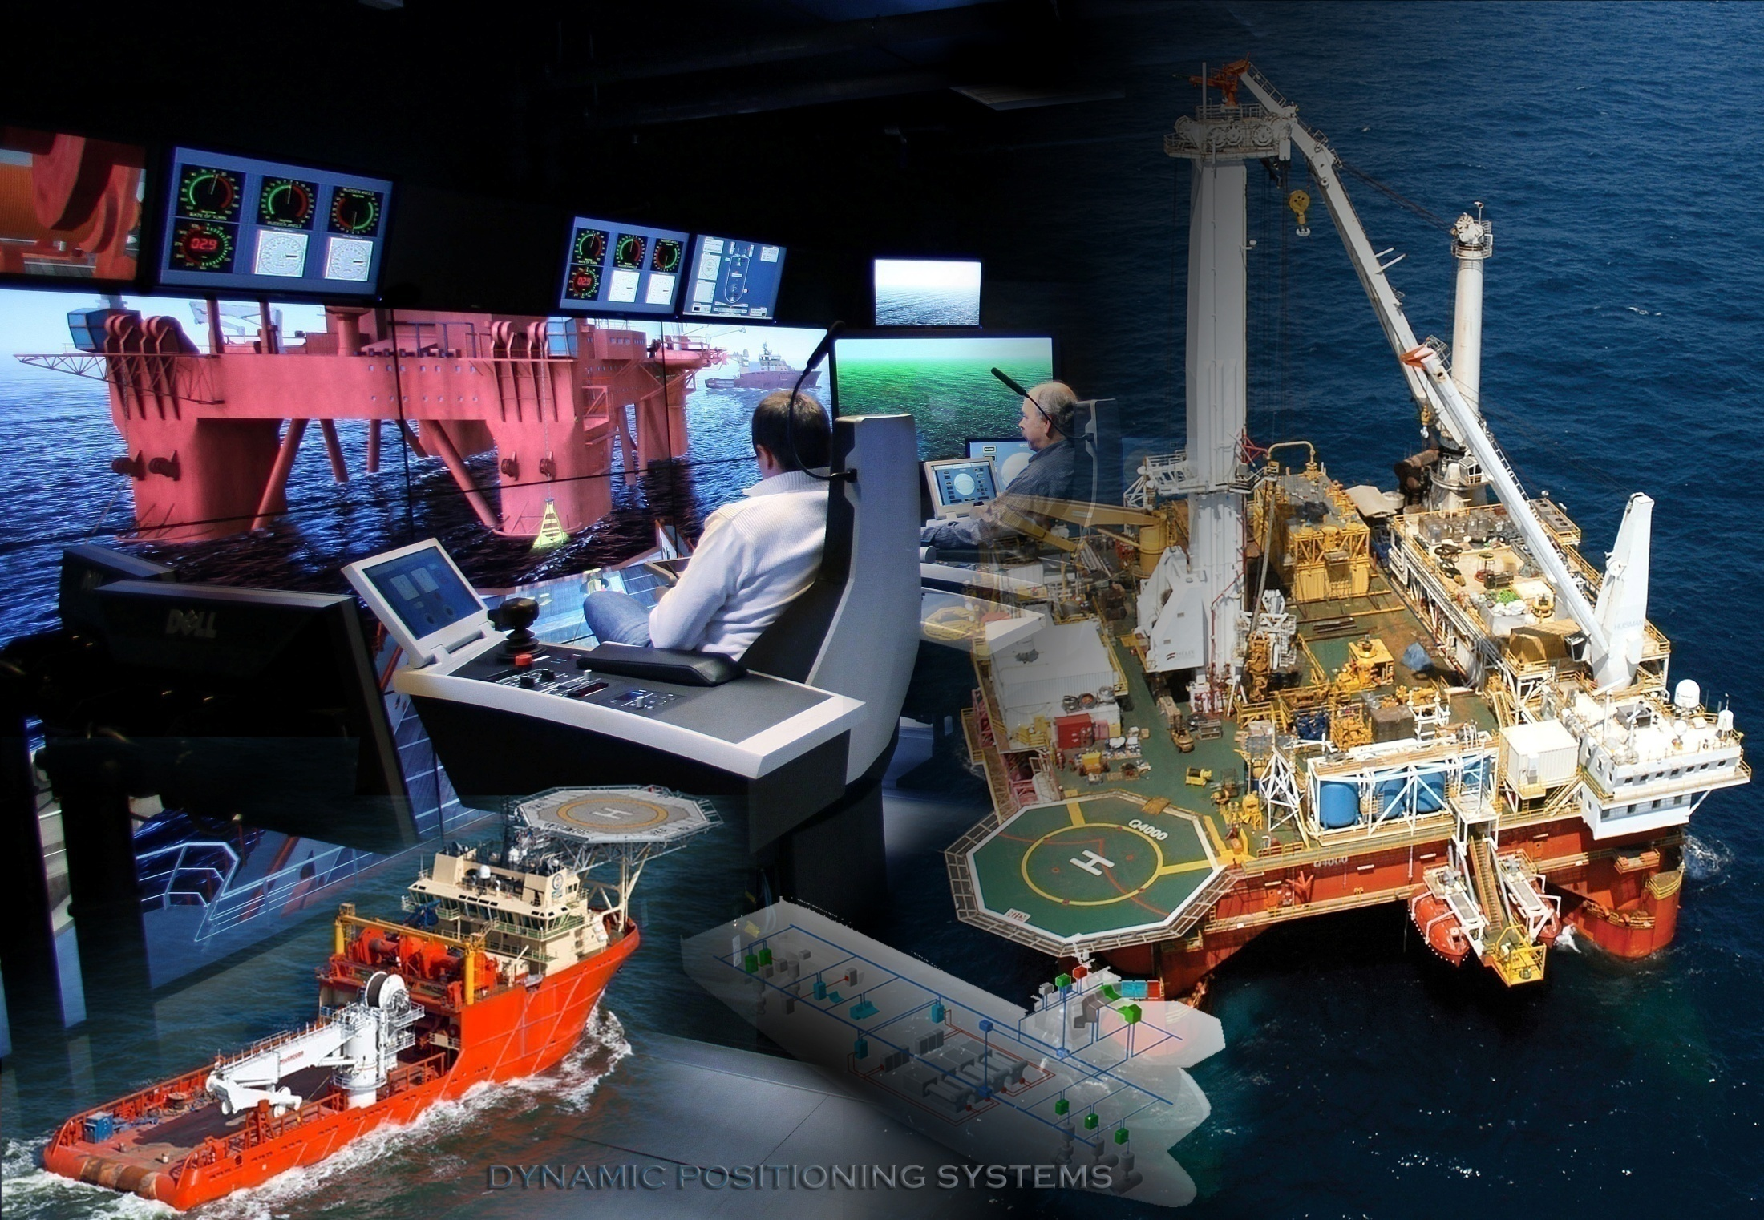
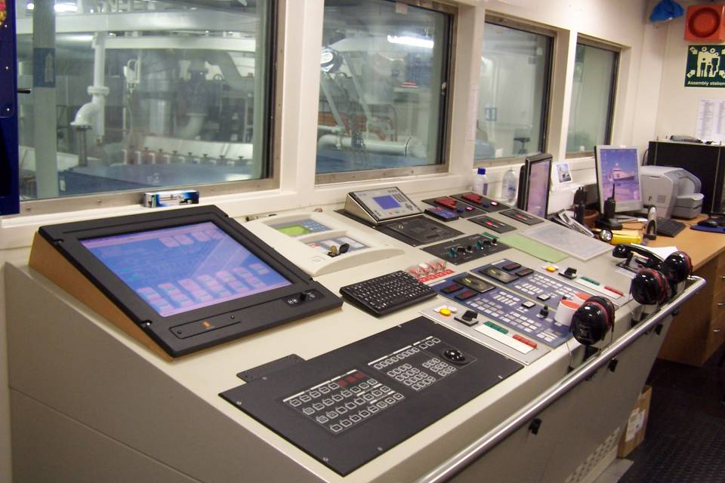
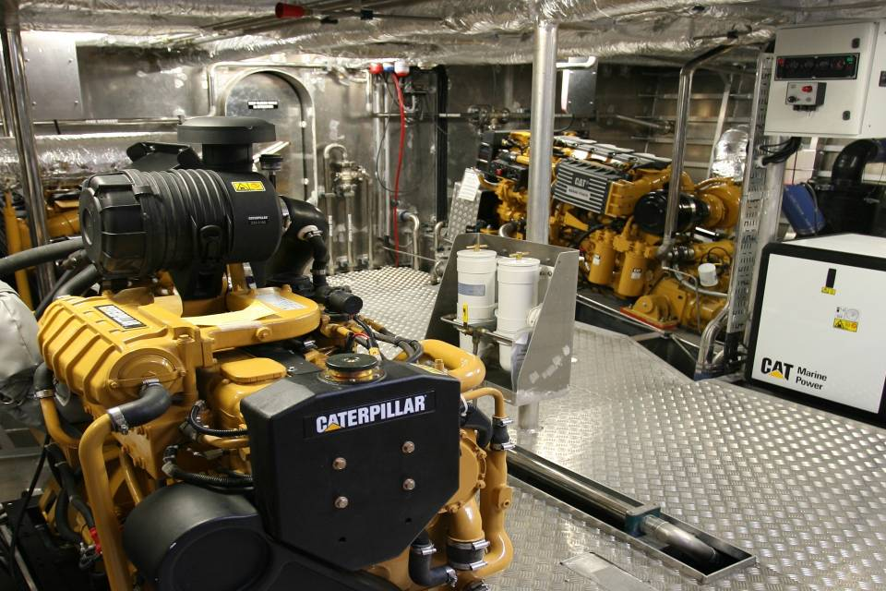
Electrical Power Systems and
Controls Engineering
Become an expert on shipboard electrical power generation, transmission, and distribution and the electronic controls used to automate marine engineering systems. The Coast Guard needs engineers who are knowledgeable in the safe design and testing of technologically advanced electric hybrid
propulsion systems and automatic controls such as those used to manage
dynamic positioning systems (DPS) on offshore supply
vessels and floating offshore energy facilities.
Next

Slide 9
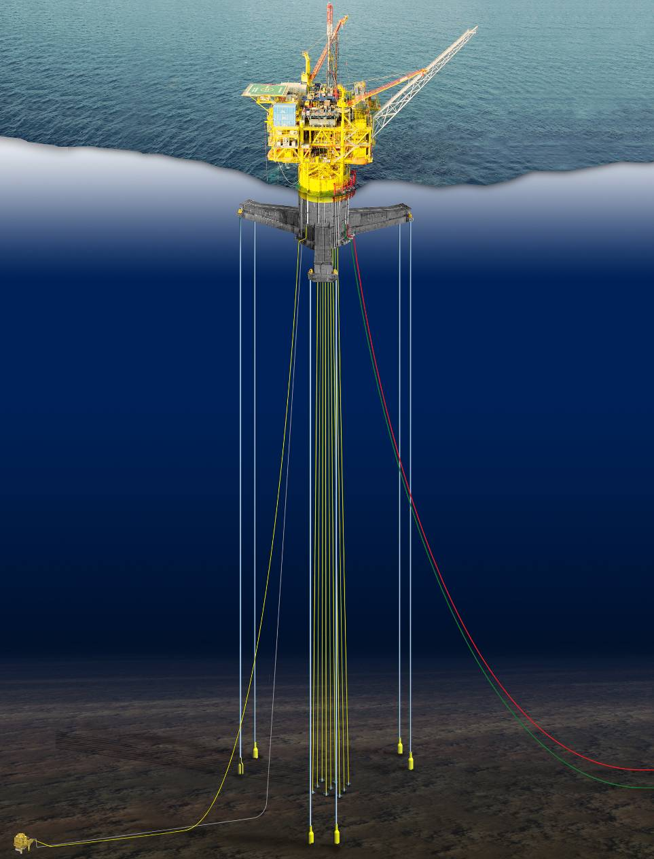
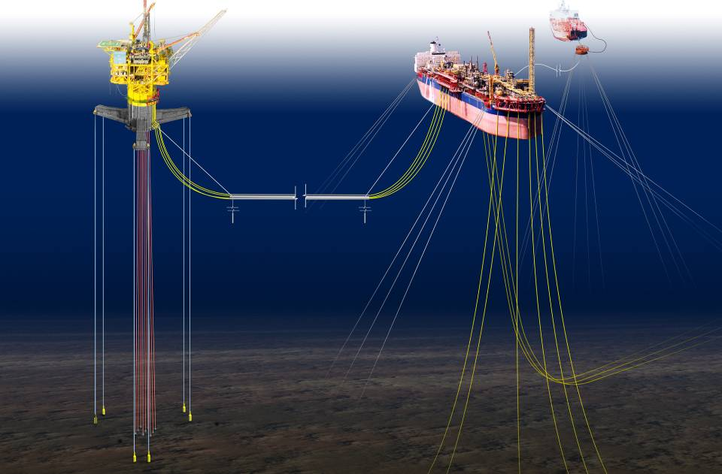
Ocean Engineering
Ocean Engineers study the ocean environment to determine its effects on ships and other marine vehicles and structures. Ocean engineering addresses the design and operation of stationary ocean platforms and manned or remotely-operated sub-surface vehicles used for deep sea exploration.
Home

Slide 10
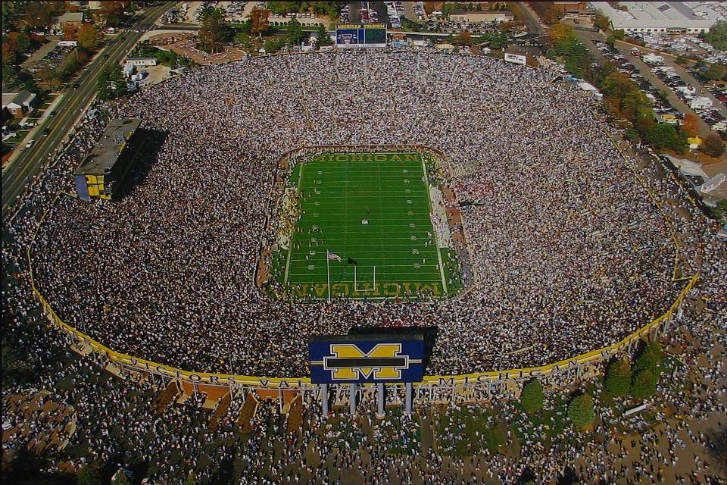


you
may
only
attend
one
of
the
finest
institutions
of
higher
learning
in
the
country.
a few examples follow.
Many CG marine engineers have spent their Fall Saturday afternoons in the Big House.
If you plan to be a Naval Architect & Marine Engineer, you may want to Go Blue!
M I C H I G A N
U of M
Next

Slide 11




EARN A BRASS RAT
MIT
Next

Slide 12
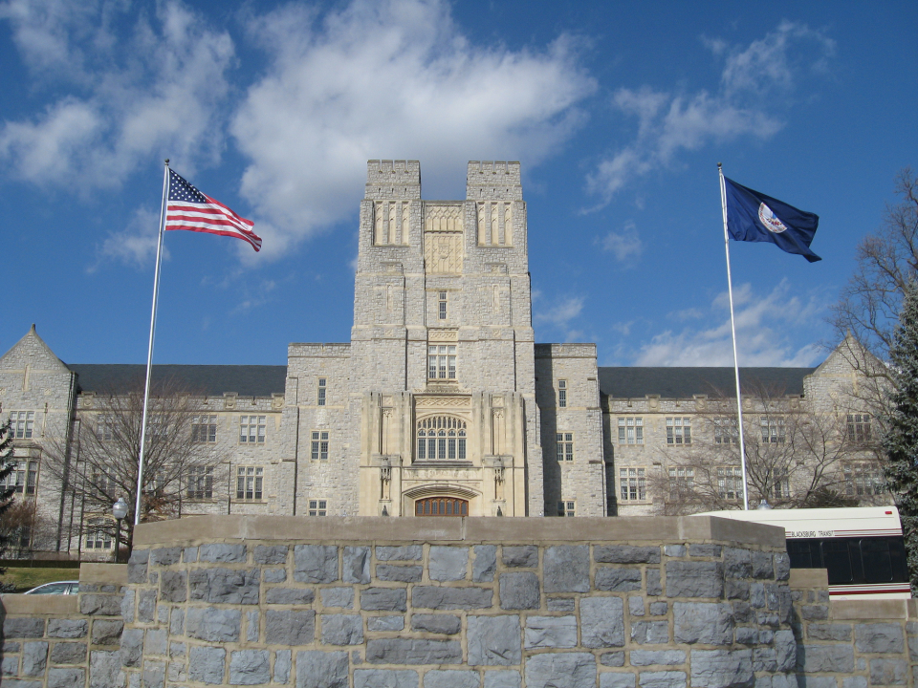
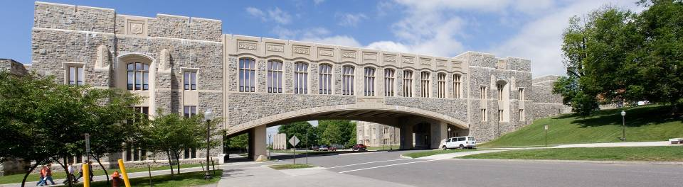

VT
Next
Notes:
12

Slide 13

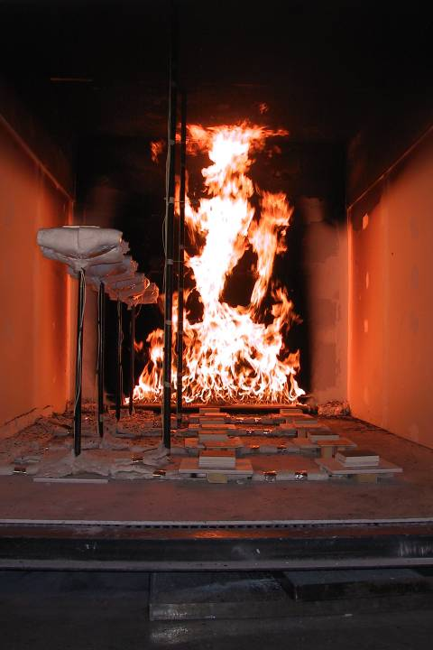
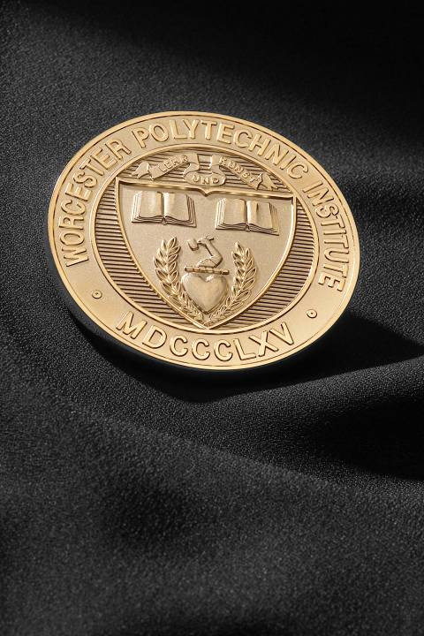

WPI
Next

Slide 14

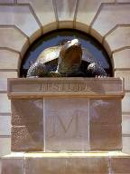
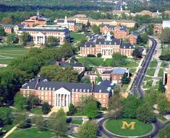
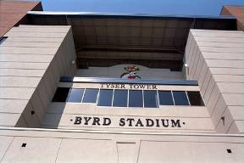

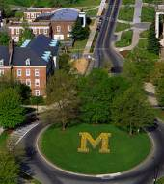

UMD
Next

Slide 15
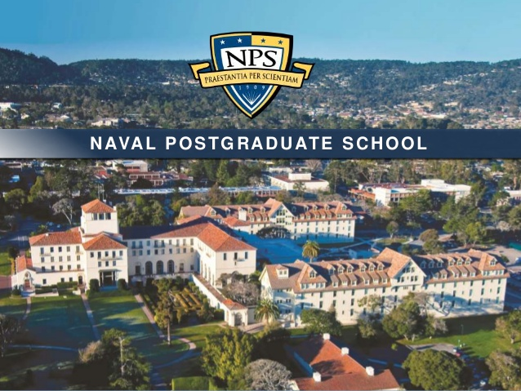
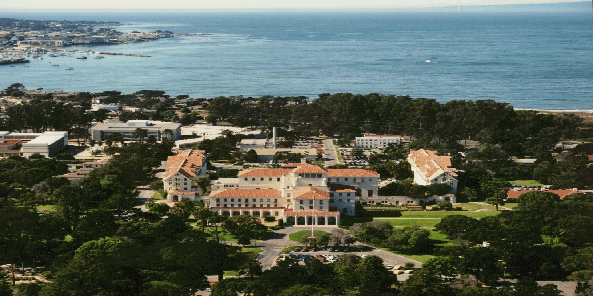
Monterey, CA
NPS
Next

Slide 16



















Coast Guard marine technical officers have attended
these and many other schools.
Home
Notes:
16

Slide 17
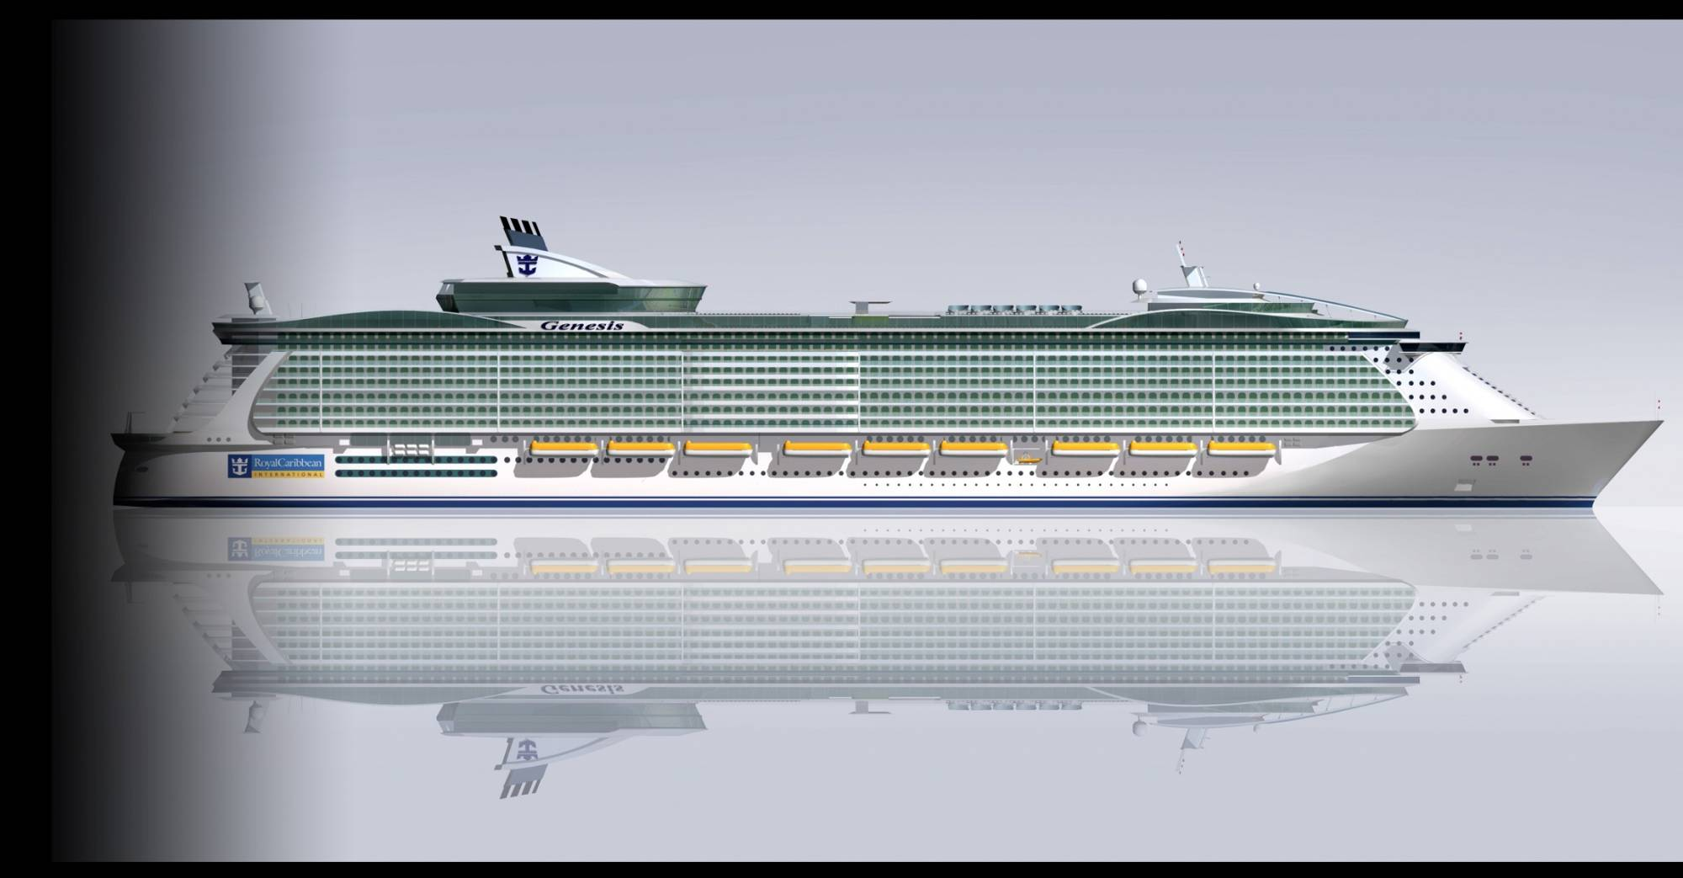
Get involved with the world’s most innovative and technologically advanced marine vehicles
Review the structural fire protection details of cruise ships, then travel to Europe to examine them while under construction. This is OASIS OF THE SEAS, the world’s largest cruise ship. She was built in Finland and entered U.S. service in late 2009.
Next
Notes:
17
17

Slide 18
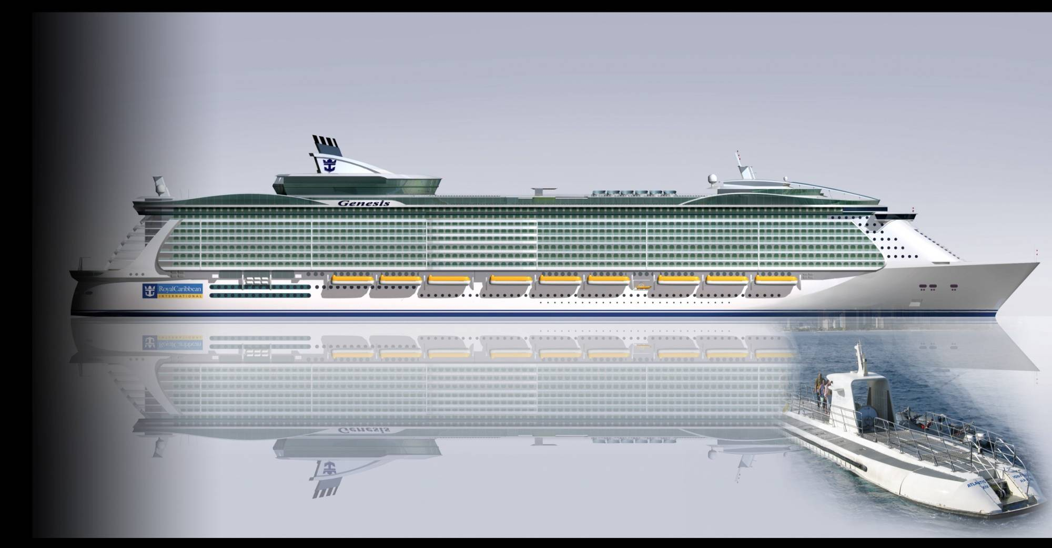
Get involved with the world’s most innovative and technologically advanced marine vehicles
Closer to home, ensure the proper design and operation of critical life support systems aboard passenger submersibles.
Next
Notes:
18
18

Slide 19
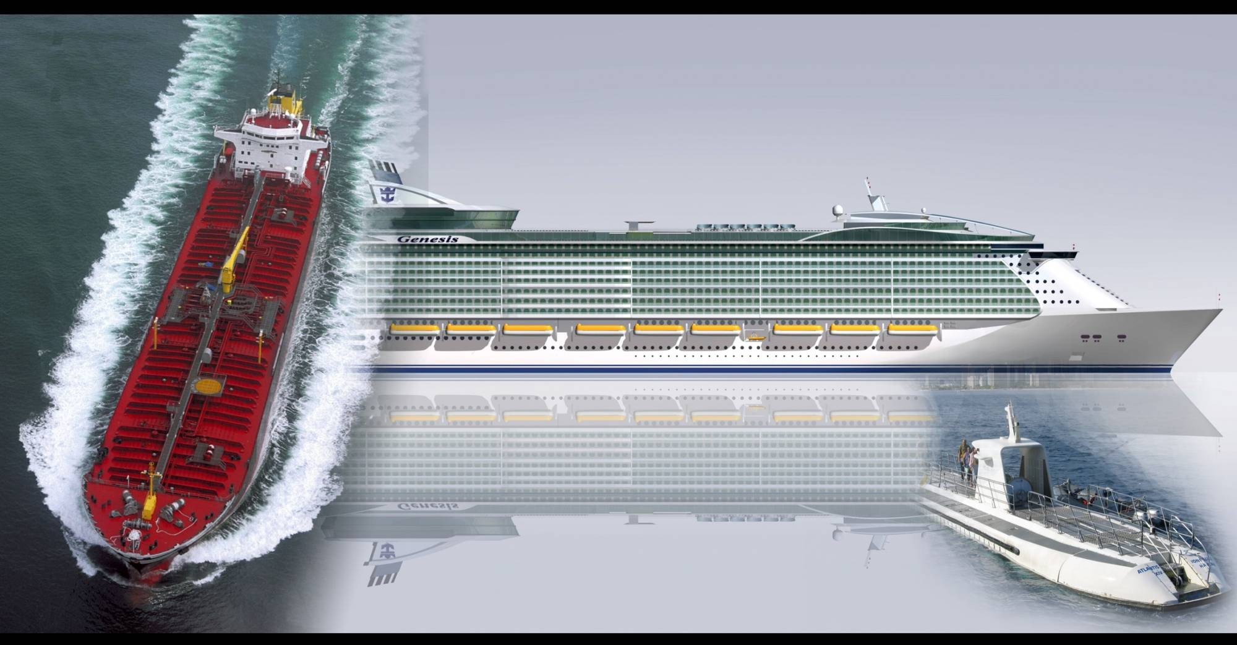
Get involved with the world’s most innovative and technologically advanced marine vehicles
Analyze the stability, structural integrity, engineering plant, and cargo handling systems for modern tank ships and cargo carriers.
Next
Notes:
19
19

Slide 20
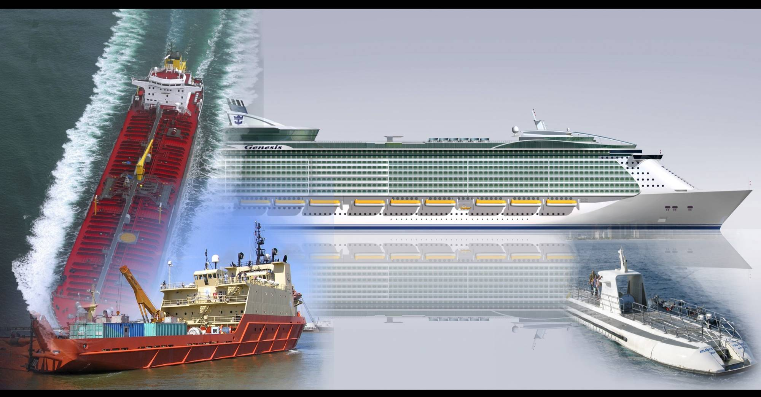
Get involved with the world’s most innovative and technologically advanced marine vehicles
Ensure the rapidly growing fleet of Offshore Supply Vessels can handle the heavier work and harsher environment as oil and gas exploration and production operations move farther offshore to find more energy resources.
Next
Notes:
20
20

Slide 21
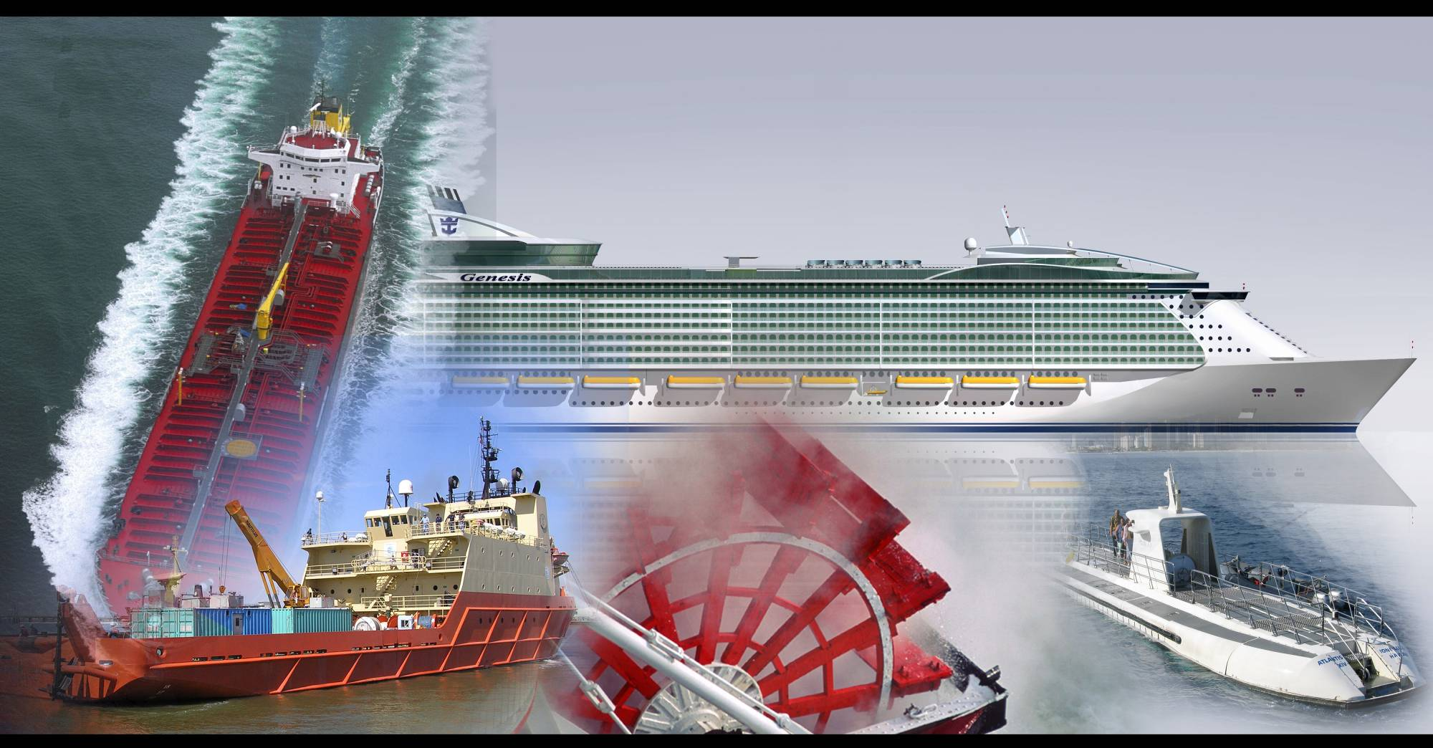
Get involved with the world’s most innovative and technologically advanced marine vehicles
Evaluate passenger egress systems on high passenger capacity gaming boats operating on the western rivers. Become an expert on elaborate fire prevention, detection, and suppression equipment used to ensure passenger safety aboard these floating casinos.
Next
Notes:
21
21

Slide 22
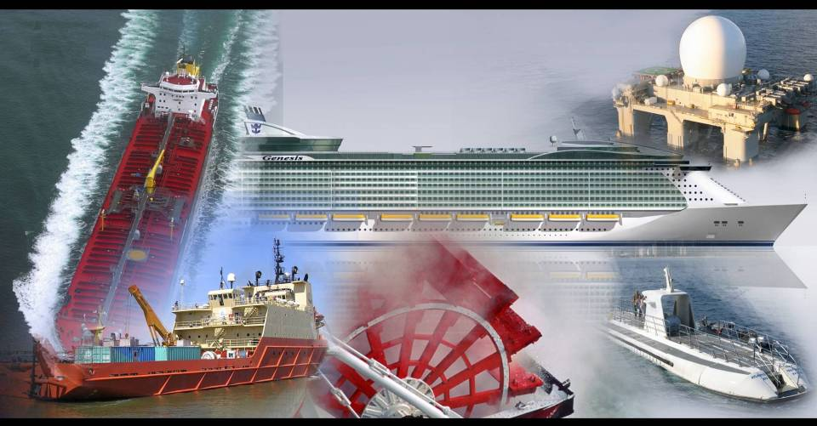
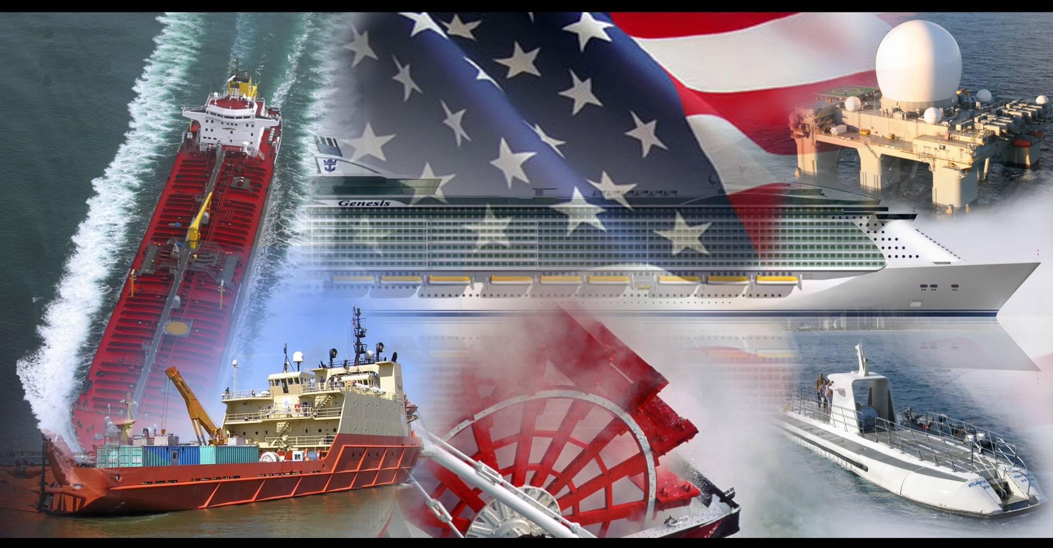
Get involved with the world’s most innovative and technologically advanced marine vehicles
Help ensure complex Dynamic Positioning Systems, electric drive controls, and power management systems aboard drill ships, tank ships, and Offshore Supply Vessels can withstand electrical and mechanical failures that could lead to loss of well control.
Next
Notes:
22
22

Slide 23
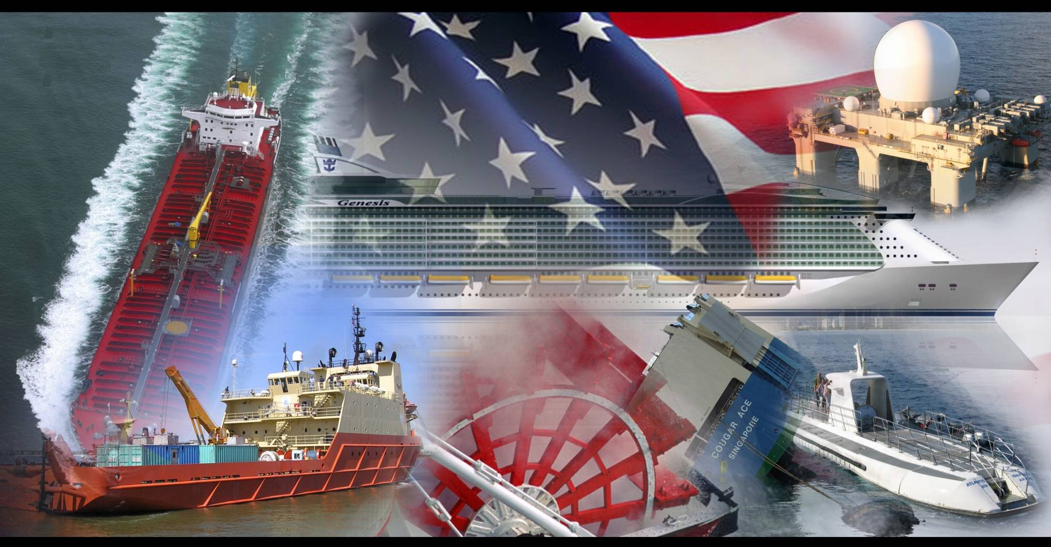
Get involved with the world’s most innovative and technologically advanced marine vehicles
Qualify as a member of the Coast Guard Salvage Engineering Response Team (SERT), a group of highly skilled engineers who help field commanders mitigate and resolve emergent commercial vessel casualty situations.
Next
Notes:
23
23

Slide 24
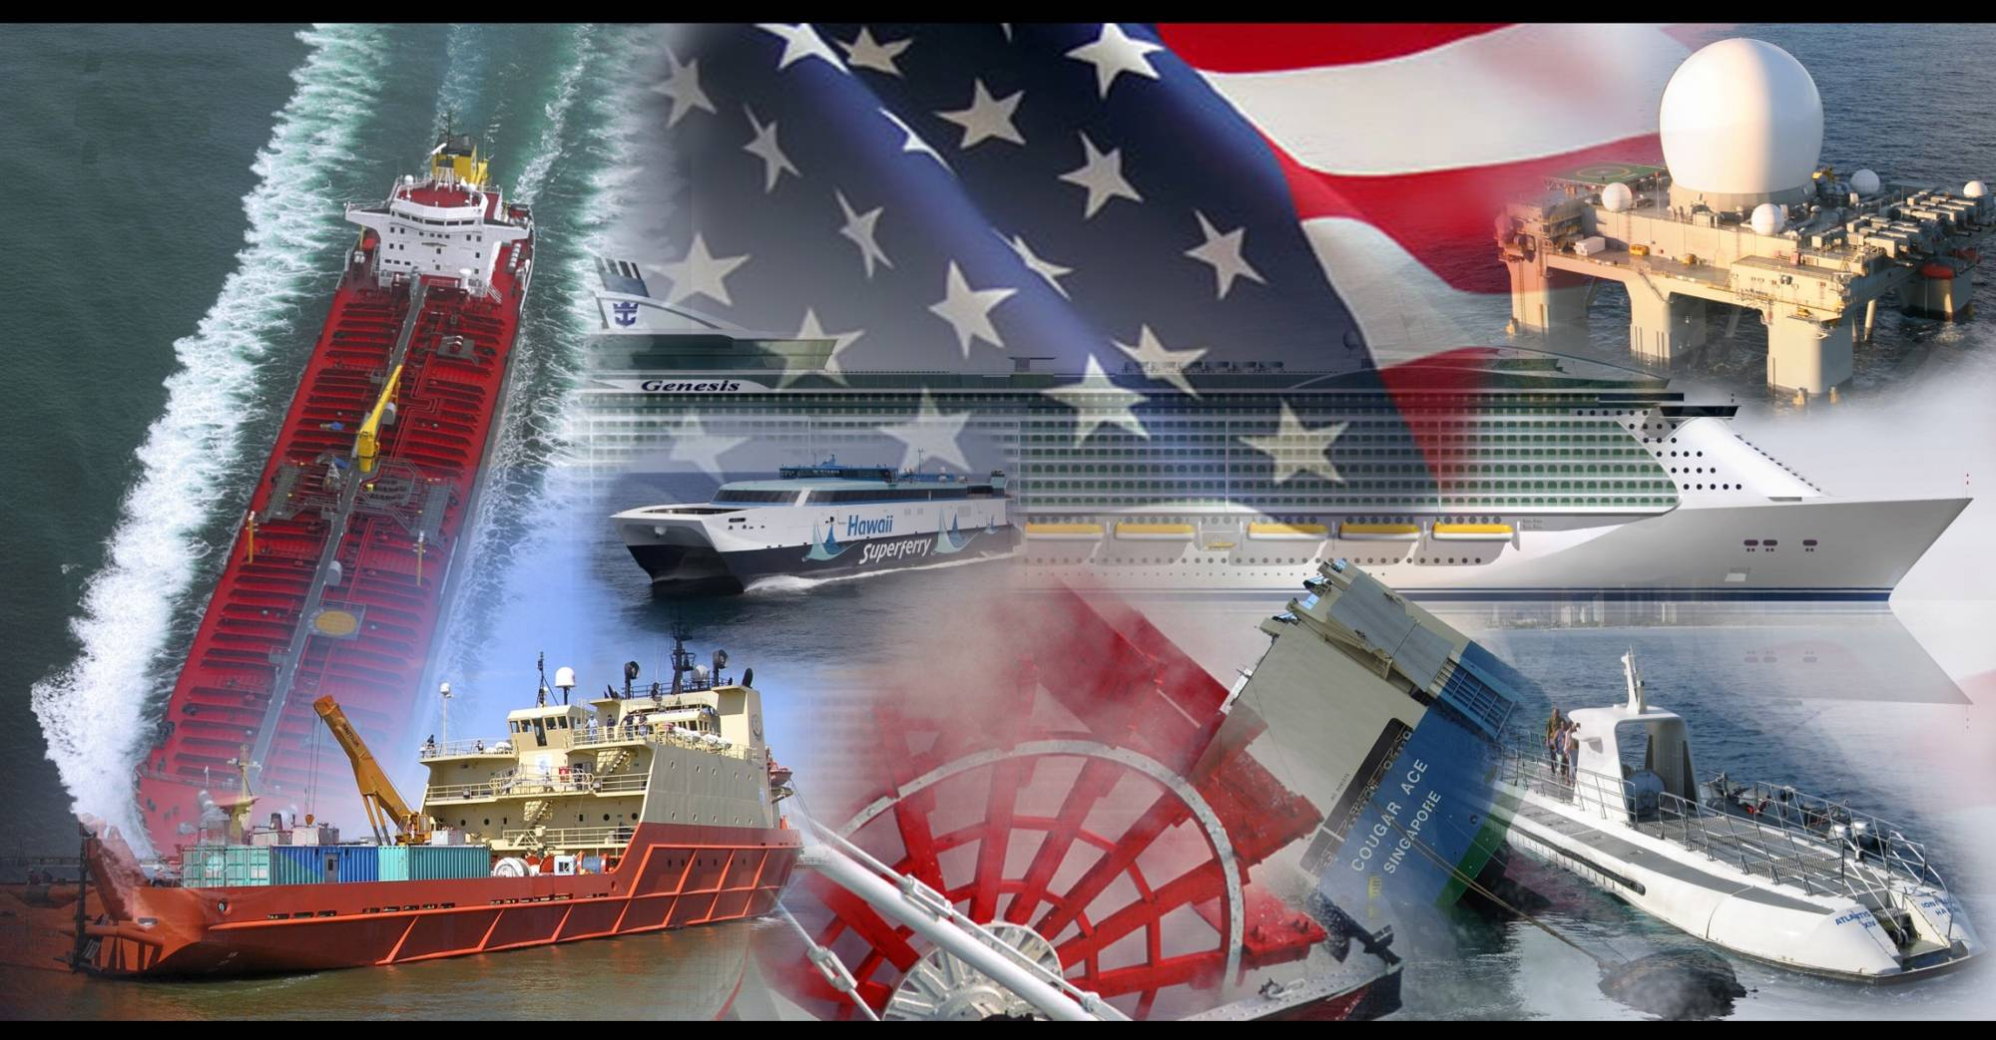
Get involved with the world’s most innovative and technologically advanced marine vehicles
Determine the maximum sea state for a given heading and speed for safe operation of cutting-edge high speed craft, like the Hawaii Superferry that served Oahu and Maui.
Next
Notes:
24
24

Slide 25
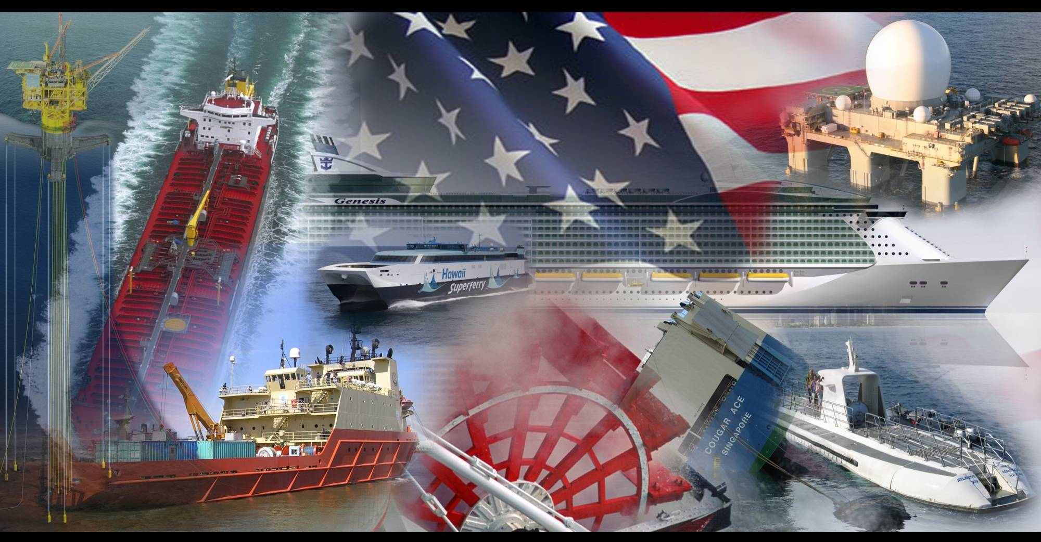
Get involved with the world’s most innovative and technologically advanced marine vehicles
Oversee Classification Society technical work on Mobile Offshore Drilling Units, Tension Leg Platforms, SPARS, Floating LNG Storage and Regasification Units, and other offshore structures that provide vital national energy infrastructure.
Next
Notes:
25
25

Slide 26
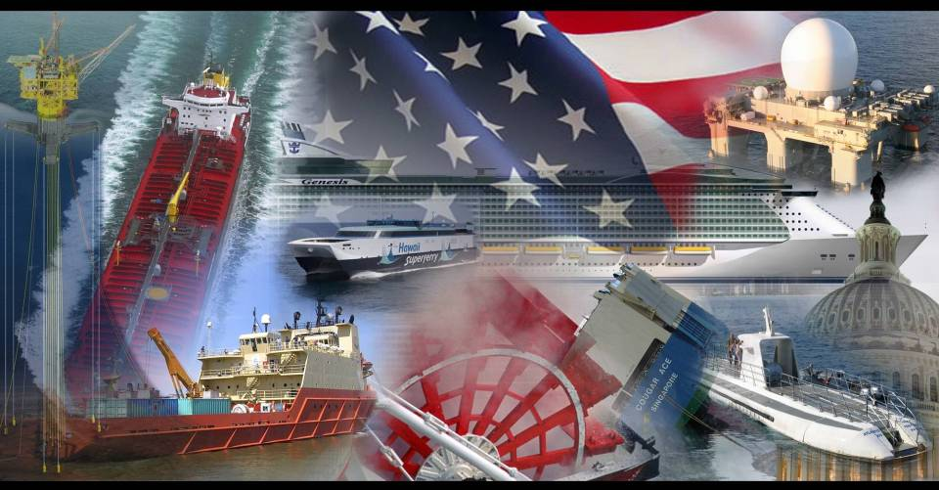
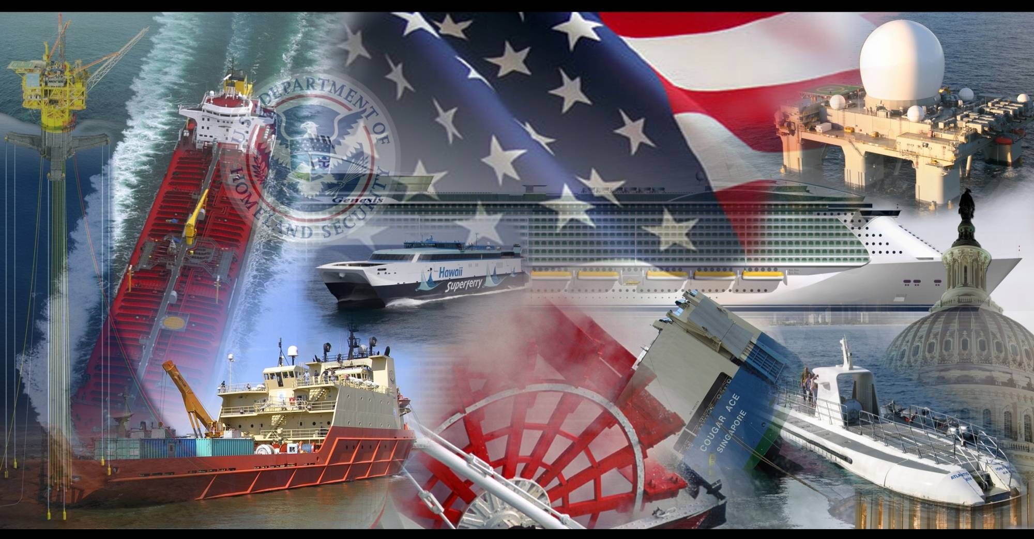
Get involved with the world’s most innovative and technologically advanced marine vehicles
Work with industry leaders and professional organizations to develop national policies, or be a member of the U.S. delegation to the International Maritime Organization (IMO) in London to promote safety, security, and stewardship in marine transportation.
Next
Notes:
26
26

Slide 27
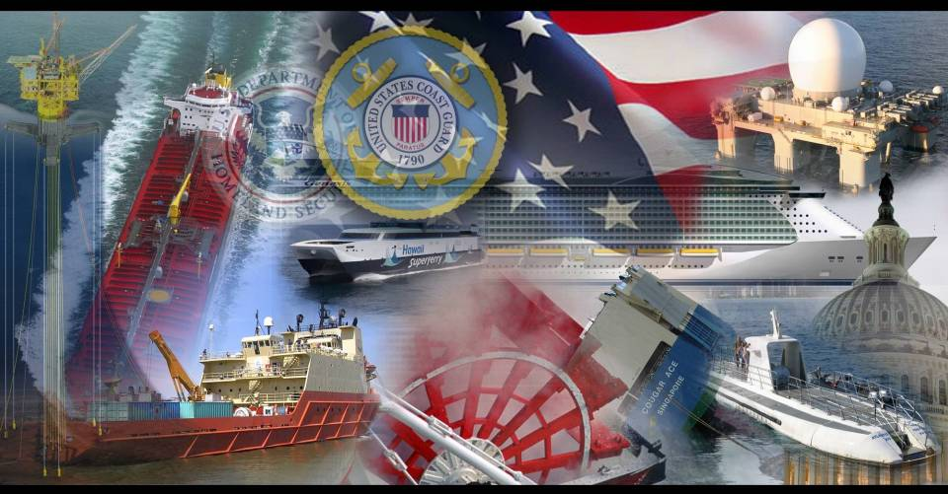
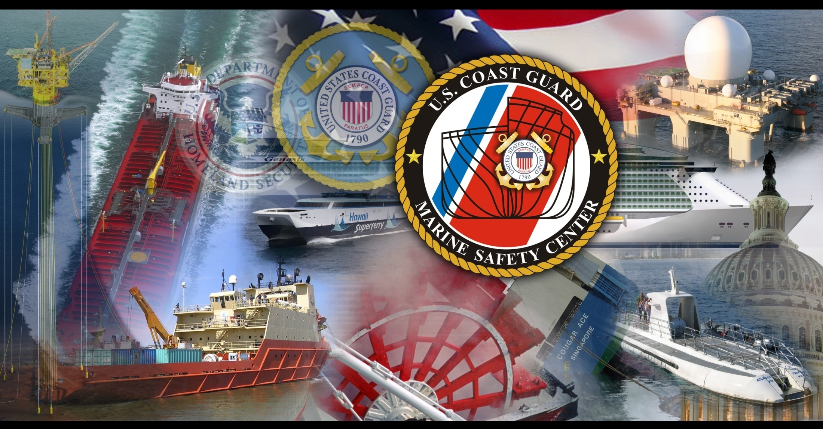
Get involved with the world’s most innovative and technologically advanced marine vehicles
After you earn your degree as a full-time student, serve at the Commercial Regulations & Standards Directorate (CG-5PS) at CGHQ or at the Marine Safety Center before returning to the field. The skills you learn will put you in high demand.
Next
Notes:
27
27

Slide 28
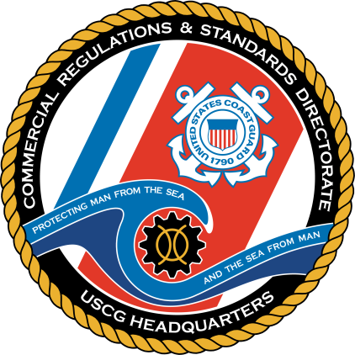
The knowledge and experience you acquire in your graduate studies and follow-on technical tour will provide an exceptionally solid foundation for future work in the Marine Safety, Security, and Environmental Protection programs. As a first-tour PG-trained engineer, you’ll be called upon to resolve some of the most difficult technical and policy issues facing CG field commanders. In doing so, you’ll rapidly gain expertise in vessel design and operation that will serve you well in future roles, including Marine Inspector, Marine Casualty Investigator, Sector Department Head, and Sector Commander. Similarly, the unique combination of technical expertise, management skills, and leadership abilities that you acquire will make you highly competitive for a wide variety of challenging out-of-specialty assignments and executive education programs. The next screen provides a few examples of the types of technical work you may be involved in after graduation.
Next
Notes:
28

Slide 29
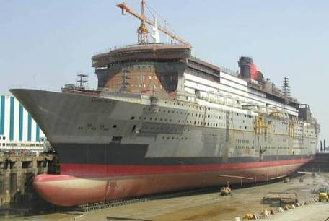
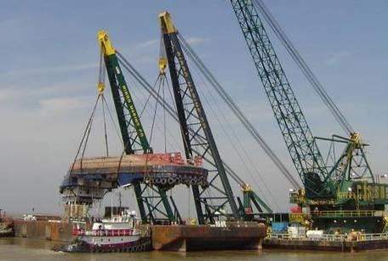
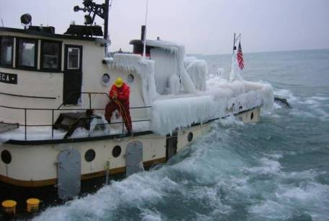
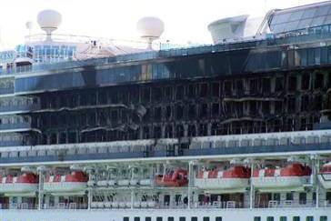
Ship Design
Salvage Engineering
Casualty Investigation
Fire Protection
Click above for examples
Home
Click above for examples

Slide 30
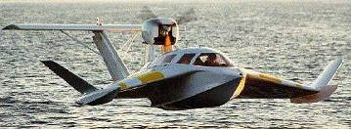



Leading-Edge Technologies in Marine Design
Today’s designs are optimized for vessels that are larger, faster, and carry more cargo than ever before. With every new innovation, Coast Guard marine engineers analyze vessel designs to ensure that passengers, cargo, and the environment remain safe.
The world’s largest cruise ship, high speed “wing in ground” craft, and offshore structures are all currently being analyzed and evaluated by CG marine engineers using the latest software and technology.
Next

Slide 31


Leading-Edge Technologies in Marine Design
Offshore oil and gas industries provide our nation with energy and create some of the largest and most complicated structures in the world.
Coast Guard marine engineers evaluate the design of offshore structures to keep our oceans safe and clean.
Next

Slide 32



Leading-Edge Technologies in Marine Design
The latest tools in computer modeling and analysis, including finite element techniques and advanced hydrostatics, allow Coast Guard marine engineers to evaluate today’s highly optimized designs.
Next

Slide 33


Marine Casualty Response
Coast Guard Salvage Engineers who have successfully completed the marine engineering advanced education program respond to marine casualties by providing real-time engineering analysis and technical support to operational CG units.
Next

Slide 34

Marine Casualty Response
COUGAR ACE
On July 24th 2006, the Coast Guard was notified that the 680’ car carrier COUGAR ACE was listing offshore of the Aleutians. LCDR Robert Compher, a graduate of the marine engineering advanced education program, was deployed on scene as the CG’s lead engineer and direct technical consultant to the Sector's Commanding Officer.
Next

Slide 35


Marine Casualty Response
COUGAR ACE
Through computer modeling, the CG’s elite Salvage Engineering Response Team (SERT) determined that improper removal of ballast water (effectively raising KG) created a negative stability situation and caused the vessel to settle at a static equilibrium point of 55° to port, as pictured here...
Using this model, CG marine engineers determined that the salvor’s plan to counter-ballast the starboard wing tanks would further jeopardize the vessel by causing it to roll 55° to starboard. Instead, CG marine engineers developed an alternative counter-intuitive solution to ballast the port side tanks (lowering KG) followed by a ballasting sequence to starboard, bringing the vessel up in a controlled manner.
Next

Slide 36


Marine Casualty Response
COUGAR ACE
The COUGAR ACE was righted and brought safely back to port because of the technical analysis done by CG marine engineers. These engineers provided the technical solutions that ultimately saved the vessel and her cargo of 4700 vehicles valued at nearly $500 million dollars.
Next

Slide 37



Marine Casualty Response
DBL -152
The DBL-152, a 448’ double-skinned tank barge, struck an underwater object while transiting with a full load of #6 fuel oil. The vessel capsized and sank over the course of three days.
Next

Slide 38

Marine Casualty Response
DBL -152
CG Salvage Engineers created a computer model and provided real-time analysis that led to the successfully re-floating and recovery of the barge.
Next

Slide 39


Accident Investigations
LADY OF GRACE
Severe icing was a concern in the capsizing and sinking of the fishing vessel LADY OF GRACE. She went down with all hands.
The computer model shown here was created using sophisticated hydrostatics software and used to analyze the effects of icing on the vessel’s stability. CG marine engineers provided key technical-engineering insight that was needed by CG investigators to determine a cause for the tragic vessel casualty.
Next

Slide 40


Accident Investigations
DISCOVERER DEEP SEAS
Marine Safety Center (MSC) electrical engineers often assist field inspectors with testing of complex automation systems during construction and after causalities. In April 2013, MSC responded to the “drift-off” of a dynamically positioned, 835 foot drill ship in 6,000 ft of water, 120 miles offshore in the Gulf of Mexico. LT Meadowcroft, a 2010 graduate of the MSE advanced education program, assisted the Officer in Charge, Marine Inspection by verifying the cause of the failure, validating the proposed corrective action plan, and witnessing fault resistance tests of the 33 MW electrical plant to ensure it’s full reliability.
Next

Slide 41

Accident Investigations
DISCOVERER DEEP SEAS
MSU Houma, MSC, DNV, the vessel operator, and LT Meadowcroft reviewed trending data captured from the vessel's advanced computer system that controls the automatic starting, stopping, operation, and electrical protection of the six 5.5 MW generators. The blackout and subsequent drift-off were caused by a fault in one of the six 3.8 MW thruster drive systems following recent maintenance performed on the drive. The findings of this investigation were provided to COMDT to aid in the continued development of Coast Guard standards for advanced power management systems and dynamic positioning systems.
Next

Slide 42


Marine Fire Protection
Fire protection technologies are constantly challenged to keep up with vessels that are getting bigger and more complex. CG fire protection engineers fuse 1st principles from chemistry & physics, mechanical, structural & electrical engineering, toxicology, psychology, and other disciplines to analyze and prevent fires aboard commercial vessels.
These engineers employ fluid dynamics, zone and heat transfer models, and systems analysis to examine fire & materials behavior aboard ships.
Evacuation modeling & “wayfinding” methods are used to predict and direct crew & passenger responses during an emergency situation.
Next

Slide 43


Marine Fire Protection
In 2006, CG fire protection engineers deployed on scene and conducted fire modeling for this major marine casualty. They provided technical support and expertise that supported changes to international fire protection standards.
Next

Slide 44



Marine Safety Engineering Program Contacts
Naval Architecture & Marine Engineering
LT Matt Faha
School: University of Michigan
Phone: 202-372-1387
Email: Matthew.J.Faha@uscg.mil
Chemical Engineering
LT Ethan Beard
School: Stanford University
Phone: 202-372-1419
Email: Ethan.T.Beard@uscg.mil
Mechanical Engineering / Electrical Power Systems & Controls Engineering
LT Carmine Faul
School: University of Washington
Phone: 202-372-1357
Email: Carmine.A.Faul@uscg.mil
Fire Protection Engineering
LCDR Sarah Rodiño
School: Worcester Polytechnic Institute
Phone: 202-372-1360
Email: Sarah.E.Rodino@uscg.mil
Click photo to send e-mail
Click photo to send e-mail
Next

Slide 45


Applicant Resources
Look for the ALCOAST soliciting applications in April 2022. Several programs will solicit applicants in the same time period. Look for the one from the Deputy Commandant for Operations that includes Marine Safety graduate programs. It will include more detailed information. In the meantime, make sure your CGPC Personnel Data Record that contains your OERs, Awards, and undergraduate transcripts is up-to-date. If you have any questions, please contact LT Matt Faha (202) 372-1387 or Matthew.J.Faha@uscg.mil. In addition, check out the info at the links below and feel free to contact any of the listed Program Managers on the previous page or POCs at MSC below.
Best of Luck!
Advanced Education Webpage:
https://www.dco.uscg.mil/CG-ENG/MSE/
Additional POCs by program at MSC (for questions regarding work done by our MSC engineers):
Naval Architecture and Marine Engineering: LT Park Suski, Park.M.Suski@uscg.mil
Chemical Engineering: LT Joel MacArthur, Joel.D.MacArthur@uscg.mil
Fire Protection Engineering: LT Danielle Knox, Danielle.A.Knox@uscg.mil
Electrical Power Systems & Controls Engineering: LT James Meyers, James.C.Meyers@uscg.mil
Mechanical Engineering: LT Lena Royster, Lena.A.Royster@uscg.mil
Home

Slide 46



be one of the best.
be a marine safety engineer
B D BRANHAM
USCG MSC
Home
Exit

